Slide 1

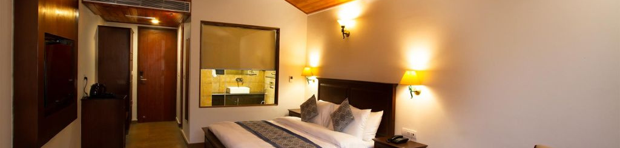
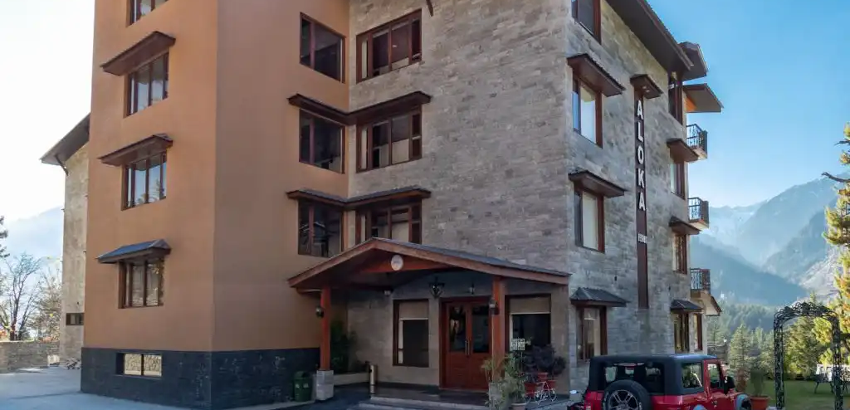

Aloka Resort Manali

Slide 2

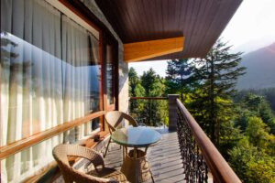
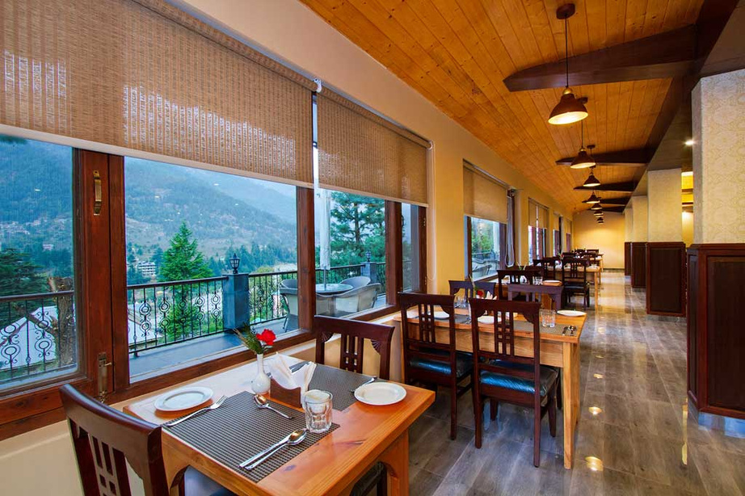
Resort in Manali
Experience the charm of Aloka Resort, a top resort in Manali, offering breathtaking mountain views, cozy accommodations, and warm hospitality. Ideal for relaxation, adventure, and exploring the natural beauty of the Himalayas.
To know more Visit,
https://alokaresortmanali.com/

Slide 3

Address
Address
Chadyari, Tehsil Manali, Distt Kullu H.P, 175131, INDIA
Phone: +91 78386-09537, +91 98160-76122
Email: alokaresortmanali@gmail.com
Website - https://alokaresortmanali.com/

Slide 4

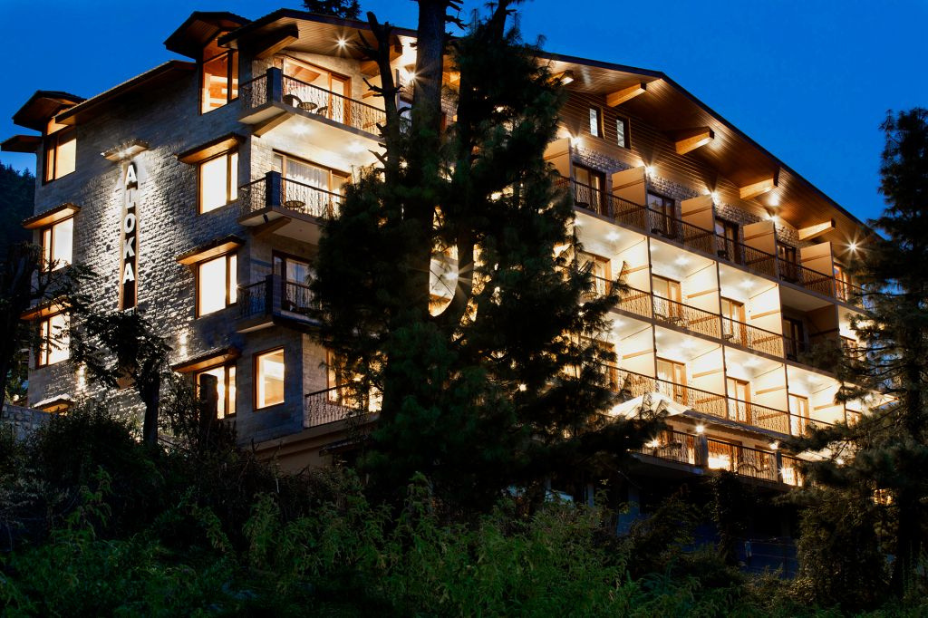
Thank You

