Slide 1

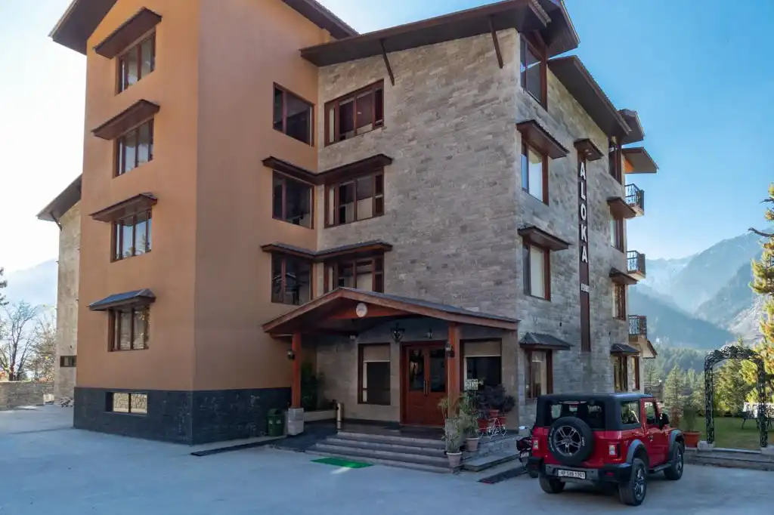

ALOKA RESORT MANALI
luxury Resort in Manali

Slide 2
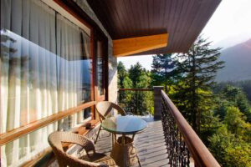

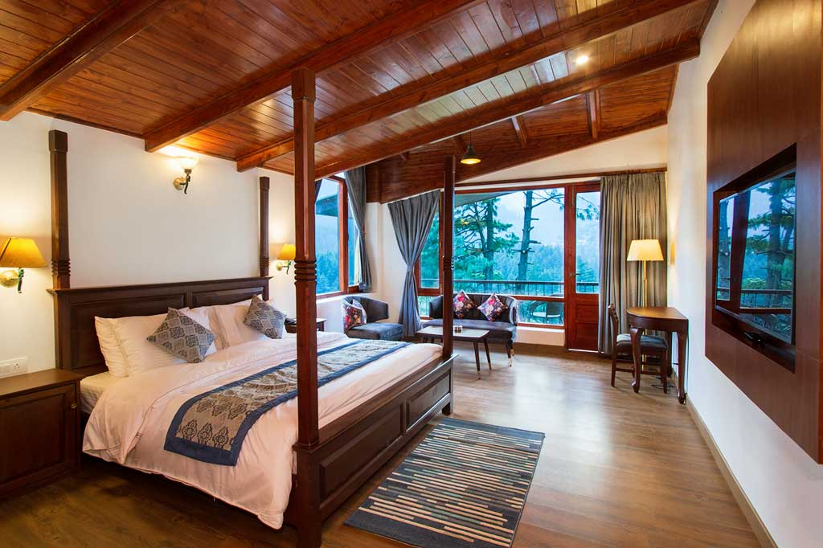
Aloka Resort, a top-rated resort in Manali, offers a perfect blend of luxury and natural beauty. Surrounded by majestic mountains, it provides modern amenities, cozy accommodations, and warm hospitality for a truly memorable Himalayan escape.
To Know more visit
, https://alokaresortmanali.com/

Slide 3
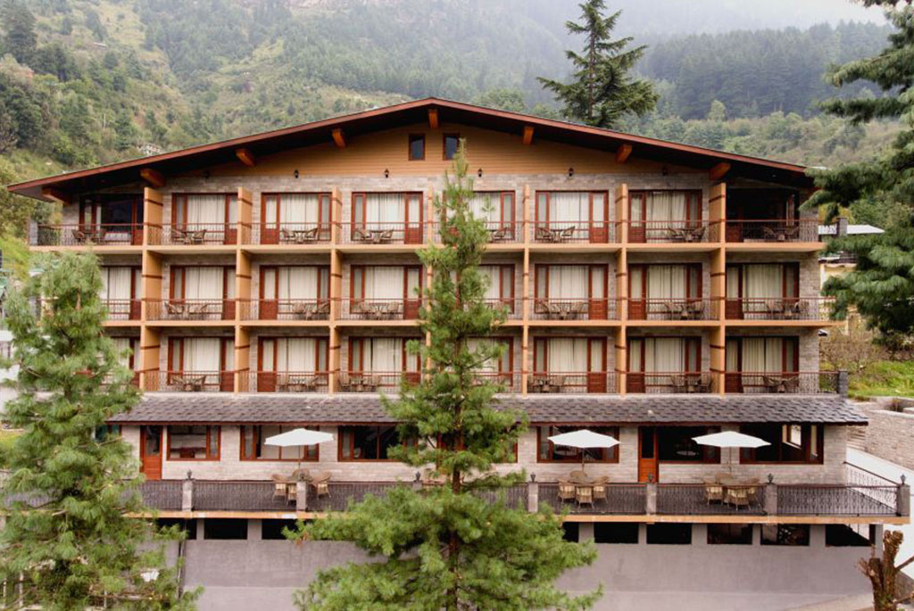

Address
Chadyari, Tehsil Manali, Distt Kullu H.P, 175131, INDIA
Phone: +91 78386-09537, +91 98160-76122
Email: alokaresortmanali@gmail.com
Website: https://alokaresortmanali.com/

Slide 4

THANK YOU
Visit - https://alokaresortmanali.com/

