Slide 1


RESORT IN MANALI
By. Aloka Resort

Slide 2





Slide 3
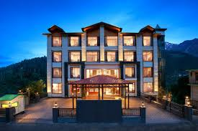

ALOKA RESORT
Aloka Resort is a beautifully designed luxury resort in Manali, offering modern comforts, scenic mountain views, and warm hospitality. Choose AlokaResort for the perfect resort in Manali experience, where relaxation and nature come together seamlessly. To know more visit , https://alokaresortmanali.com/

Slide 4

CONTACT DETAILS
Aloka Resort Manali
Phone: +91 78386-09537, +91 98160-76122
Email: alokaresortmanali@gmail.com
Location :- Chadyari Tehsil Manali Distt Kullu H.P
175131 INDIA

