Slide 1
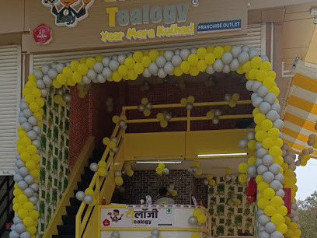

Tea Franchise in Pune

Slide 2

Tealogy offers a premier tea café franchise in Pune, blending traditional kulhad chai with modern ambiance. With over 430 outlets nationwide, it provides comprehensive support, including site selection, staff training, and marketing strategies. Franchisees benefit from a proven business model and a strong brand presence, ensuring a profitable venture in the growing tea café market.

Slide 3

Contact Us
503-A/B, 5th Floor Princess Business Sky Park, Block no. 23,24 SCH No.54, PU-3 Commercial,
Opp C21, AB Rd, Indore, Madhya Pradesh 452001
Phone: +91 6269116000 / 6269120500
Email: business@tealogy.in / franchise@tealogy.in

Slide 4

Thank You
Visit - https://tealogy.in/city/tea-cafe-franchise-pune

