Slide 1



Tealogy Franchise
https://tealogy.in/teacafe-franchise

Slide 2
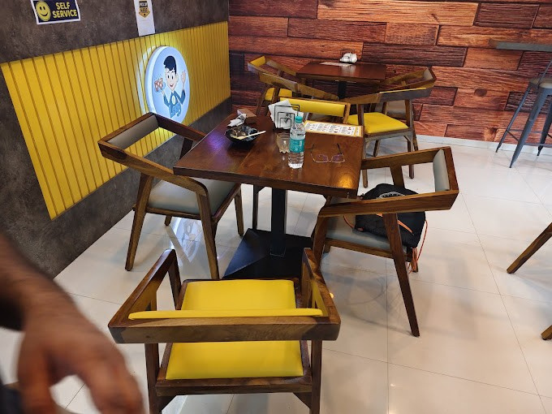
Tealogy offers a dynamic tea café franchise model in India, featuring three formats: Pocket Café (150+ sq ft), Café (300+ sq ft), and Neo (1000+ sq ft). With over 430 outlets nationwide, Tealogy is renowned for its kulhad chai and pocket-friendly menu. Franchisees benefit from comprehensive support, including staff training, marketing assistance, and a proven business model. Investment ranges from ₹6–25 lakh, depending on the chosen format. Tealogy's commitment to quality and customer satisfaction makes it a compelling opportunity for aspiring entrepreneurs

Slide 3



Contact us
+91 6269116000 / 6269120500
business@tealogy.in / franchise@tealogy.in
503-A/B, 5th Floor Princess Business Sky Park, Block no. 23,24
AB Rd, Indore, Madhya Pradesh 452001
https://tealogy.in/teacafe-franchise
https://tealogy.in/

Slide 4
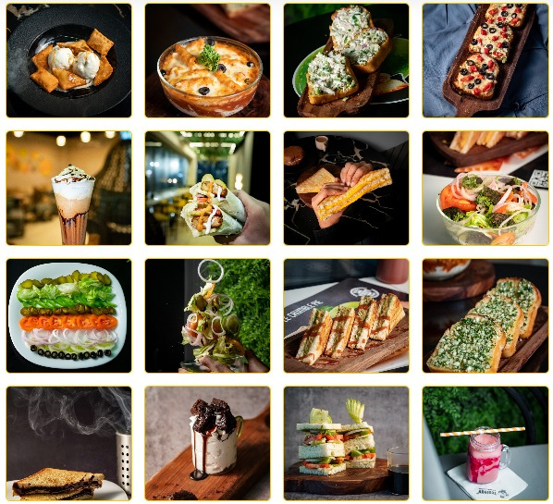
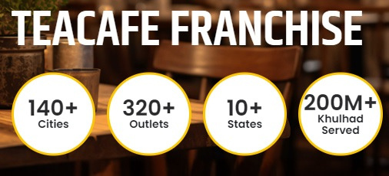
Thank You

