Slide 1


Tealogy
Top Tea Franchise
Visit -https://tealogy.in/state/tea-cafe-franchise-delhi

Slide 2
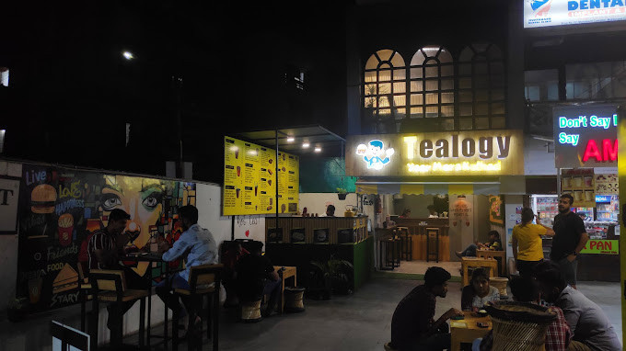
Tealogy offers exciting Tea & Cafe Franchise opportunities in Delhi, providing a proven business model, quality products, and comprehensive support for entrepreneurs looking to succeed in the beverage industry.

Slide 3
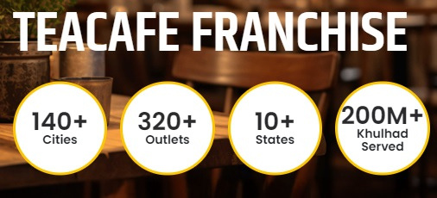
Contact Us
503-A/B, 5th Floor Princess Business Sky Park, Block no. 23,24 SCH No.54, PU-3 Commercial,
Opp C21, AB Rd, Indore, Madhya Pradesh 452001
Phone: +91 6269116000 / 6269120500
Email: business@tealogy.in / franchise@tealogy.in

Slide 4
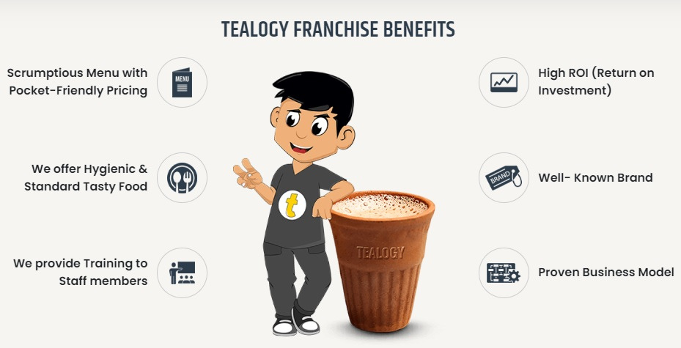
Thank You
Visit -https://tealogy.in/state/tea-cafe-franchise-delhi

