Slide 1

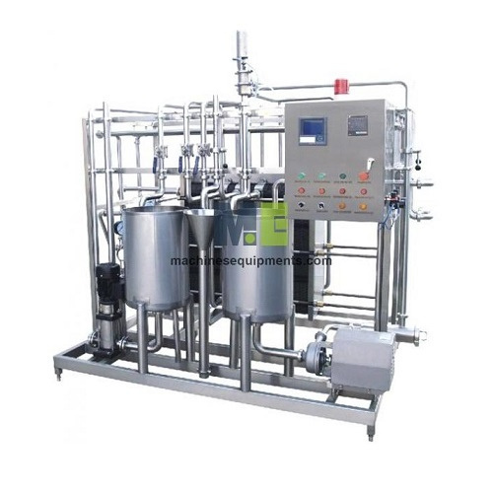
Machines Equipments
Dairy Processing Plant & Machinery Suppliers

Slide 2
MachinesEquipments offers advanced Dairy Processing plants designed to transform raw milk into high-quality dairy products efficiently. Their systems encompass essential processes such as pasteurization, homogenization, cream separation, and cooling, ensuring optimal safety and product integrity. Equipped with robust components like homogenizers, milk separators, batch mixers, and aseptic filling machines, these plants are tailored for both small-scale and large-scale operations. Built with durable materials and adhering to international quality standards, MachinesEquipments' dairy processing solutions are engineered for longevity and consistent performance. Whether you're producing milk, butter, cheese, yogurt, or ice cream, their comprehensive machinery lineup supports diverse dairy production need.

Slide 3
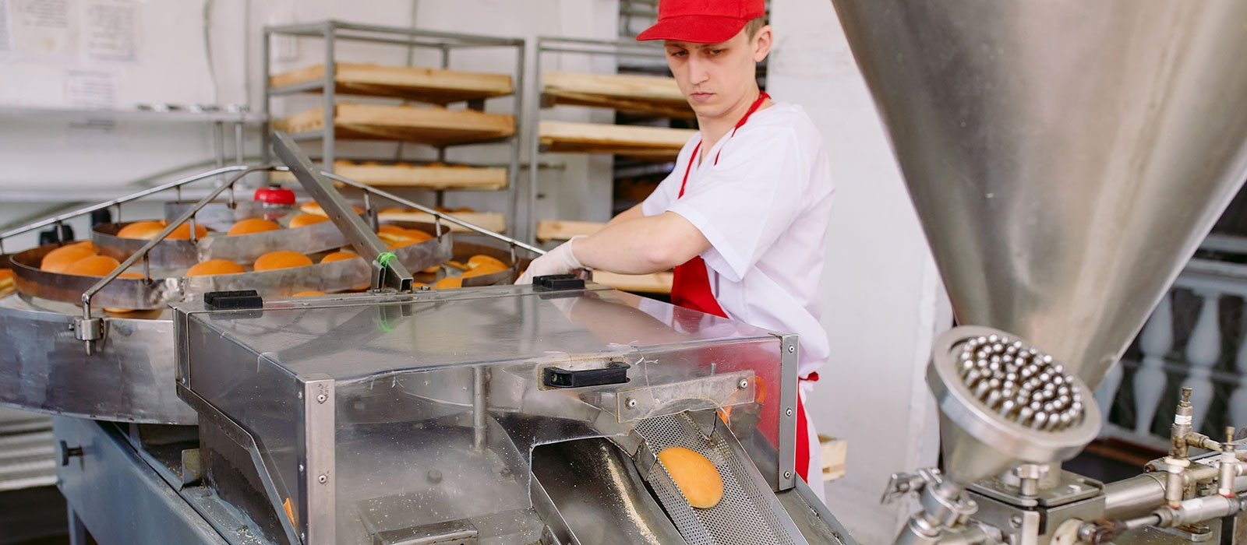

Thank You
sales@machinesequipments.com
https://www.machinesequipments.com/food-processing-plants-and-line/dairy-processing-plant

