Slide 1

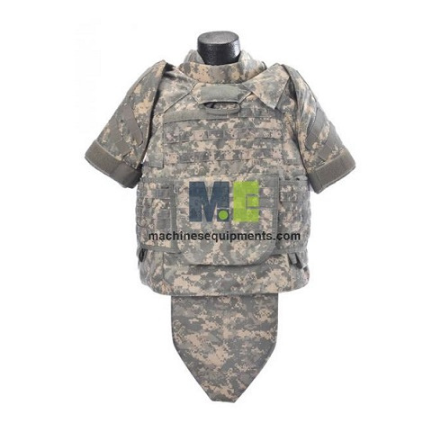
Machines Equipments
Army Military Bulletproof Vest Suppliers

Slide 2
The Army Military Bulletproof Vest from MachinesEquipments offers reliable protection for military personnel. Crafted from high-performance materials like Dupont Kevlar or UHMWPE, this vest ensures durability and safety. Weighing approximately 3 kg, it provides a balance between protection and mobility. The vest features an outer cover made of polyester, nylon, or Cordura, and covers a bulletproof area of 0.3–0.45 m², customizable to specific needs. Available in various colors, it comes in a one-size-fits-most design, with options for customization and OEM services, including logo placement. Ideal for military applications, this vest combines functionality with adaptability to meet diverse operational requirements.

Slide 3
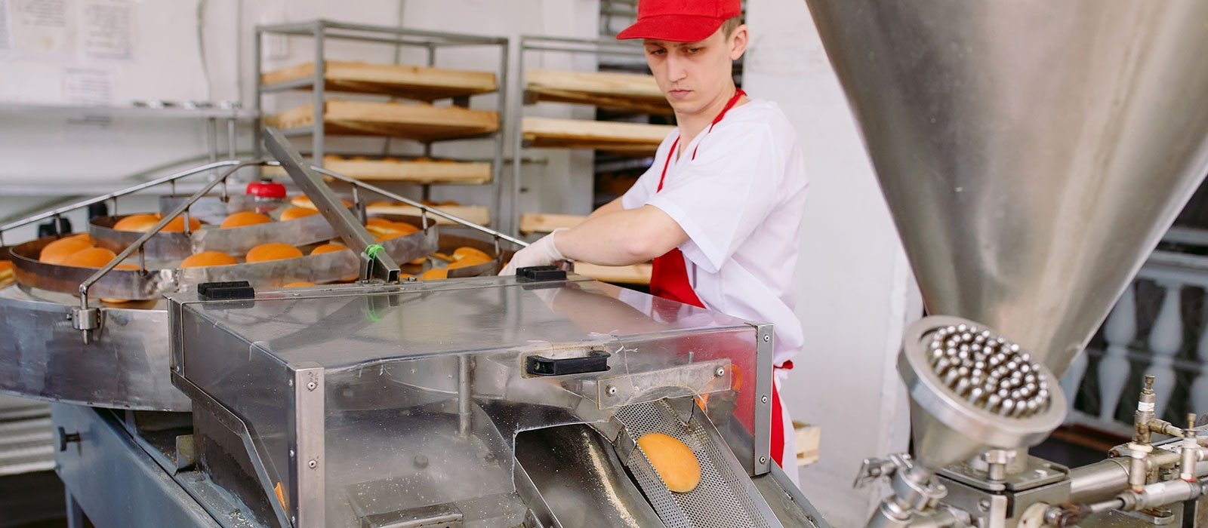

Thank You
sales@machinesequipments.com
https://www.machinesequipments.com/army-military-bulletproof-vest

