Slide 1




Home
Service
About Us
Contact
Best Coffee Shop Franchise
https://sutocafe.com/

Slide 2


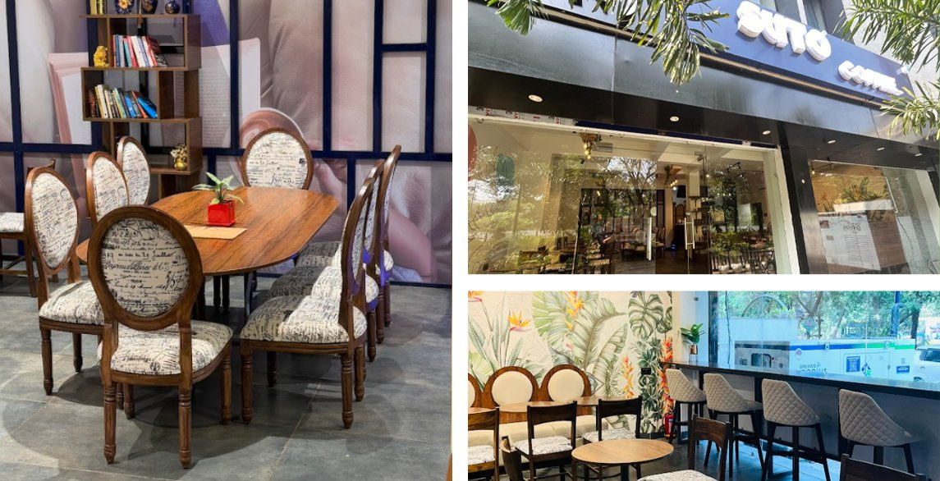
Home
Service
About Us
Contact
About Suto Cafe and Its Coffee Franchise Opportunities
Suto Cafe was founded with a mission to redefine the coffee experience. With a focus on premium quality, customer satisfaction, and innovation, it has grown into a trusted brand among coffee lovers. The brand aims to provide a unique and delightful café experience while maintaining strong values of excellence and service.
https://sutocafe.com/

Slide 3
Home
Service
About Us
Contact
Best Coffee Shop Franchise
Discover the best coffee shop franchise with Suto Cafe! Renowned for its cozy ambiance, premium artisanal brews, and delectable pastries, Suto Cafe offers an unmatched experience. With a commitment to sustainability and community, each location feels like home. Join the franchise revolution and bring Suto’s exceptional coffee culture to your neighborhood. Elevate your mornings—choose Suto Cafe for quality, warmth, and unforgettable flavors!
https://sutocafe.com/

Slide 4
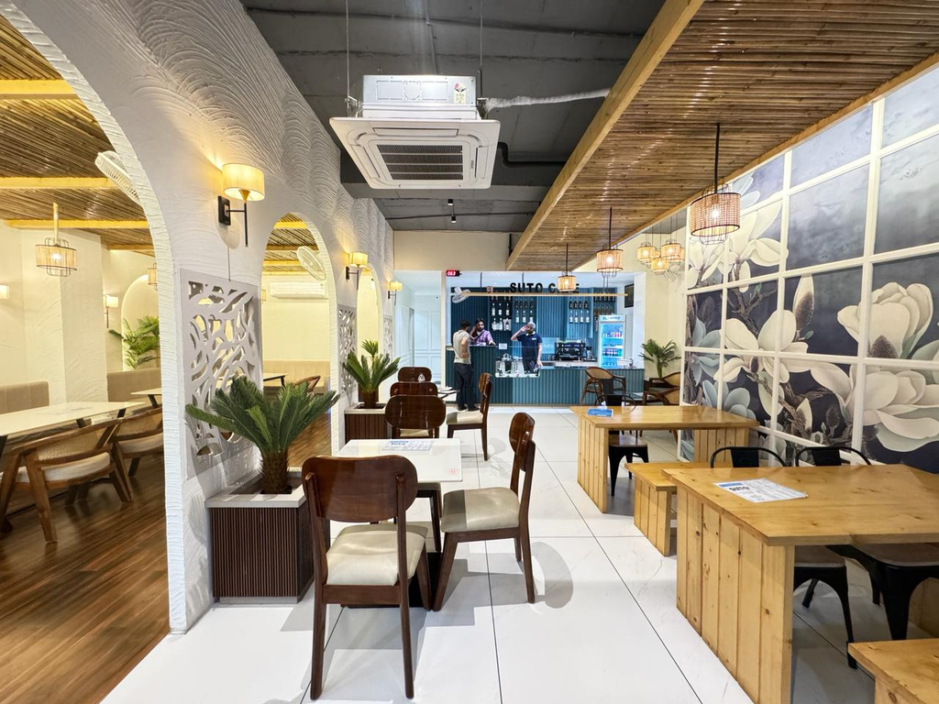
Home
Service
About Us
Contact
Why Partner with Suto Cafe?
  High-quality brews & unique café experiences
  Youth-focused, trendy interiors
  Affordable franchise model with great ROI
  Marketing & operational support at every step
  Easy setup, training, and branding support
https://sutocafe.com/

Slide 5
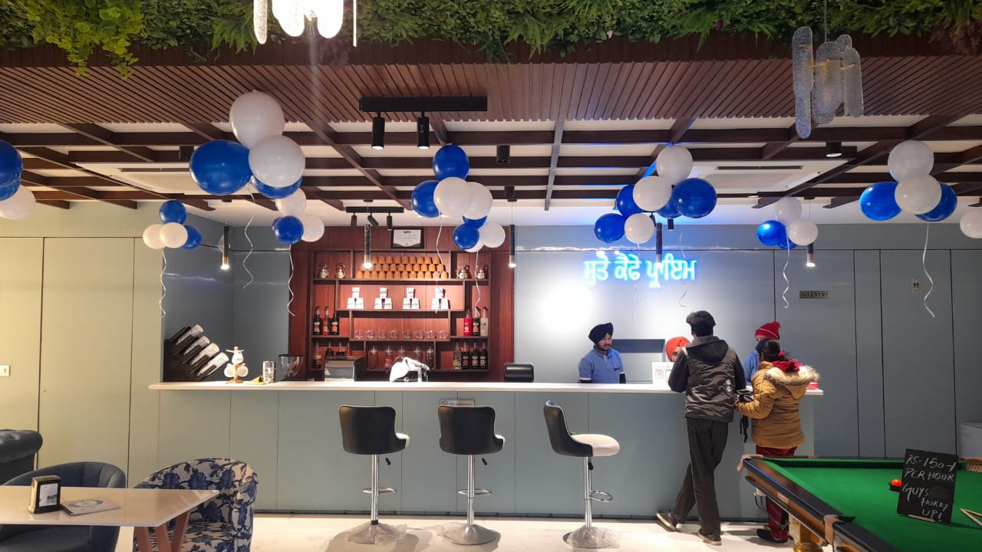
Home
Service
About Us
Contact
Suto Cafe and Its Coffee Franchise Opportunities
  High-Quality Coffee & Beverages
  Modern & Cozy Ambiance
  Innovative Menu
  Customer-Centric Approach
  Affordable Franchise Investment
  Training & Operational Guidance
  Marketing & Branding Support
  Ongoing Assistance
https://sutocafe.com/

Slide 6


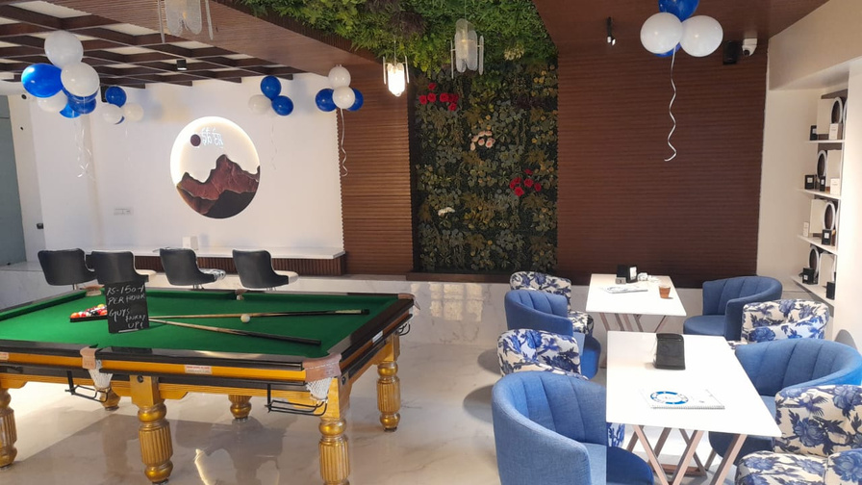

Home
Service
About Us
Contact
For more detailed information or to apply for a franchise
+91 7880128851
https://sutocafe.com/
franchise@sutocafe.com
Ground Floor, WB-85A, Ring Road, Bombay Hospital Service Rd, Scheme No 94 Sector Ea, Indore, Madhya Pradesh 452010

