Slide 1




Home
Service
About Us
Contact
Coffee Franchise in Ahmedabad
https://sutocafe.com/coffee-cafe-franchise-in-ahmedabad/

Slide 2


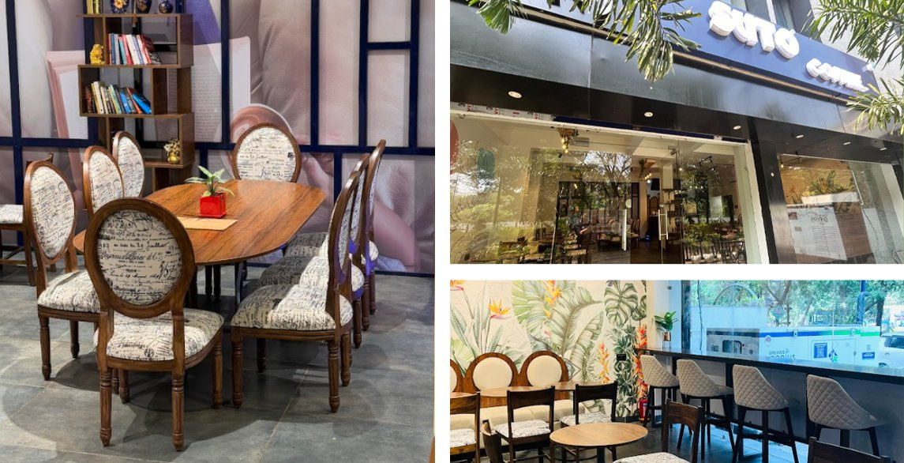
Home
Service
About Us
Contact
About Suto Cafe and Its Coffee Franchise Opportunities
Suto Cafe was founded with a mission to redefine the coffee experience. With a focus on premium quality, customer satisfaction, and innovation, it has grown into a trusted brand among coffee lovers. The brand aims to provide a unique and delightful café experience while maintaining strong values of excellence and service.
https://sutocafe.com/coffee-cafe-franchise-in-ahmedabad/

Slide 3
Home
Service
About Us
Contact
Coffee Franchise in Ahmedabad
Brew success with Suto Cafe, the ultimate Coffee Franchise in Ahmedabad! Join a top-tier coffee chain with 70+ outlets, offering exotic flavors and high ROI. Suto Cafe’s vibrant ambiance, premium Kerala-sourced coffee, and comprehensive support—site selection, training, and marketing—ensure your triumph. Seize this lucrative franchise opportunity in Ahmedabad’s thriving market and pour happiness into every cup! Contact Suto Cafe today to start your coffee empire
https://sutocafe.com/coffee-cafe-franchise-in-ahmedabad/

Slide 4
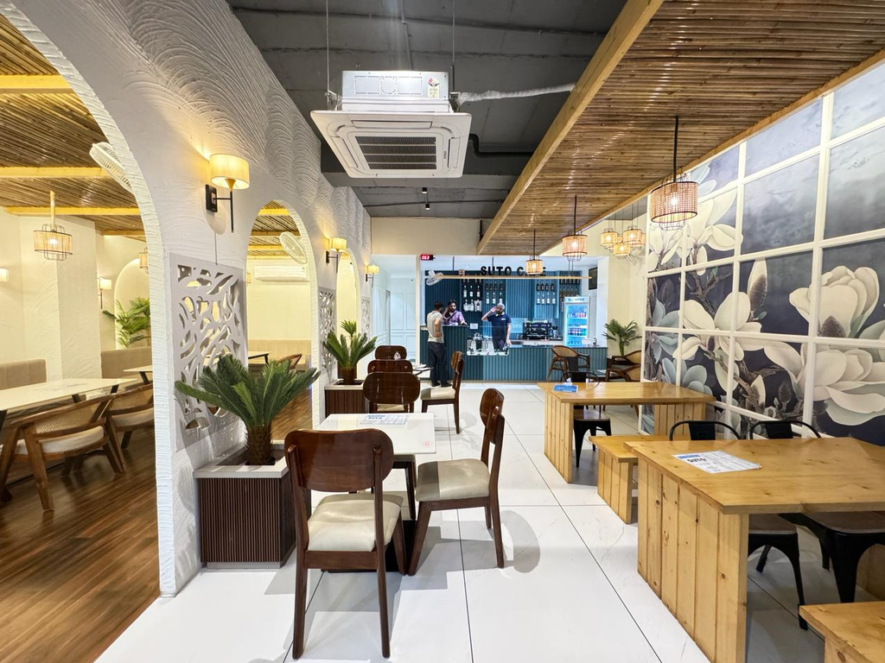
Home
Service
About Us
Contact
Why Partner with Suto Cafe?
  High-quality brews & unique café experiences
  Youth-focused, trendy interiors
  Affordable franchise model with great ROI
  Marketing & operational support at every step
  Easy setup, training, and branding support
https://sutocafe.com/coffee-cafe-franchise-in-ahmedabad/

Slide 5
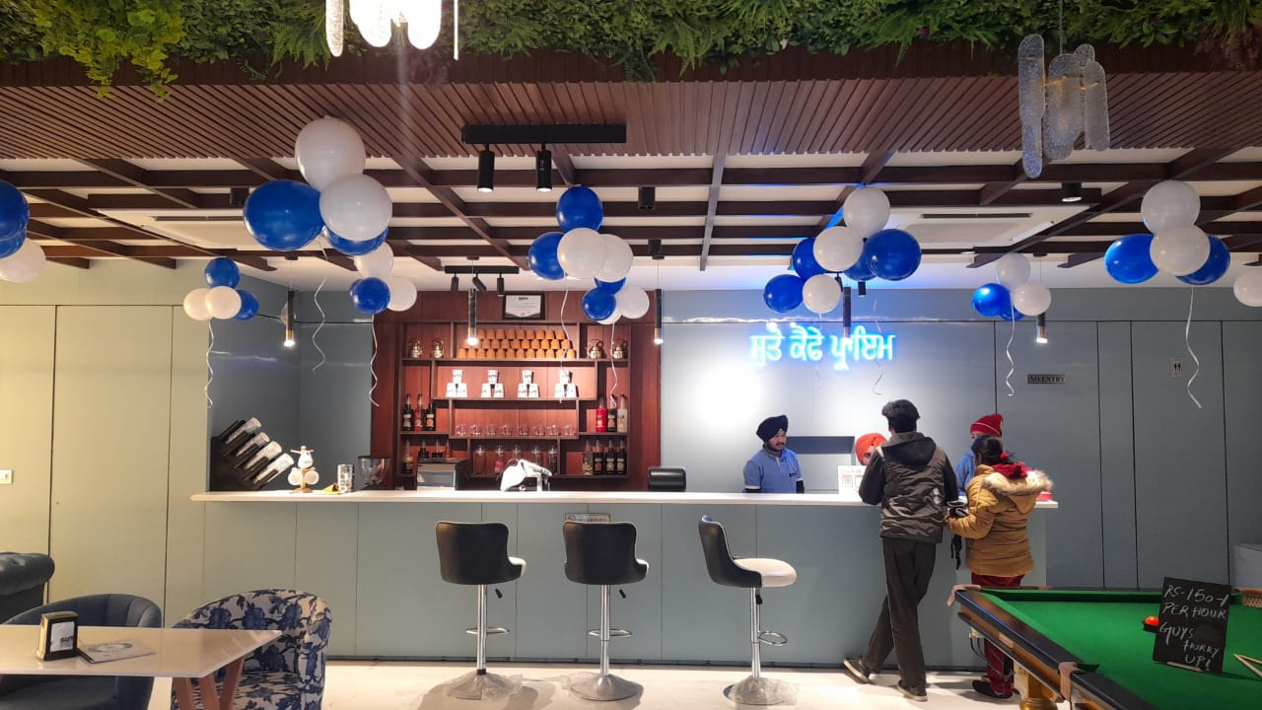
Home
Service
About Us
Contact
Suto Cafe and Its Coffee Franchise Opportunities
  High-Quality Coffee & Beverages
  Modern & Cozy Ambiance
  Innovative Menu
  Customer-Centric Approach
  Affordable Franchise Investment
  Training & Operational Guidance
  Marketing & Branding Support
  Ongoing Assistance
https://sutocafe.com/coffee-cafe-franchise-in-ahmedabad/

Slide 6


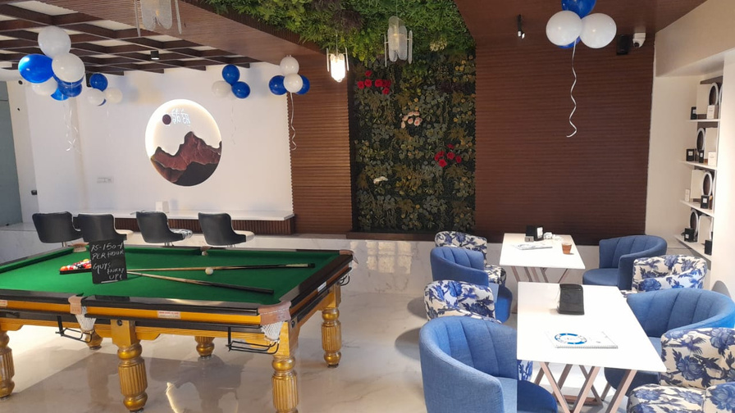

Home
Service
About Us
Contact
For more detailed information or to apply for a franchise
+91 7880128851
https://sutocafe.com/coffee-cafe-franchise-in-ahmedabad/
franchise@sutocafe.com
Ground Floor, WB-85A, Ring Road, Bombay Hospital Service Rd, Scheme No 94 Sector Ea, Indore, Madhya Pradesh 452010

