Slide 1
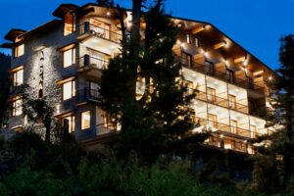


Home
About
Contact
WELCOME TO
BEST RESORT IN MANALI
WHERE COMFORT MEETS LUXURY
https://alokaresortmanali.com/

Slide 2
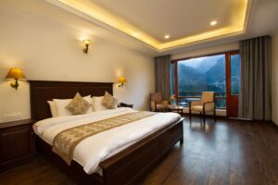
Home
About
Contact
ABOUT OUR RESORT
WHERE COMFORT MEETS LUXURY
​Aloka Resort, nestled amidst fir forests above the Beas River and overlooking Manali town, offers a luxurious retreat cradled by majestic mountain slopes. Each room provides stunning views of Himalayan peaks and valleys, combining modern comfort with the region's rich heritage. Our attentive staff ensures personalized service, making your stay memorable. Whether seeking adventure or relaxation, Aloka Resort serves as your gateway to the enchanting beauty and culture of Kullu Manali.
https://alokaresortmanali.com/

Slide 3
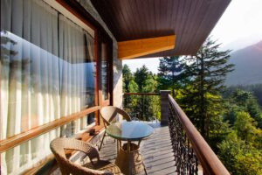
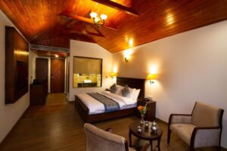
Home
About
Contact
BEST ResoRT IN MANALI
Experience the charm of the Himalayas at Aloka Resort Manali, the Best Resort in Manali for comfort, luxury, and scenic beauty. Enjoy cozy rooms, mountain views, and warm hospitality. Perfect for family vacations, romantic getaways, and nature lovers. Book your peaceful escape today and discover Manali like never before!
alokaresortmanali.com

Slide 4
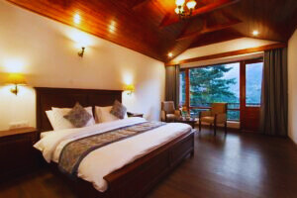
Home
About
Contact
CONTACT US
GET MORE INFORMATION
OUR ADDRESS :
OUR PHONE :
Chadyari, Tehsil Manali, Distt Kullu H.P, 175131, INDIA
+91 78386-09537, +91 98160-76122
alokaresortmanali.com

