Slide 1




Home
Service
About Us
Contact
Top Coffee Shop in Indore
https://sutocafe.com/coffee-cafe-in-indore/

Slide 2


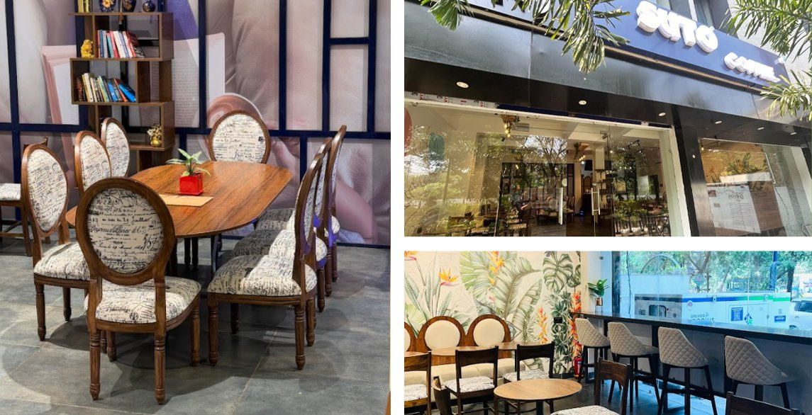
Home
Service
About Us
Contact
About Suto Cafe and Its Coffee Franchise Opportunities
Suto Cafe was founded with a mission to redefine the coffee experience. With a focus on premium quality, customer satisfaction, and innovation, it has grown into a trusted brand among coffee lovers. The brand aims to provide a unique and delightful café experience while maintaining strong values of excellence and service.
https://sutocafe.com/coffee-cafe-in-indore/

Slide 3
Home
Service
About Us
Contact
Top Coffee Shop in Indore
Suto Cafe stands out as the Top Coffee Shop in Indore, offering a perfect blend of rich flavors, cozy ambiance, and exceptional service. Located in the heart of the city, it's a favorite spot for coffee lovers seeking quality brews and delicious snacks. With its welcoming vibe and premium coffee selection, Suto Cafe delivers an unforgettable experience, making it the ultimate destination for relaxation and great conversations in Indore.
https://sutocafe.com/coffee-cafe-in-indore/

Slide 4
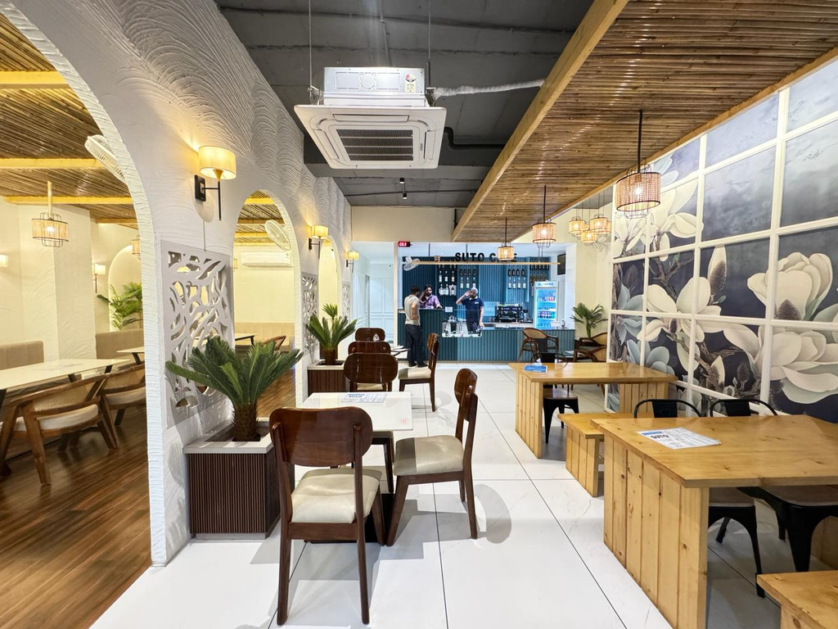
Home
Service
About Us
Contact
Steps to Becoming a Suto Cafe Franchise Owner
  Submit Your Franchise Application
  Discuss Business Requirements
  Finalize Agreement & Training
  Set Up Your Café
  Grand Opening & Business Operations
https://sutocafe.com/coffee-cafe-in-indore/

Slide 5
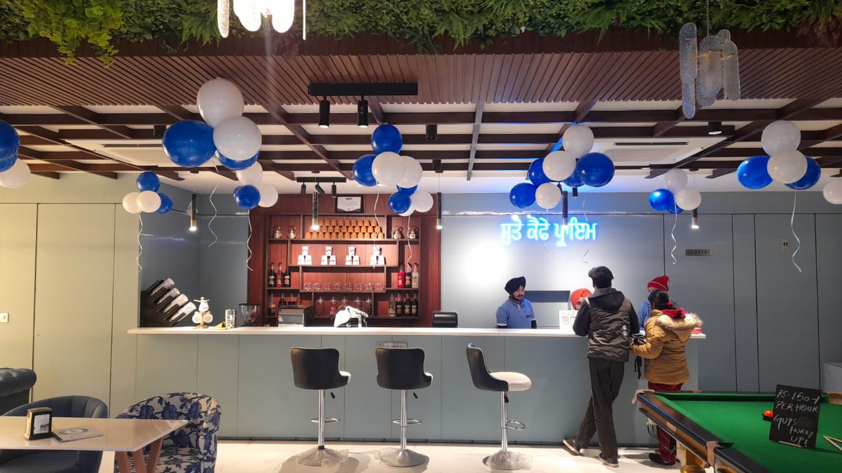
Home
Service
About Us
Contact
Suto Cafe and Its Coffee Franchise Opportunities
  High-Quality Coffee & Beverages
  Modern & Cozy Ambiance
  Innovative Menu
  Customer-Centric Approach
  Affordable Franchise Investment
  Training & Operational Guidance
  Marketing & Branding Support
  Ongoing Assistance
https://sutocafe.com/coffee-cafe-in-indore/

Slide 6


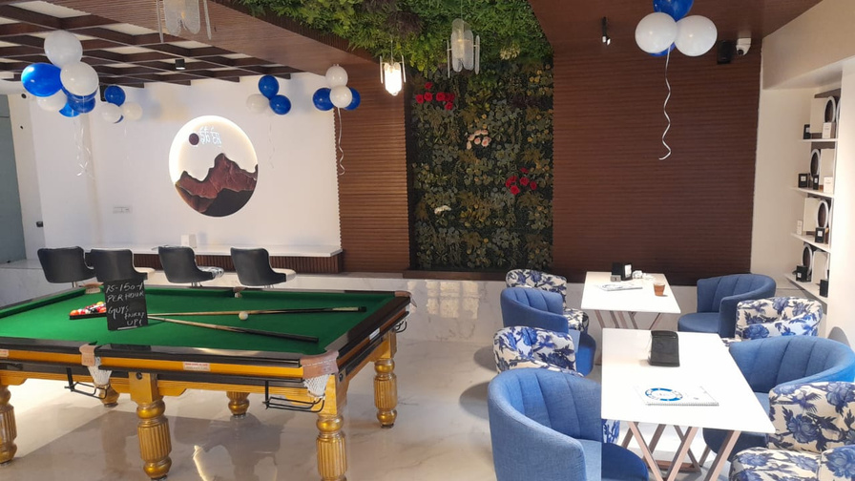

Home
Service
About Us
Contact
For more detailed information or to apply for a franchise
+91 7880128851
https://sutocafe.com/coffee-cafe-in-indore/
franchise@sutocafe.com
Ground Floor, WB-85A, Ring Road, Bombay Hospital Service Rd, Scheme No 94 Sector Ea, Indore, Madhya Pradesh 452010

