Slide 1

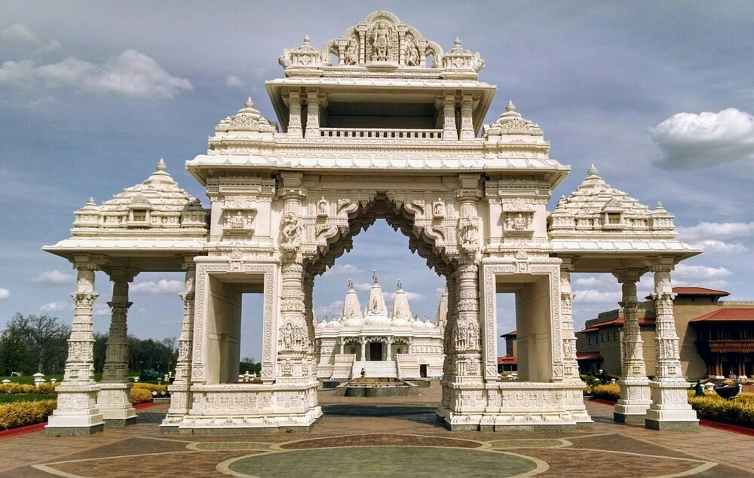



Best Religious Holiday Tour Packages
5 PLACE TO VISIT IN INDIA
HOLIDAYS BOOKING INDIA
https://www.holidaysbookingindia.com/tour-category/religious-tour-packages

Slide 2
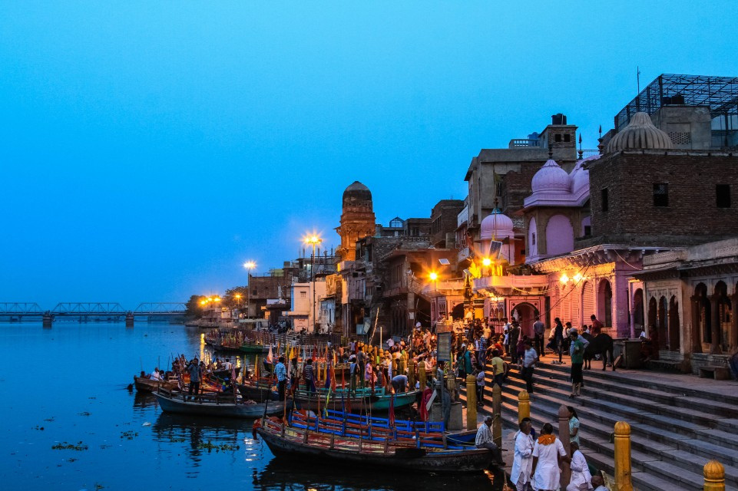
Best Religious Holiday Tour Packages
Discover the Best Religious Holiday Tour Packages with Holidays Booking India. Visit sacred temples, revered shrines, and spiritual destinations across India. Experience divine serenity and cultural richness on a well-planned pilgrimage. Book your journey today!
https://www.holidaysbookingindia.com/tour-category/religious-tour-packages

Slide 3
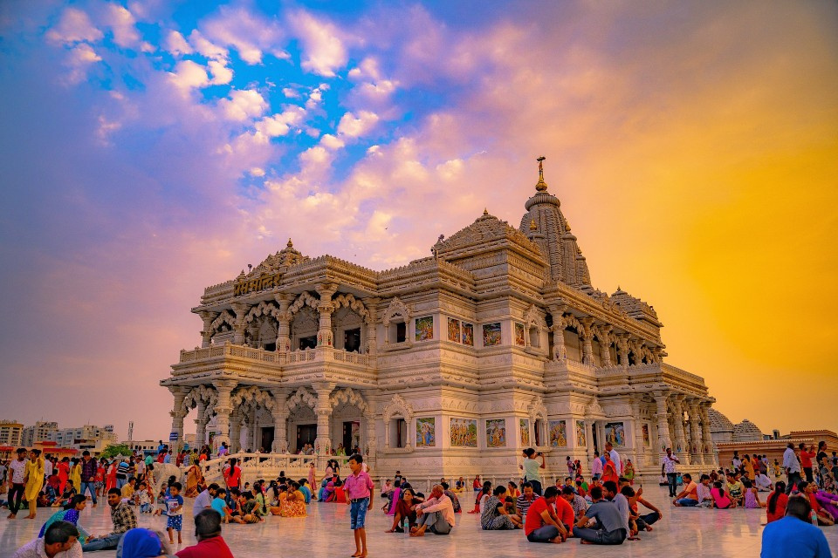

MUST VISIT RELIGIOUS PLACE:
  Mathura and Vrindavan, Uttar Pradesh
  Agra, Uttar Pradesh
  Haridwar and Rishikesh, Uttarakhand
  Vaishno Devi, Jammu & Kashmir
  Varanasi, Uttar Pradesh
  Delhi
https://www.holidaysbookingindia.com/tour-category/religious-tour-packages

Slide 4
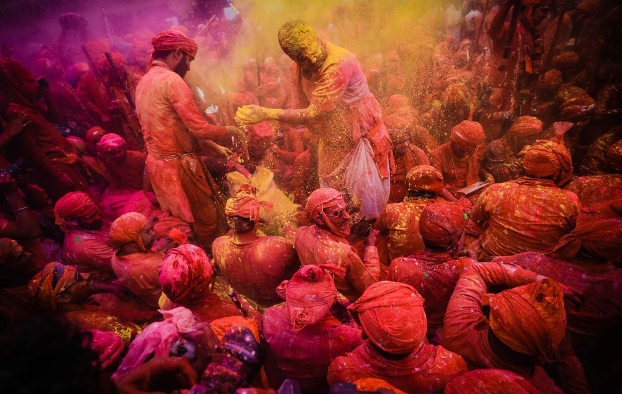




Contact Us
HOLIDAYS BOOKING INDIA
GROUND FLOOR, SHOP. NO 2, H. NO. 172, NEAR
BHAGAT COLONY WEST SANT NAGAR,
NORTH DELHI, DELHI - 110084
+91-9717883003
https://www.holidaysbookingindia.com/tour-category/religious-tour-packages

