Slide 1
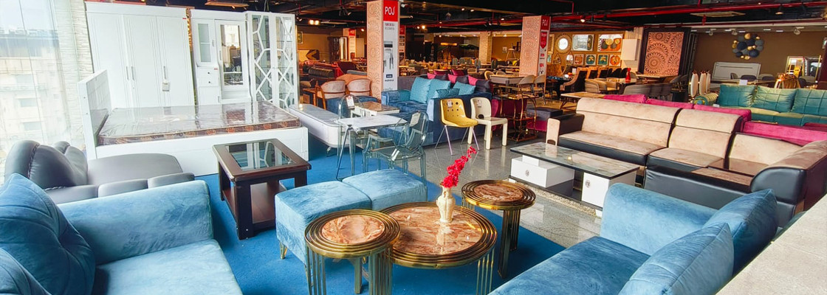

Furniture Store Franchise Opportunities
By POJ Furniture

Slide 2
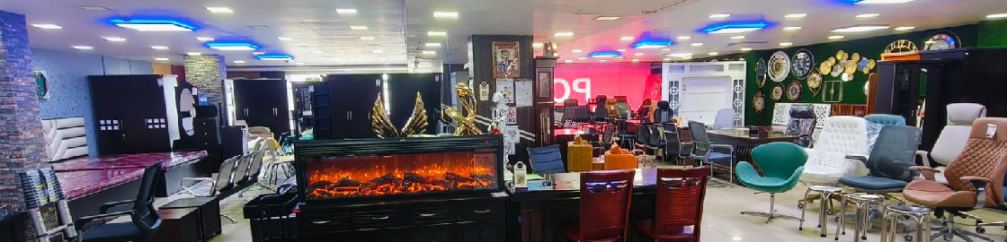
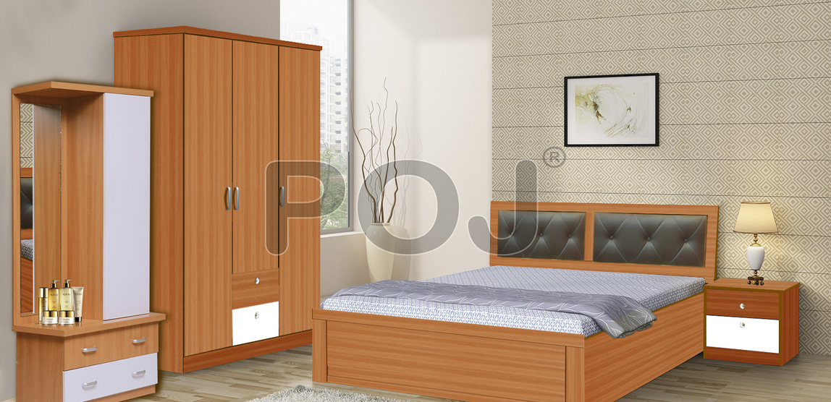
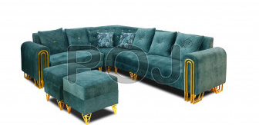
POJ Furniture offers lucrative franchise opportunities in India's thriving furniture market, providing comprehensive support and a proven business model. ​

Slide 3

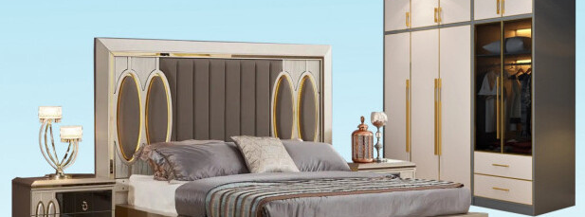

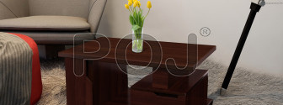
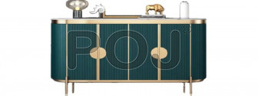
Thank You
Visit - https://www.pojfurniture.com/franchisee

