Slide 1

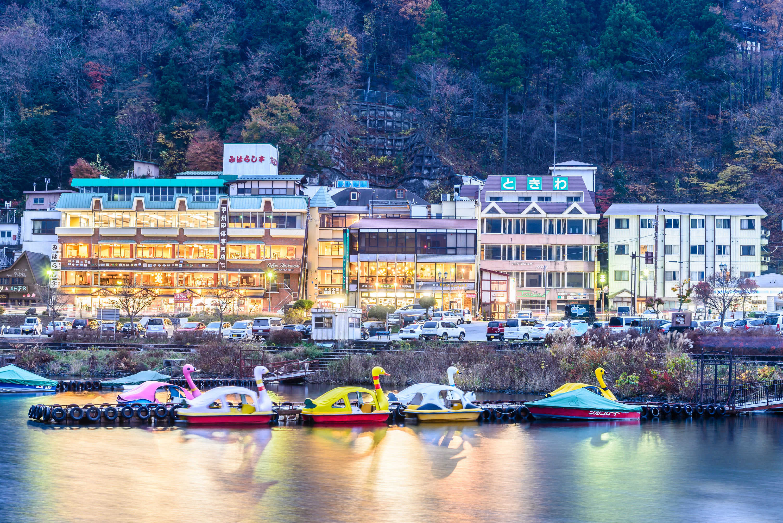



Best Nainital Tour Packages for Family
5 PLACE TO VISIT IN NAINITAL
HOLIDAYS BOOKING INDIA
https://www.holidaysbookingindia.com/tour-packages/nainital

Slide 2
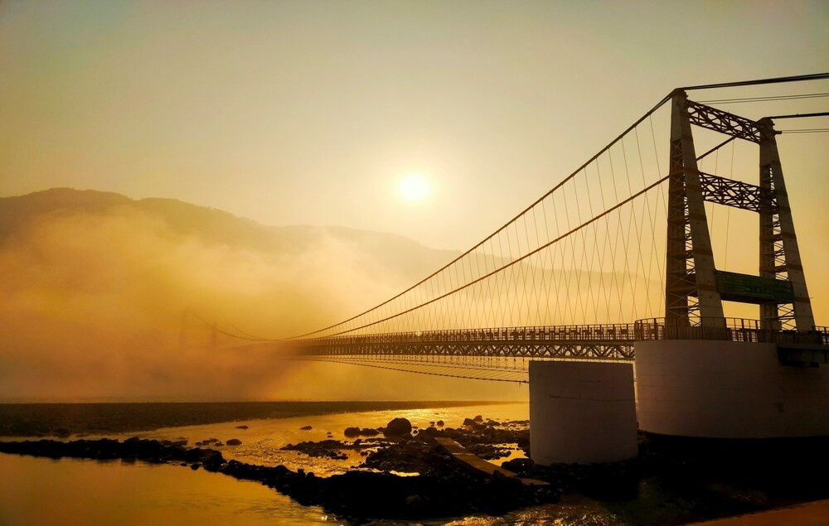
BEST NAINITAL TOUR PACKAGES FOR FAMILY
Nainital is famous for its breathtaking natural beauty, serene lakes, and pleasant weather. It is known as the "Lake District of India" due to its iconic Naini Lake. The town also boasts attractions like Snow View Point, Naina Devi Temple, The Mall Road, and Eco Cave Gardens. Families visit for boating, scenic views, adventure activities, and a peaceful retreat amidst lush green hills.
https://www.holidaysbookingindia.com/tour-packages/nainital

Slide 3
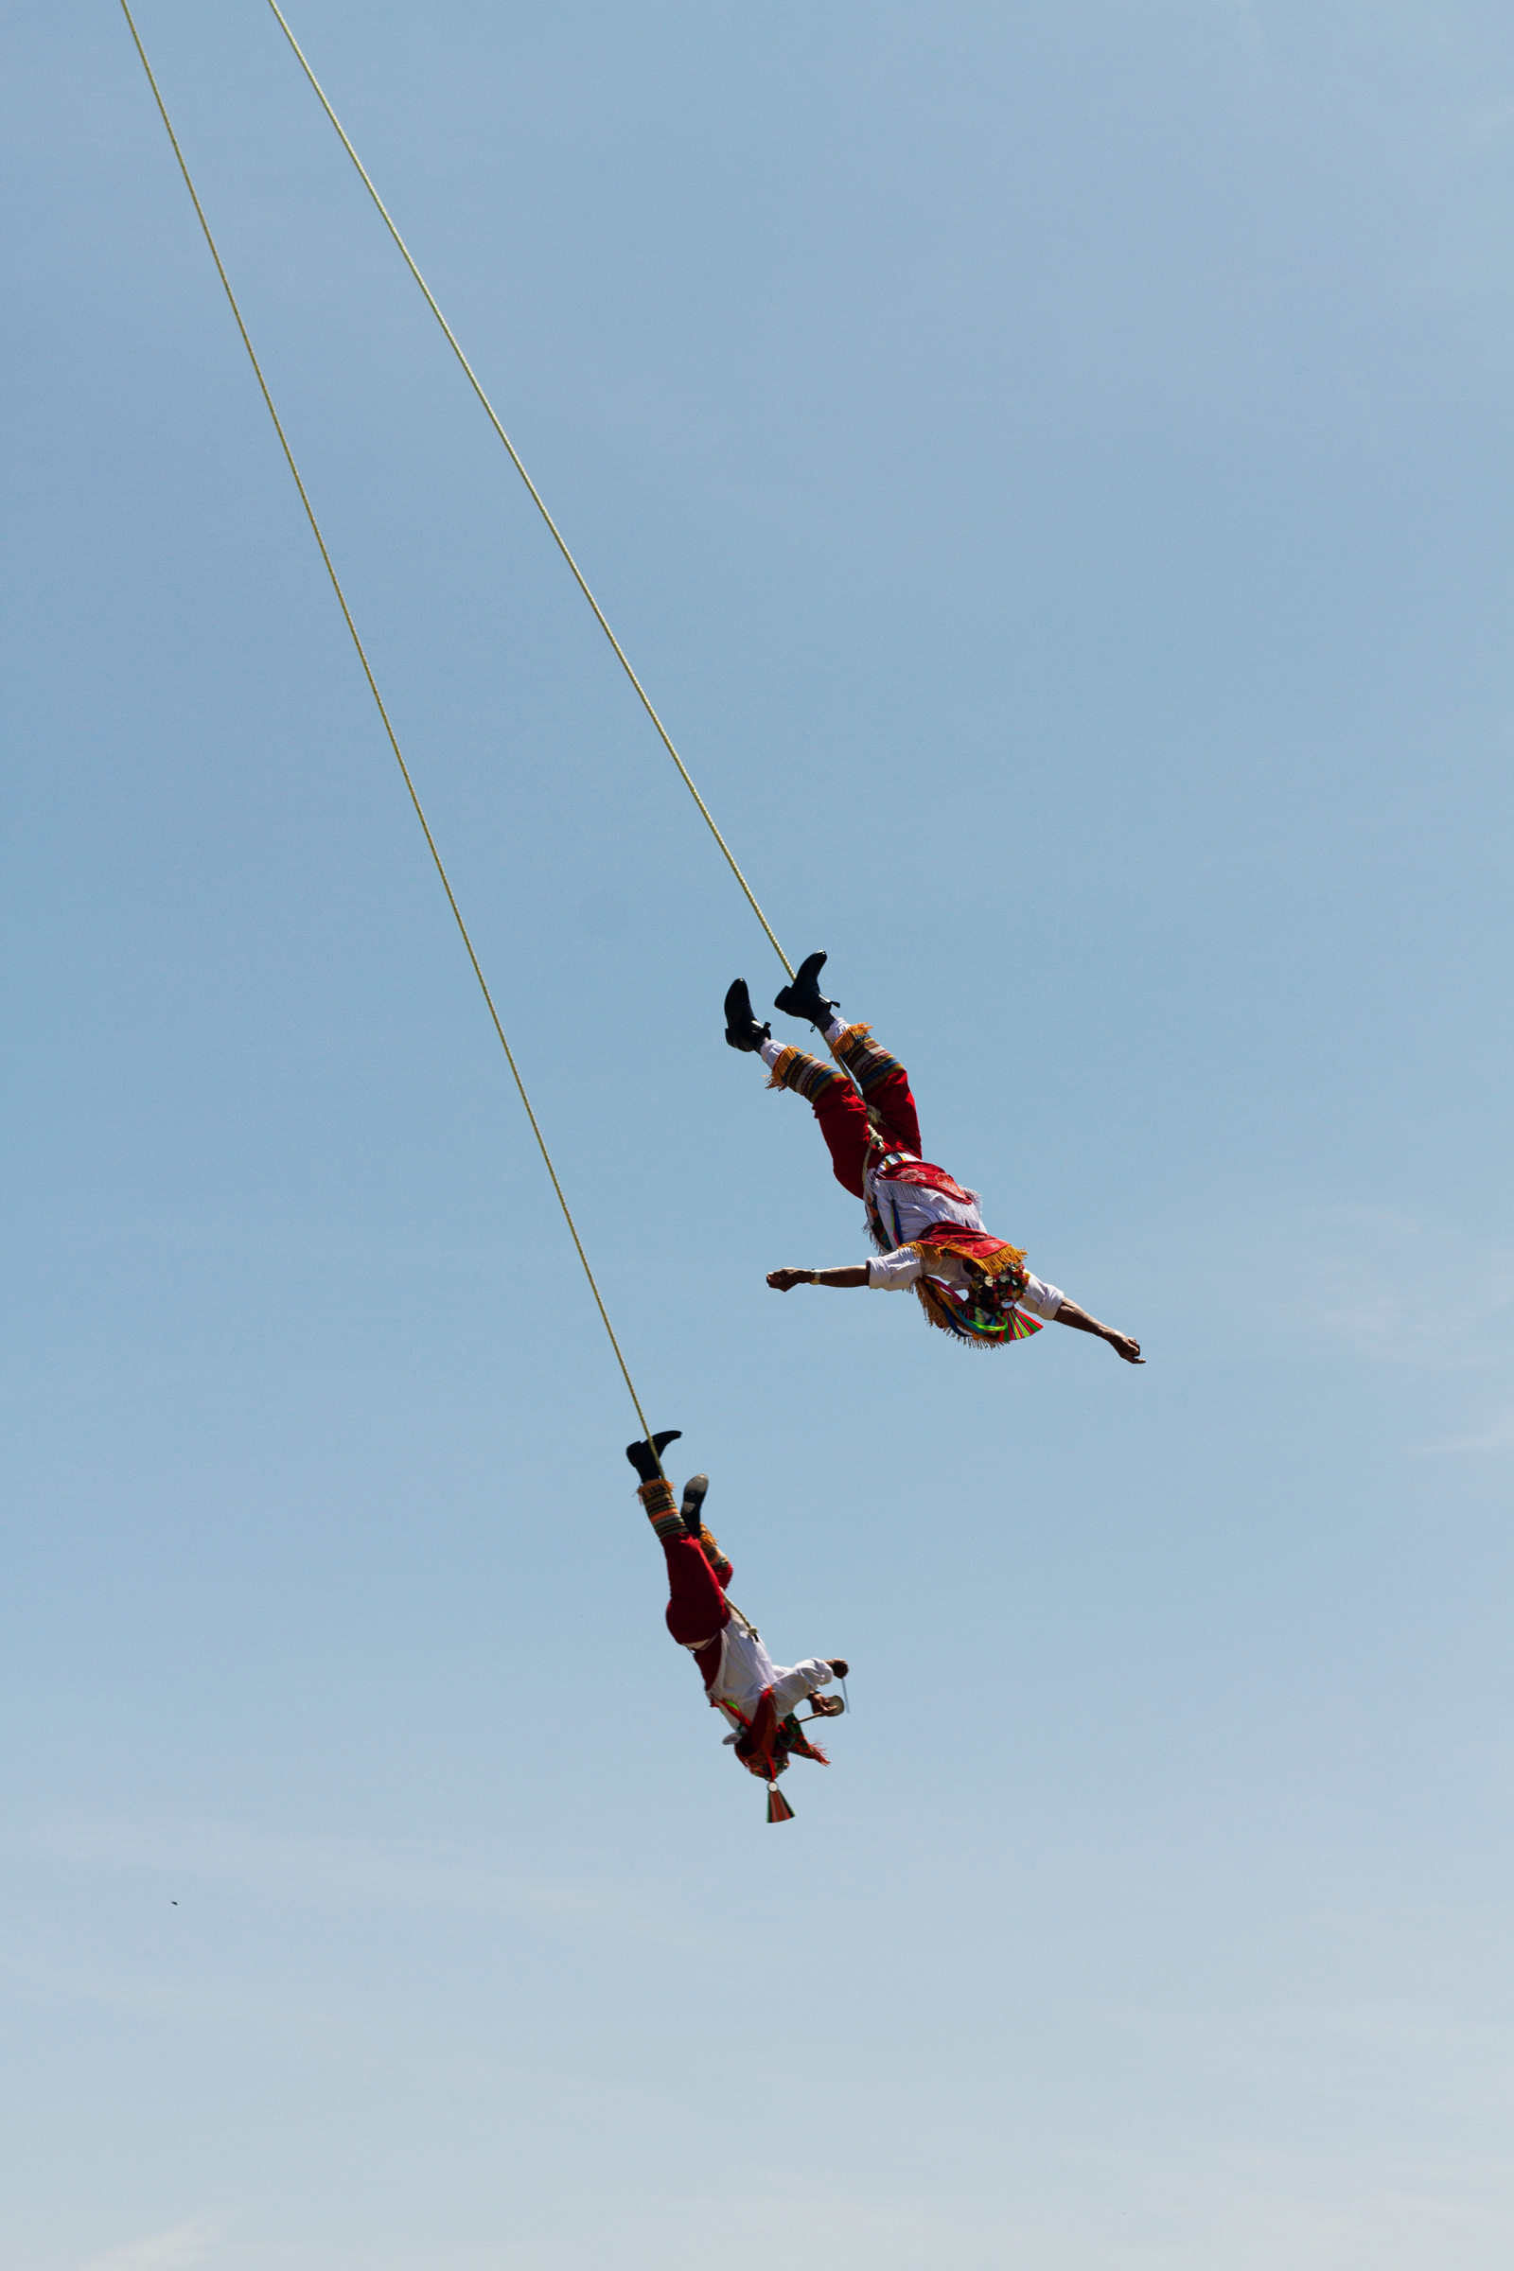

MUST-DO THINGS IN RISHIKESH
  River Rafting on the Ganges
  Visit Triveni Ghat for Ganga Aarti
  Explore Laxman Jhula & Ram Jhula
  Visit The Beatles Ashram
  Bungee Jumping & Adventure Sports
  Waterfall Treks
  Temple Visits
  Café Hopping & Ganga View Dining
https://www.holidaysbookingindia.com/tour-packages/nainital

Slide 4
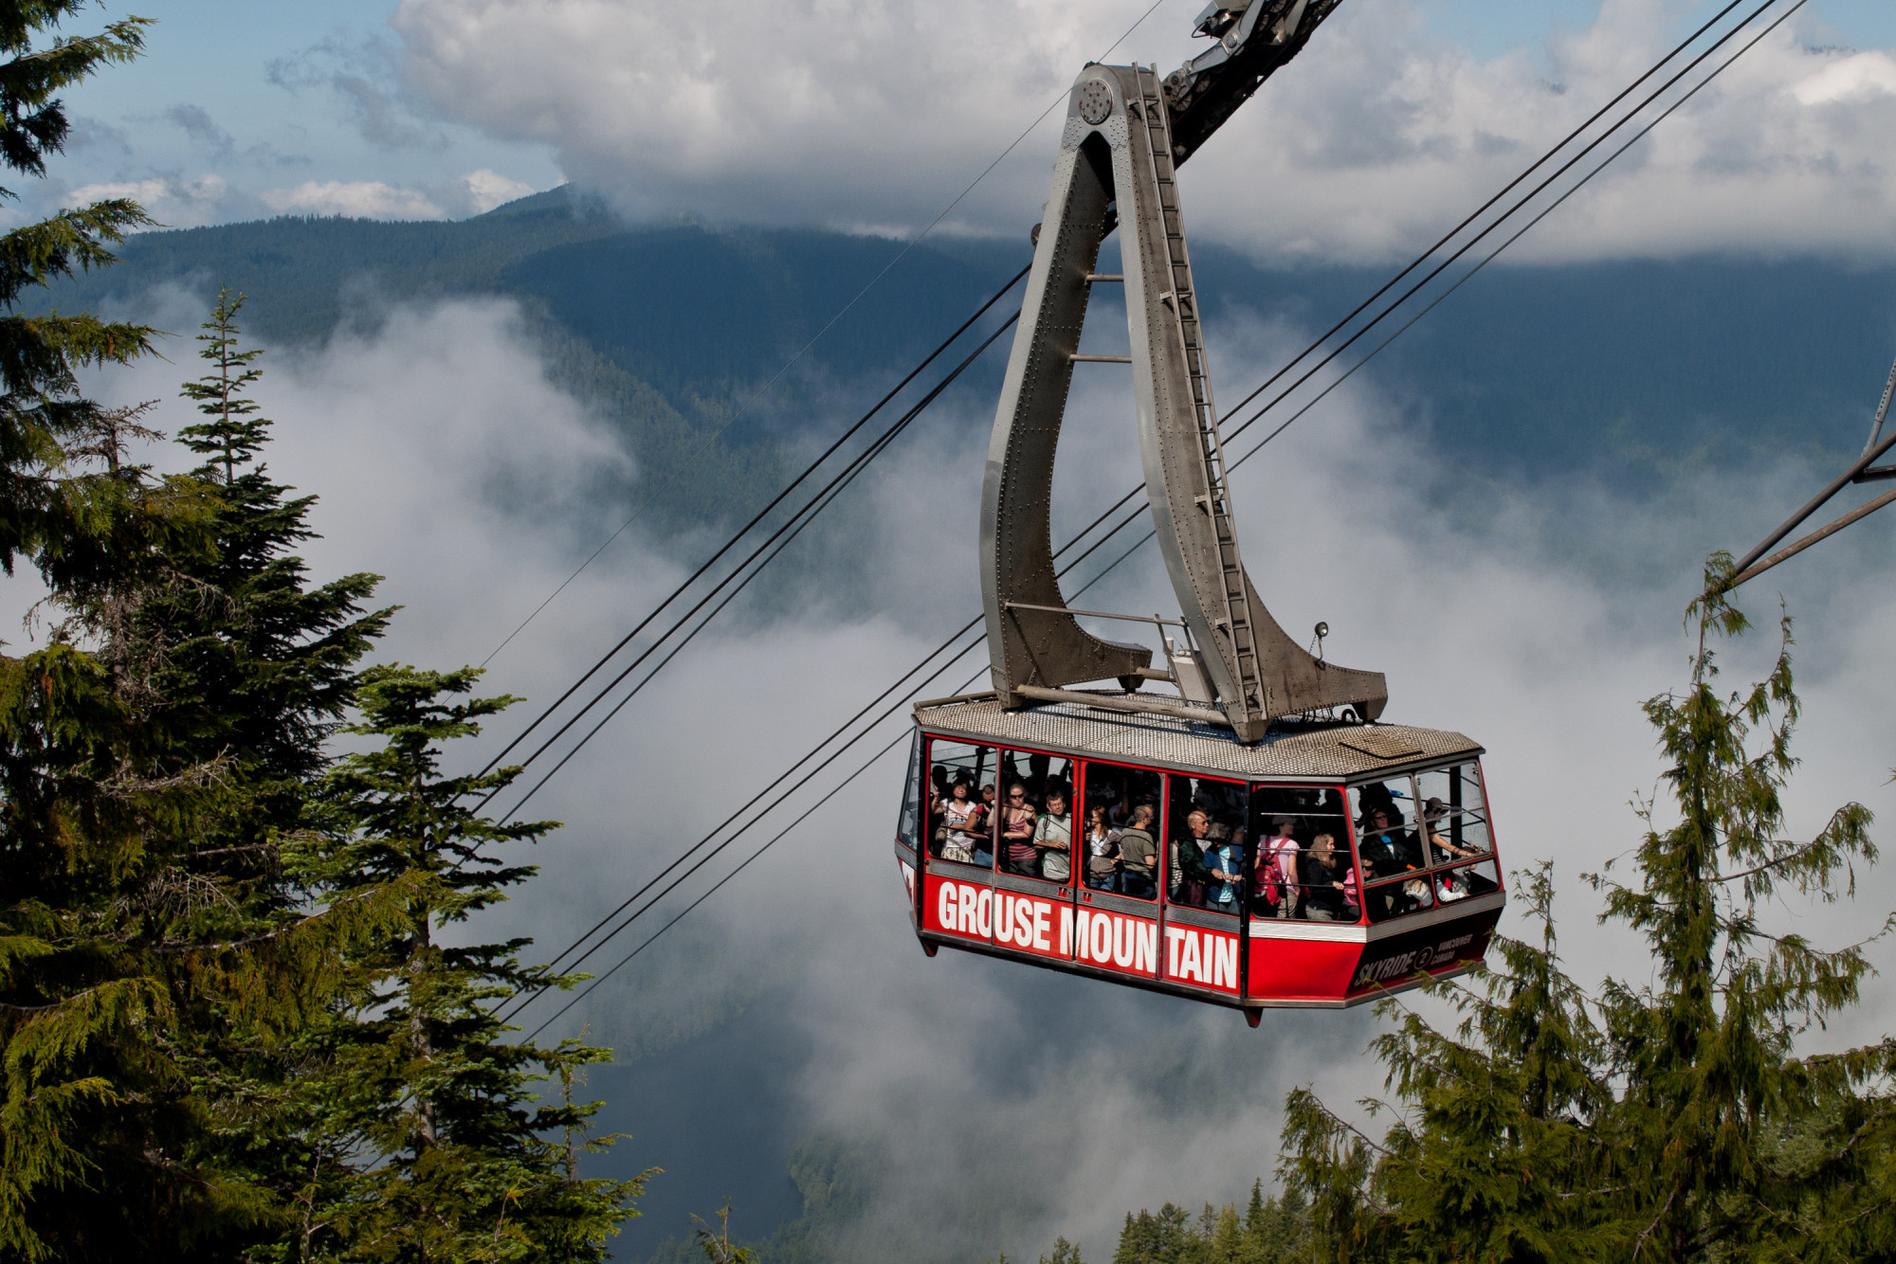




Contact Us
HOLIDAYS BOOKING INDIA
GROUND FLOOR, SHOP. NO 2, H. NO. 172, NEAR
BHAGAT COLONY WEST SANT NAGAR,
NORTH DELHI, DELHI - 110084
+91-9717883003
https://www.holidaysbookingindia.com/tour-packages/nainital

