Slide 1
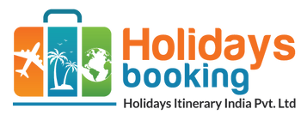
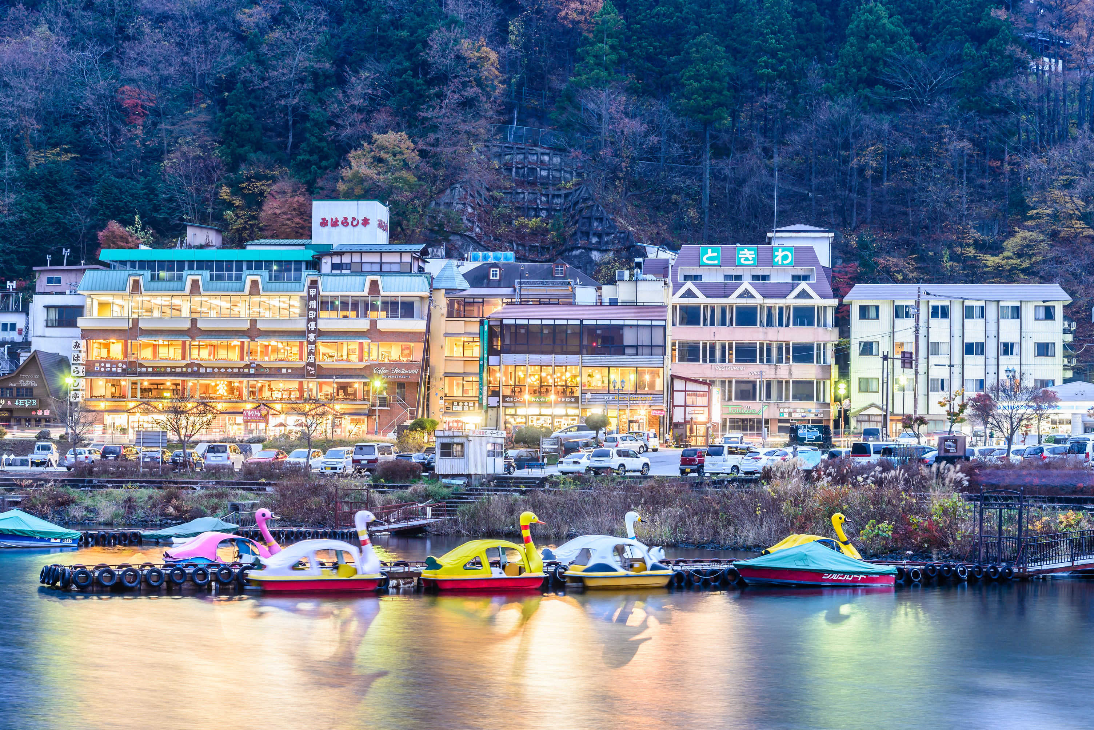



Best Rishikesh Tour Packages for Family
5 PLACE TO VISIT IN RISHIKESH
HOLIDAYS BOOKING INDIA
https://www.holidaysbookingindia.com/tour-packages/rishikesh

Slide 2
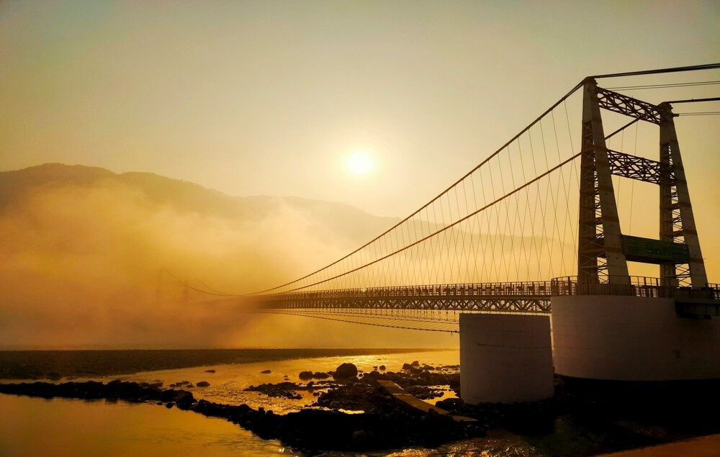
BEST RISHIKESH TOUR PACKAGES FOR FAMILY
Explore the serene beauty of Rishikesh with Holidays Booking India’s best Rishikesh tour packages for family. Enjoy river rafting, temple visits, yoga retreats, and scenic landscapes. Our customized packages include comfortable stays, guided tours, and adventure activities for an unforgettable family getaway. Book now for a perfect holiday experience!
https://www.holidaysbookingindia.com/tour-packages/rishikesh

Slide 3
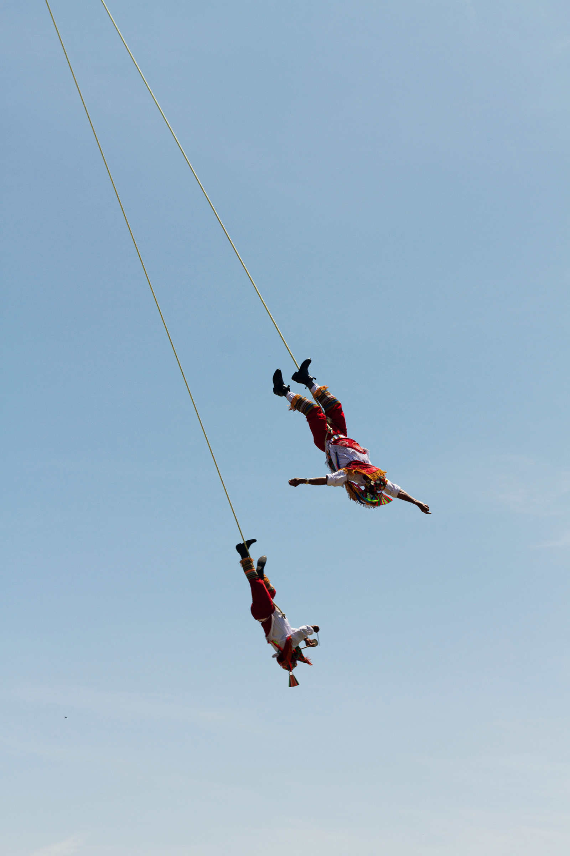

MUST-DO THINGS IN RISHIKESH
  River Rafting
  Ganga Aarti at Triveni Ghat
  Yoga & Meditation
  Lakshman Jhula & Ram Jhula
  Bungee Jumping & Adventure Sports
  Riverside Camping & Bonfire
  Neelkanth Mahadev Temple Visit
  Beatles Ashram
https://www.holidaysbookingindia.com/tour-packages/rishikesh

Slide 4
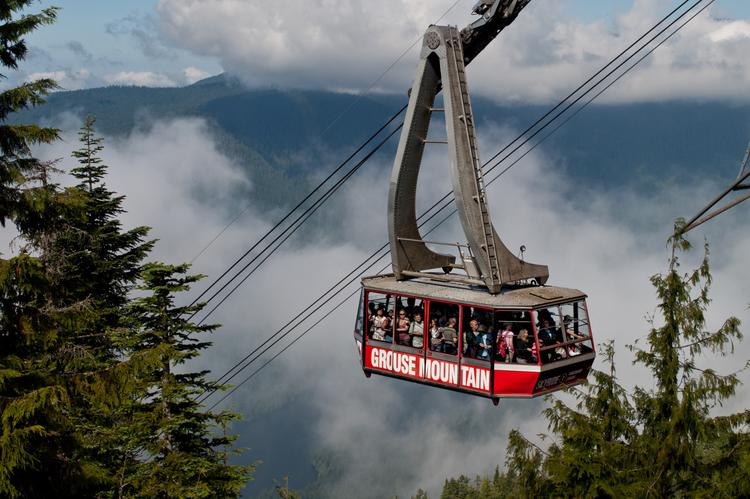




Contact Us
HOLIDAYS BOOKING INDIA
GROUND FLOOR, SHOP. NO 2, H. NO. 172, NEAR
BHAGAT COLONY WEST SANT NAGAR,
NORTH DELHI, DELHI - 110084
+91-9717883003
https://www.holidaysbookingindia.com/tour-packages/rishikesh

