Slide 1
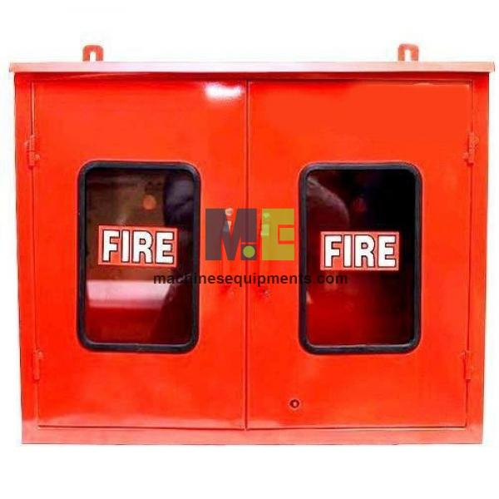
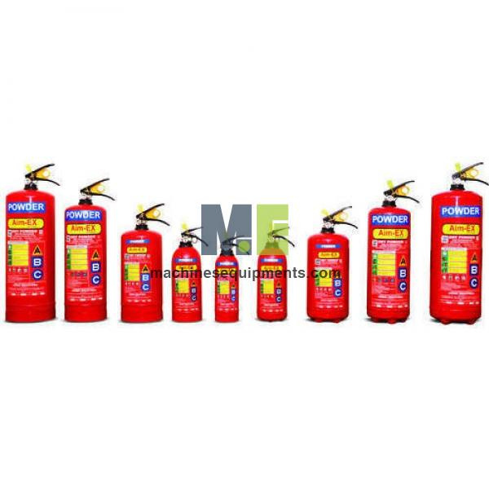

Machines Equipments
Fire Fighting Equipments Exporters

Slide 2
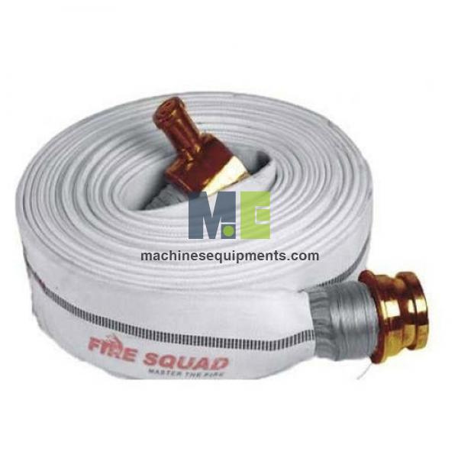
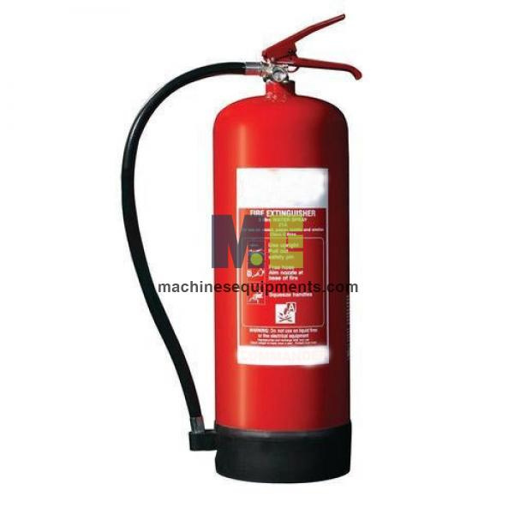
MachinesEquipments is a leading manufacturer, supplier, and exporter of fire fighting equipment in China. They offer a comprehensive range of products designed to combat fires effectively, including fire alarms, fire blankets, various types of fire extinguishers, hose reels, and fire hoses. Their equipment is utilized across multiple industries such as construction, commercial, residential, aviation, and oil and gas sectors. Committed to quality and safety, MachinesEquipments ensures that their products meet high standards to protect lives and property from fire hazards.

Slide 3
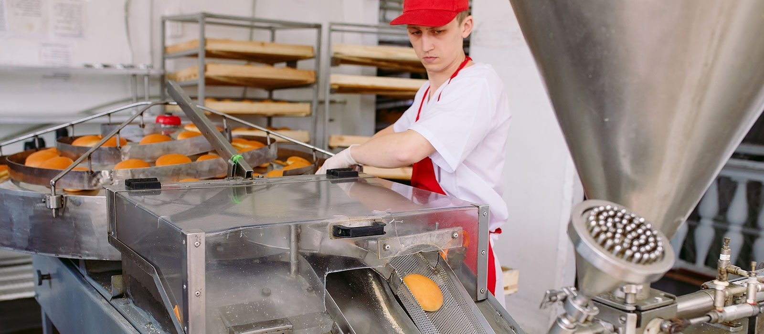

Thank You
sales@machinesequipments.com
https://www.machinesequipments.com/fire-fighting-equipment

