Slide 1
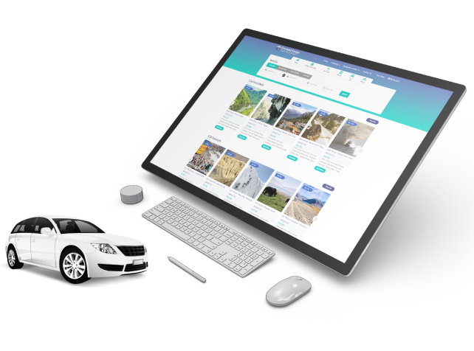

Hotel Booking System
By Travipro

Slide 2
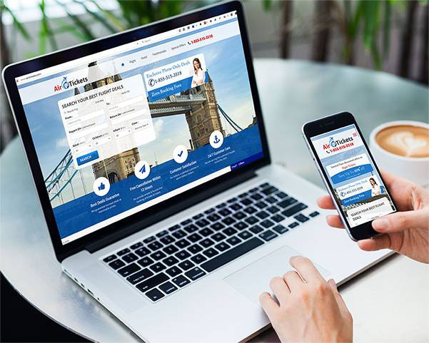
TraviPro’s Hotel Booking System offers a seamless solution for online reservations, enhancing efficiency with real-time availability, secure payments, and multi-channel bookings. Ideal for hotels seeking streamlined operations and improved customer experience.
Key Featurers of Travipro’s Hotel Booking System
  Real-time availability updates
  Secure online payment integration
  Multi-channel booking support
  Automated reservation management
  User-friendly interface design
  Customizable pricing and discounts
  Seamless third-party integrations

Slide 3
Address
B-112, Sector-64 Noida - 201301, Uttar Pradesh
Phone - +91 9560 433 318
Email - info@travipro.com
Website - https://www.travipro.com/hotel-booking-system.html

Slide 4
Thank
You
Visit - https://www.travipro.com/hotel-booking-system.htmll

