Slide 1

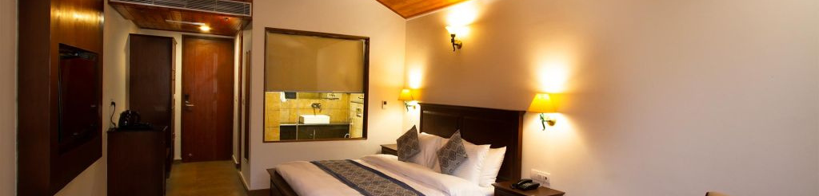
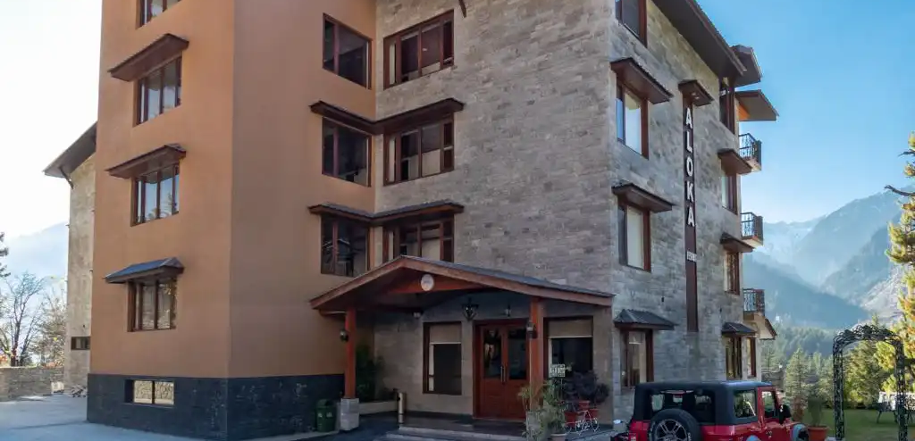

Aloka Resort Manali

Slide 2

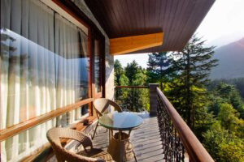
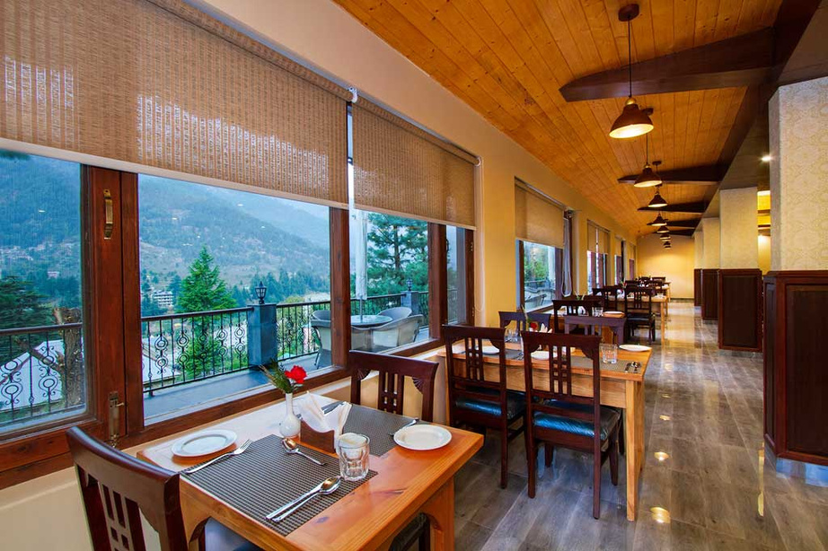
Premium Resort in Manali
Experience the charm of luxury resorts in Manali at Aloka Resort Manali, offering breathtaking mountain views, elegant accommodations, premium amenities, and serene surroundings for a perfect Himalayan retreat.

Slide 3

Address
Address
Chadyari, Tehsil Manali, Distt Kullu H.P, 175131, INDIA
Phone: +91 78386-09537, +91 98160-76122
Email: alokaresortmanali@gmail.com
Website - https://alokaresortmanali.com/

Slide 4

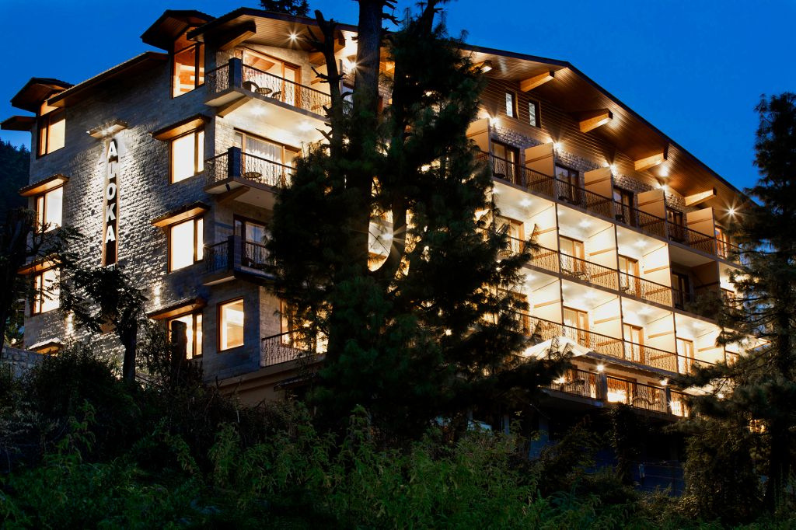
Thank You

