Slide 1




Cold Chain Equipments Manufacturers
Reliable Solutions for Advanced Medical
Presented by: Naugra Medical
Website
https://www.naugramedical.com/cold-chain-equipments

Slide 2



About Us
We are Naugra Medical, a leading name in the Medical and Hospital Lab Instruments industry. Our services include manufacturing, supplying, and exporting the associated medical instruments and equipment. We offer an integrated service to our clients to ease the necessities related to the medical field.
As Hospital and medical laboratory instruments manufacturers suppliers and exporters, we never compromise on the quality of the products that we deliver. Each piece of medical equipment and furniture that we manufacture features premium attributes. A perfect blend of effectivity and usability is what we work to achieve with our established collection.
https://www.naugramedical.com/cold-chain-equipments
Website

Slide 3
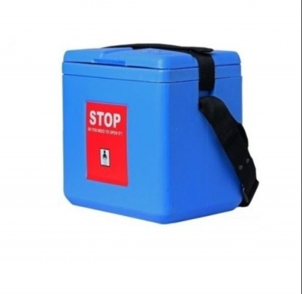
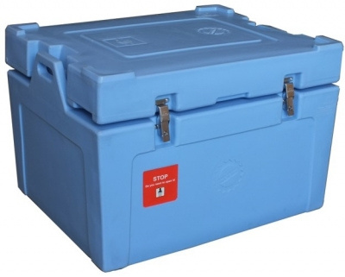
https://www.naugramedical.com/cold-chain-equipments

Slide 4
Cold Chain Equipments Manufacturers
Naugra Medical is a leading Cold Chain Equipment Manufacturer, offering high-quality solutions for storing and transporting temperature-sensitive medical supplies. Their range includes vaccine refrigerators, ice-lined freezers, cold boxes, and temperature monitoring devices. Designed for reliability and efficiency, Naugra Medical ensures optimal preservation of pharmaceuticals, vaccines, and biological products for healthcare and research needs.
https://www.naugramedical.com/cold-chain-equipments

Slide 5


Thank You.
Get In Touch
Phone
Email : sales@naugramedical.com
+91-0171-2643080 , 2601773
https://www.naugramedical.com/cold-chain-equipments

