Slide 1

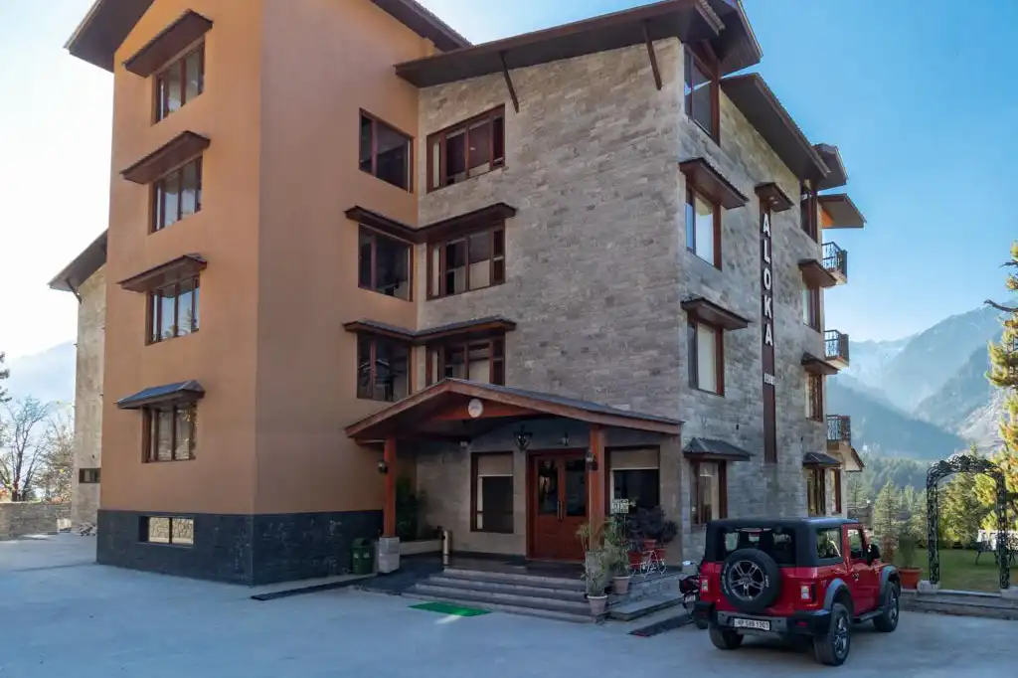

ALOKA RESORT MANALI
Best Resort in Manali

Slide 2

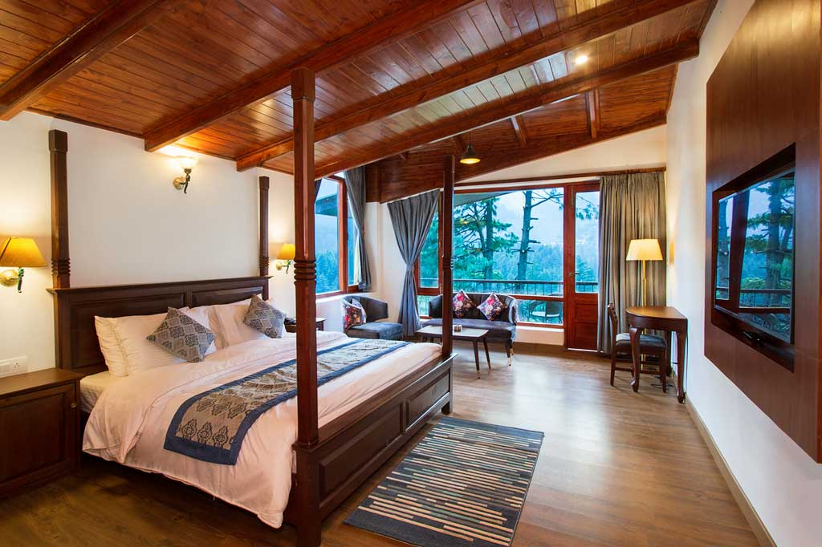

Aloka Resort Manali offers luxurious accommodations with stunning Himalayan views, modern amenities, and exceptional hospitality, ensuring a memorable stay in Manali's serene environment

Slide 3
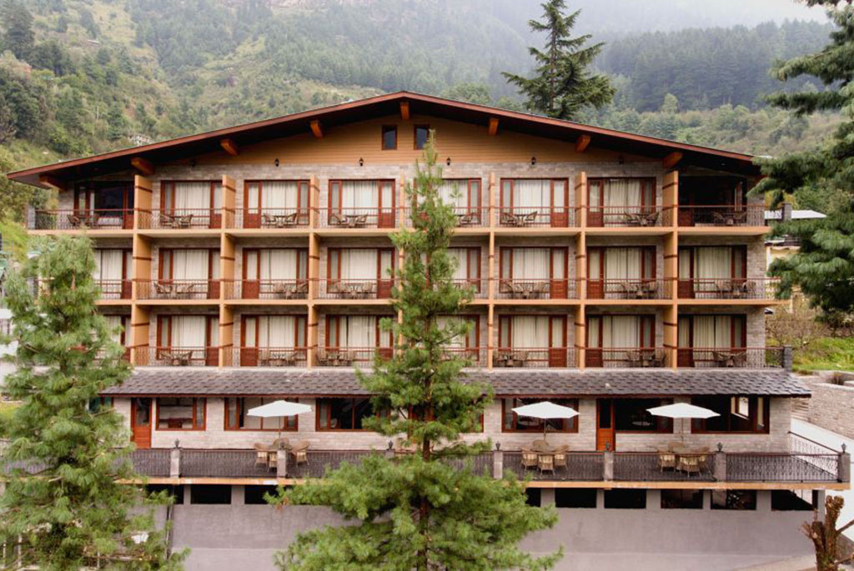

Address
Chadyari, Tehsil Manali, Distt Kullu H.P, 175131, INDIA
Phone: +91 78386-09537, +91 98160-76122
Email: alokaresortmanali@gmail.com
Website: https://alokaresortmanali.com/

Slide 4

THANK YOU
Visit - https://alokaresortmanali.com/

