Slide 1



Talbros Engineering
Heavy Duty Axle Shafts Manufacturers

Slide 2
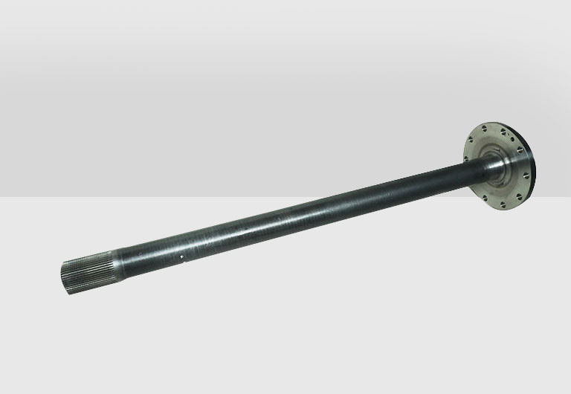
Talbros Axles offers heavy-duty axle shafts designed for strength and durability, ensuring reliable performance in demanding environments. These shafts are engineered to meet the highest industry standards for heavy vehicles and machinery.

Slide 3







Contact US
91-1294284300
axleshafts@talbrosaxles.com
https://talbrosaxles.com/products/heavy-duty-axle-shafts/
Plot No. 74-75-76, Sector-6 Faridabad 121006 ( Haryana)

Slide 4

Thank
you
Visit - https://talbrosaxles.com/products/heavy-duty-axle-shafts/

