Slide 1


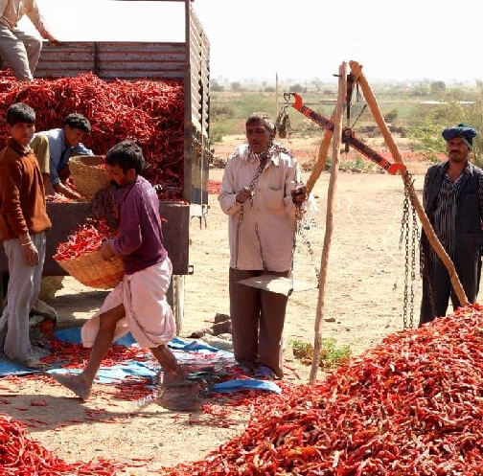
Agrocrops
Red Chilli Export from India

Slide 2
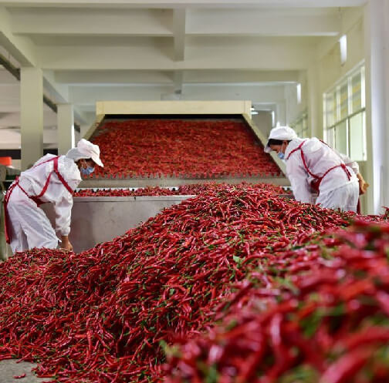
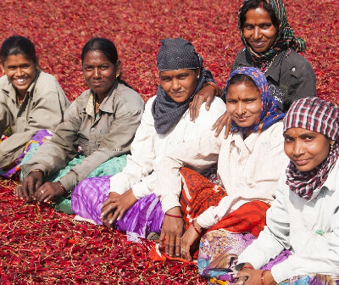
As the biggest producer and exporter of chillies worldwide, Agrocrops makes a substantial contribution to the world market for spices. Andhra Pradesh's Guntur region is well known for producing and exporting a wide range of chillies, including Teja, Sannam S4, and Byadgi. A mainstay in many international cuisines, Indian chillies are prized globally for their vivid color and unique spiciness. The United States, United Kingdom, United Arab Emirates, and Saudi Arabia are among the top importers of Indian chillies.

Slide 3

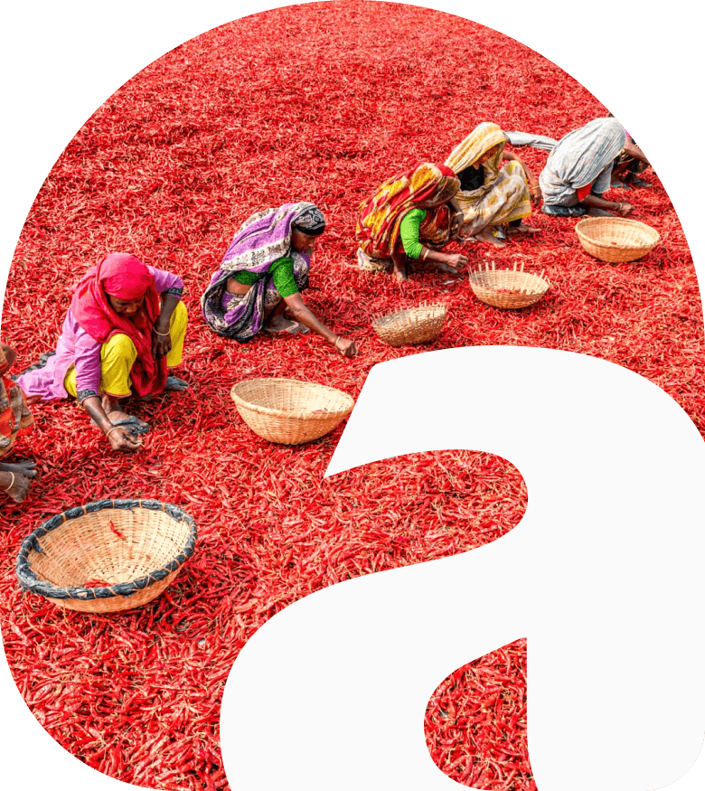




Contact US
91 9701363424
contact@agrocrops.com
https://www.spicesindia.net/types-of-dry-red-chillies-in-india
D.No 25-16-180, 181, Mirichi Yard Road, Guntur, Andhra Pradesh, 522005

Slide 4
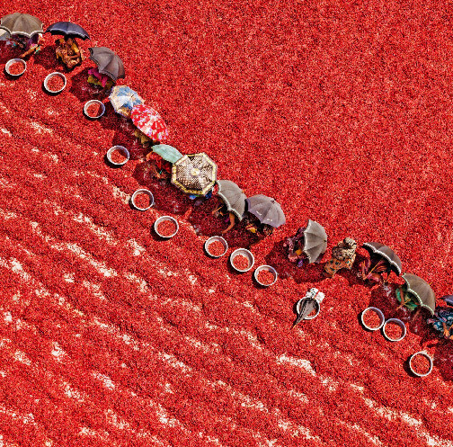
Thank you
Visit - https://www.spicesindia.net/types-of-dry-red-chillies-in-india

