Slide 1
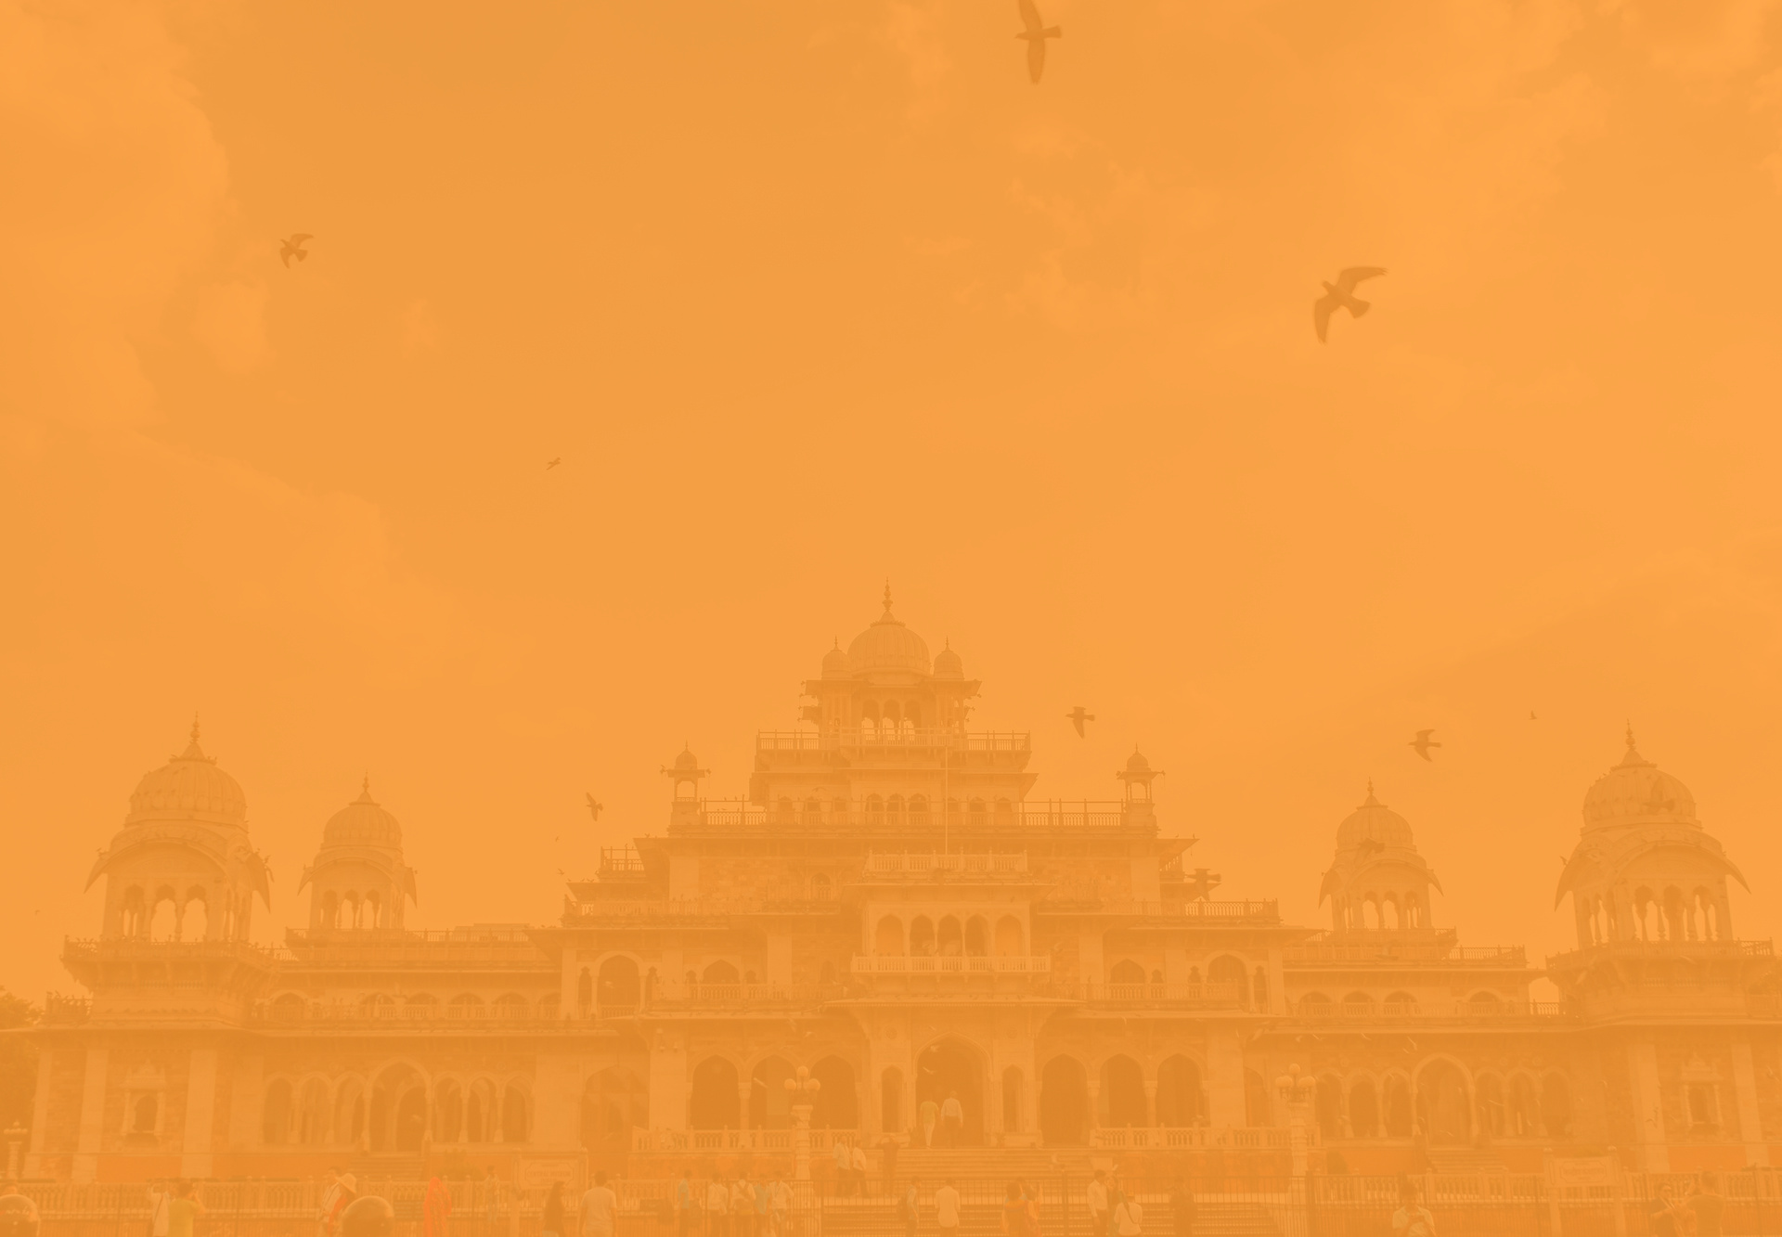

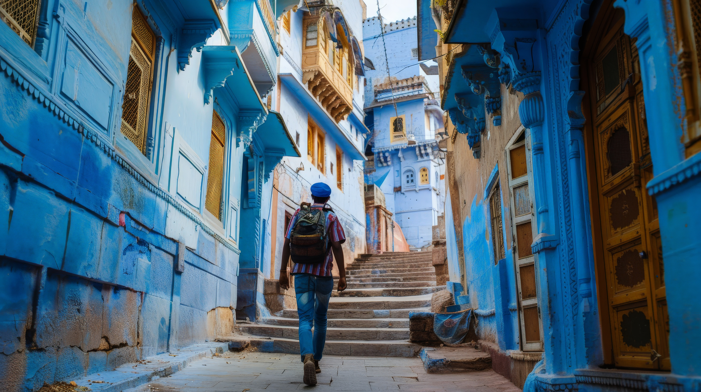



My
Affordable Jodhpur Family Tour Packages
5 PLACE TO VISIT IN JODHPUR
HOLIDAYS BOOKING INDIA
https://www.holidaysbookingindia.com/tour-packages/jodhpur

Slide 2
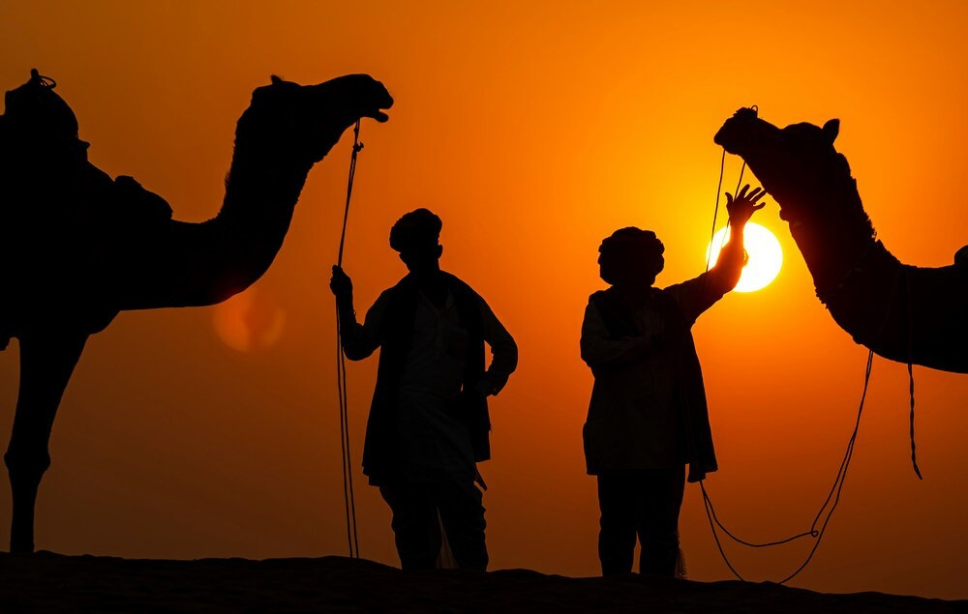
AFFORDABLE JODHPUR FAMILY TOUR PACKAGES
Explore Jodhpur with Affordable Jodhpur Family Tour Packages from Holidays Booking India. Discover majestic forts, vibrant markets, and rich heritage without exceeding your budget. Our customized packages include comfortable stays, guided tours, and seamless travel experiences. Enjoy a memorable family getaway in the Blue City with us. Book now for an unforgettable Rajasthan adventure!
https://www.holidaysbookingindia.com/tour-packages/jodhpur

Slide 3
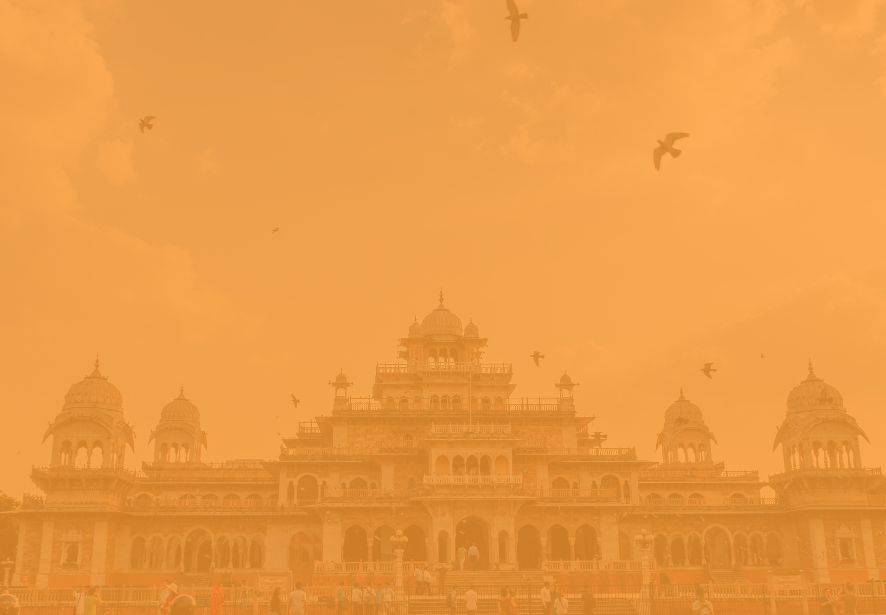
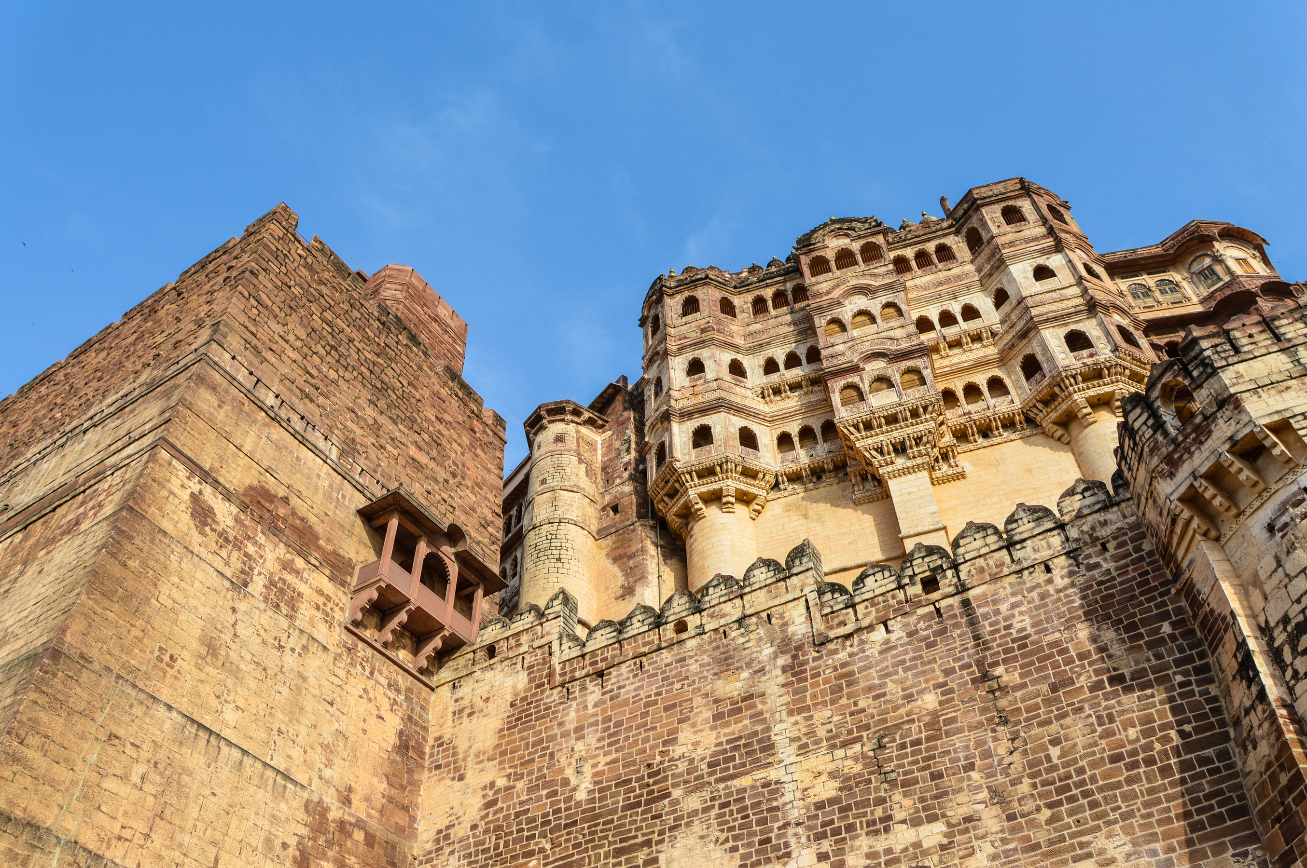
  Mehrangarh Fort
  Umaid Bhawan Palace
  Jaswant Thada
  Ghanta Ghar
  Rao Jodha Desert Rock Park
https://www.holidaysbookingindia.com/tour-packages/jodhpur

Slide 4
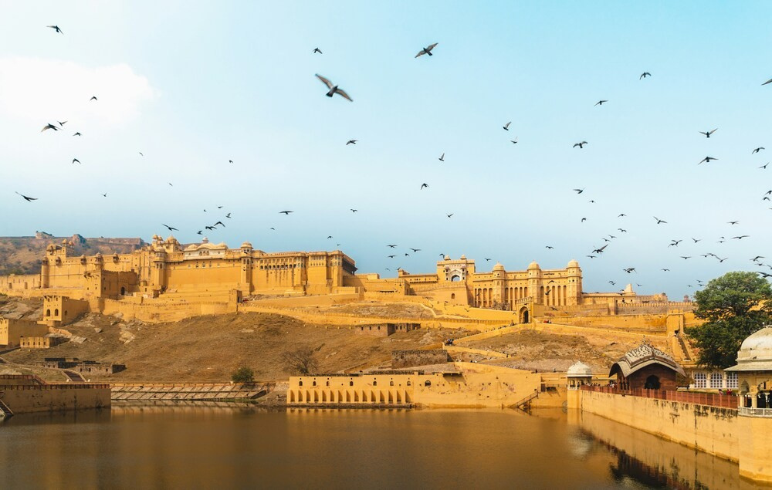


Contact Us
HOLIDAYS BOOKING INDIA
GROUND FLOOR, SHOP. NO 2, H. NO. 172, NEAR
BHAGAT COLONY WEST SANT NAGAR,
NORTH DELHI, DELHI - 110084
+91-9717883003
https://www.holidaysbookingindia.com/tour-packages/jodhpur

