Slide 1
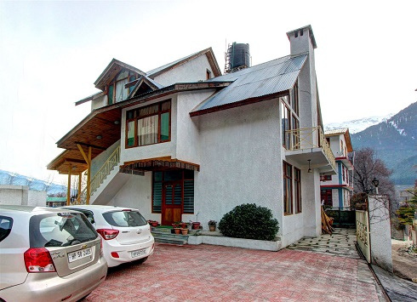

Wood Valley Cottage
https://www.woodvalleycottage.com/

Slide 2
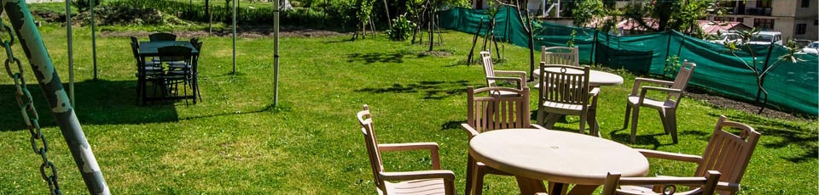
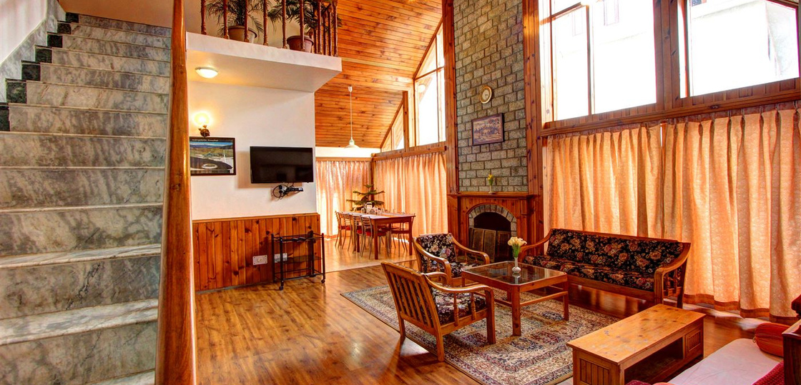
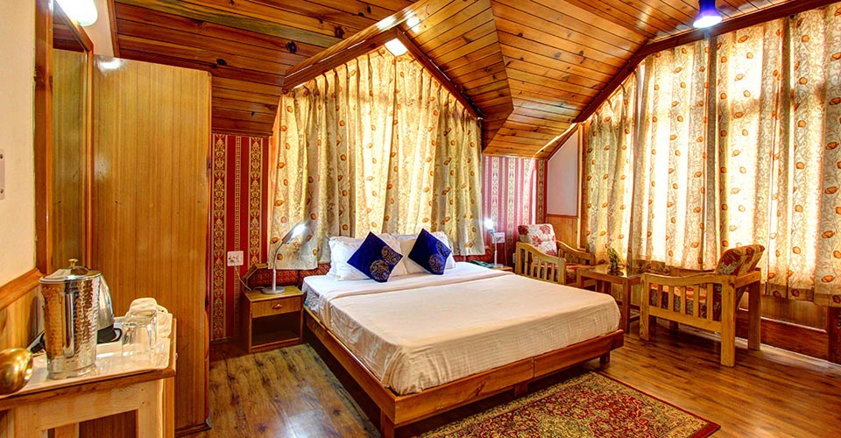
Kullu Manali Cottage
Visit - https://www.woodvalleycottage.com/

Slide 3
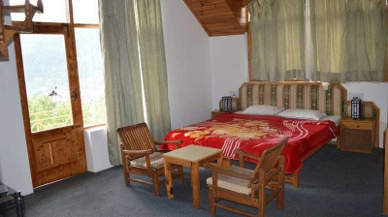
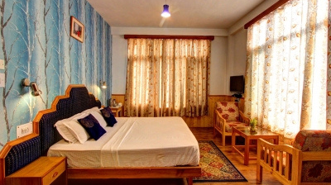
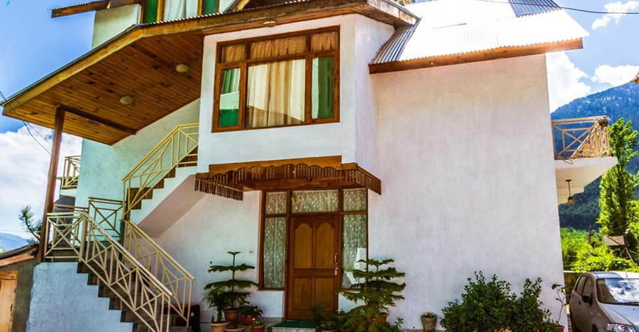

Visit us at - https://www.woodvalleycottage.com/
Address - Bhutani Gompa Road, Aleo, Manali 175 131,Himachal Pradesh, India
Phone-+91 9816094402
Email-prem@woodvalleycottage.com, prem.woodvalleycottage@gmail.com

Slide 4
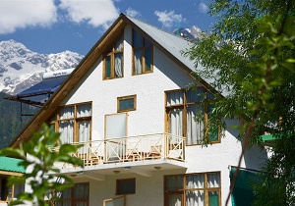

Thank You

