Slide 1




Orthopedic Implants Exporters
Reliable Solutions for Advanced Medical
Presented by: Naugra Medical
Website
https://www.naugramedical.com/orthopedics-implants

Slide 2



About Us
We are Naugra Medical, a leading name in the Medical and Hospital Lab Instruments industry. Our services include manufacturing, supplying, and exporting the associated medical instruments and equipment. We offer an integrated service to our clients to ease the necessities related to the medical field.
As Hospital and medical laboratory instruments manufacturers suppliers and exporters, we never compromise on the quality of the products that we deliver. Each piece of medical equipment and furniture that we manufacture features premium attributes. A perfect blend of effectivity and usability is what we work to achieve with our established collection.
https://www.naugramedical.com/orthopedics-implants
Website

Slide 3
Orthopedic Implants Exporters
Naugra Medical is one of the leading Orthopedic Implants Exporters, offering high-quality surgical implants and instruments worldwide. With precision engineering and strict quality standards, we provide a wide range of orthopedic solutions for hospitals and healthcare professionals.
https://www.naugramedical.com/orthopedics-implants

Slide 4
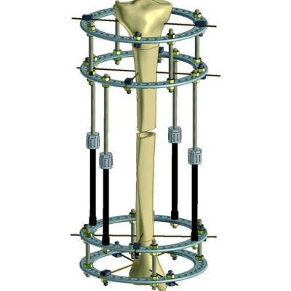
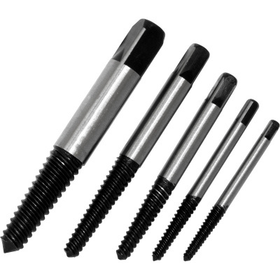
https://www.naugramedical.com/orthopedics-implants

Slide 5

Thank You.
Get In Touch
Phone
+91-0171-2643080 , 2601773
https://www.naugramedical.com/orthopedics-implants

