Slide 1

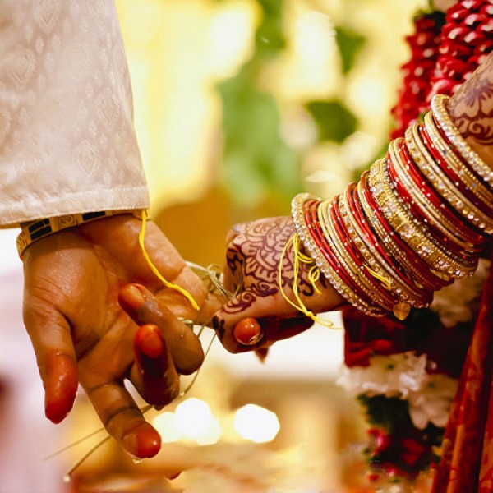
Home
Service
About Us
Contact
IMPERIAL WEDDINGS
AGGARWAL MATRIMONIAL SERVICES IN DELHI
Presented by Imperial Wedding
Website:
https://www.imperial.wedding/aggarwal-rishte-in-delhi-ncr-india

Slide 2

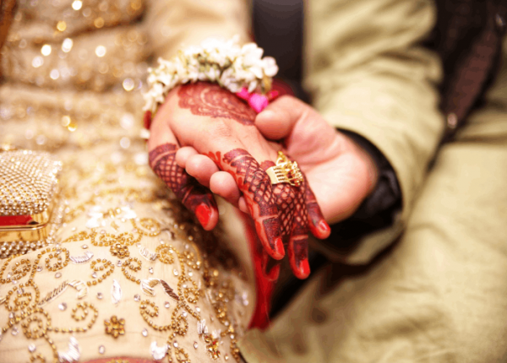

Home
Service
About Us
Contact
About us:-
Why Choose Imperial Weddings?
  Tailored matchmaking services for personalized connections.
  Expert team with years of experience in matrimonial services.
  Focused on finding compatible matches based on your preferences.
  Trusted by hundreds of happy couples in Gurgaon.
Website:
https://www.imperial.wedding/aggarwal-rishte-in-delhi-ncr-india

Slide 3
Home
Service
About Us
Contact
Aggarwal Matrimonial Services in Delhi
Aggarwal Matrimonial Services in Delhi are provided by Imperial Weddings, which assists you in locating the ideal match in the neighborhood. Personalized matchmaking, family customs, and cultural values are our top priorities. We guarantee a smooth and reliable mate search for a happy and prosperous marriage thanks to our extensive network of real profiles.
Website:
https://www.imperial.wedding/aggarwal-rishte-in-delhi-ncr-india

Slide 4


Home
Service
About Us
Contact
Thank you For Watching
contact us :
011-40505815 9773525525
117, 1st Floor, NDM-1
Netaji Subhash Place
Pitampura, Delhi-110034
info@imperial.wedding
Website: https://www.imperial.wedding/aggarwal-rishte-in-delhi-ncr-india

