Slide 1







Best Residential Schools In India
Start Slide
https://pinegrove.in/location.aspx

Slide 2
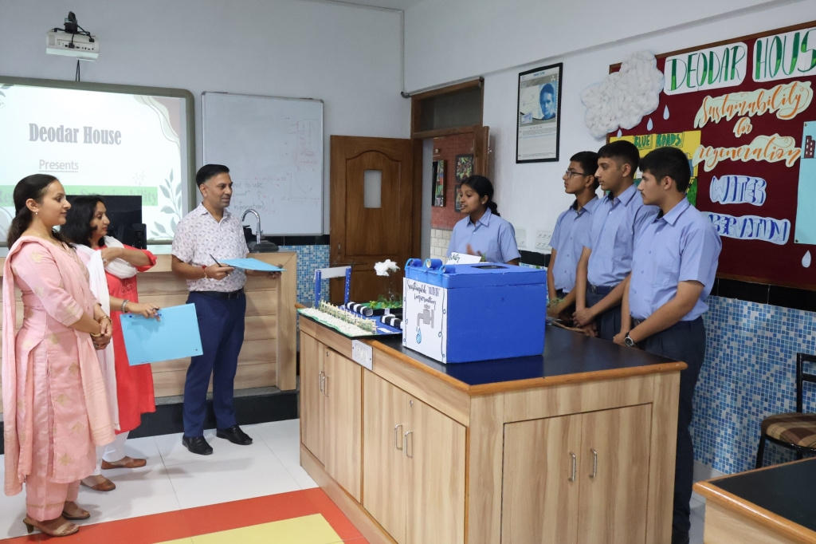
Pinegrove School, established in 1991, is a premier co-educational, fully residential CBSE boarding school in Himachal Pradesh. Nestled in the serene Shivalik Hills, it offers top-notch academics, sports, and extracurricular activities. With a strong focus on holistic education, Pinegrove nurtures students into confident, responsible individuals, making it one of India's finest residential schools.
https://pinegrove.in/location.aspx
Welcome To Our School

Slide 3
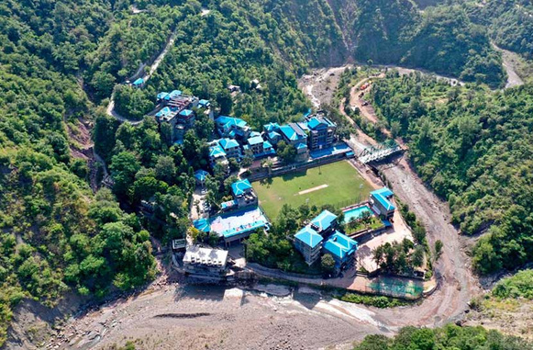

Best Residential Schools In India
Pine Grove School is among the best residential schools in India, offering top-tier education with a focus on academic excellence, discipline, and holistic development. Nestled in the serene hills, it provides a nurturing environment with state-of-the-art facilities, experienced faculty, and a strong emphasis on extracurricular activities. The school ensures students receive a well-rounded education, fostering leadership and critical thinking skills. With a legacy of excellence, Pine Grove School is the ideal choice for quality residential schooling in India.
https://pinegrove.in/location.aspx

Slide 4
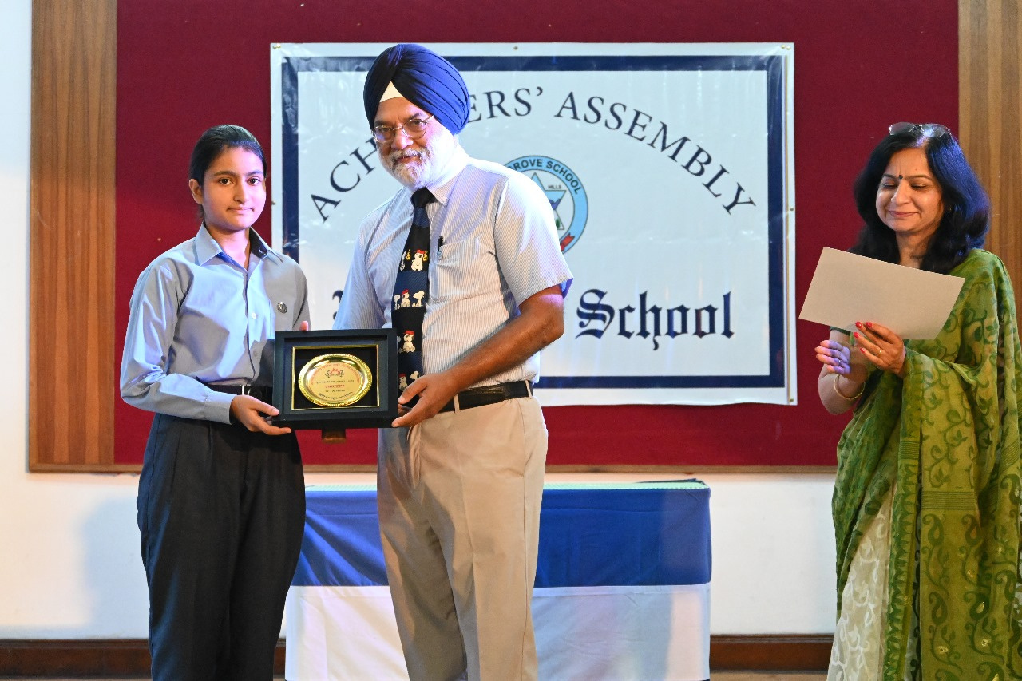

Portfolio
https://pinegrove.in/location.aspx

Slide 5



Contact Us
+91 980 5004 114 +91 980 5004 115
https://pinegrove.in/location.aspx
dharampur@pinegroveschool.com
subathu@pinegroveschool.com
Kuthar Road, Subathu 173 206 District Solan HP,India
Kasauli Road, Dharampur 173 209 District Solan HP,India

