Slide 1







https://pinegrove.in/
Best School In India
Start Slide

Slide 2
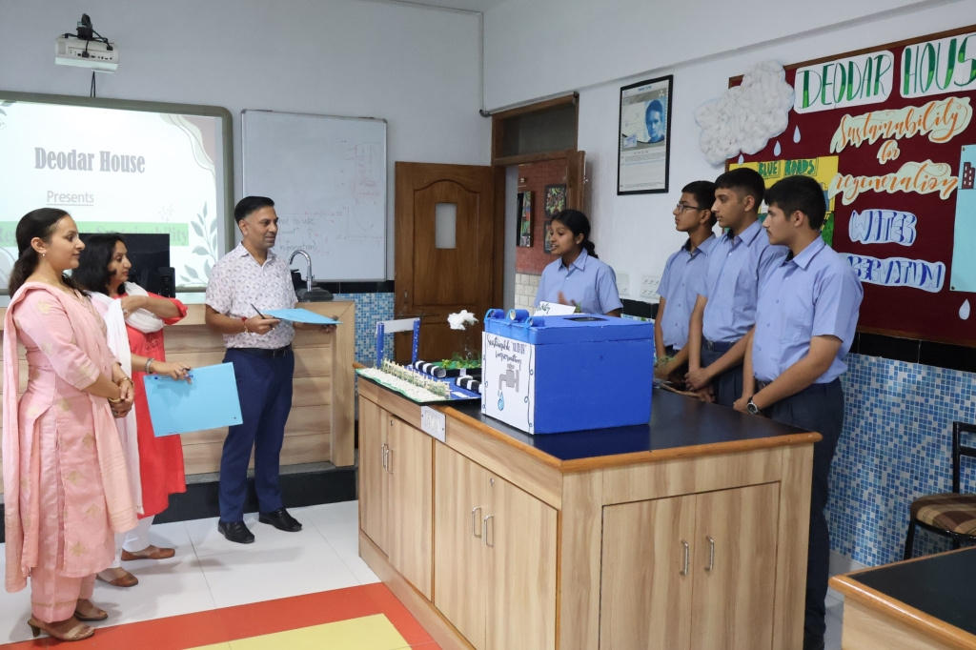
Pinegrove School, established in 1991, is a premier co-educational, fully residential CBSE boarding school in Himachal Pradesh. Nestled in the serene Shivalik Hills, it offers top-notch academics, sports, and extracurricular activities. With a strong focus on holistic education, Pinegrove nurtures students into confident, responsible individuals, making it one of India's finest residential schools.
https://pinegrove.in/
Welcome To Our School

Slide 3
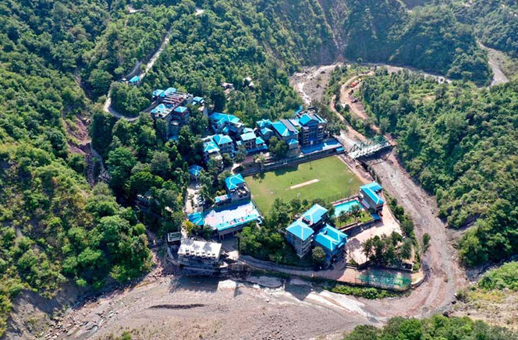

Best School In India
Pine Grove School is recognized as one of the best schools in India, offering top-quality education, modern infrastructure, and a holistic learning approach. With a strong focus on academics, sports, and character development, it prepares students for a successful future.
https://pinegrove.in/

Slide 4
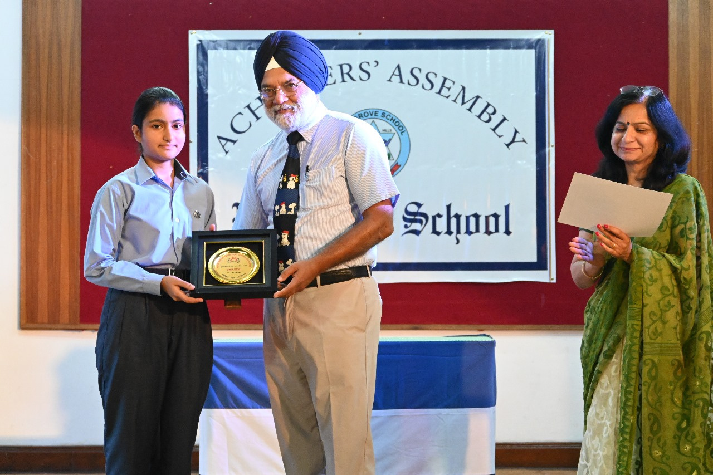

Portfolio
https://pinegrove.in/

Slide 5



Contact Us
+91 980 5004 114 +91 980 5004 115
https://pinegrove.in/
dharampur@pinegroveschool.com
subathu@pinegroveschool.com
Kuthar Road, Subathu 173 206 District Solan HP,India
Kasauli Road, Dharampur 173 209 District Solan HP,India

