Slide 1




Home
Service
About Us
Contact
Top Coffee Shop Franchise in India
https://sutocafe.com/

Slide 2


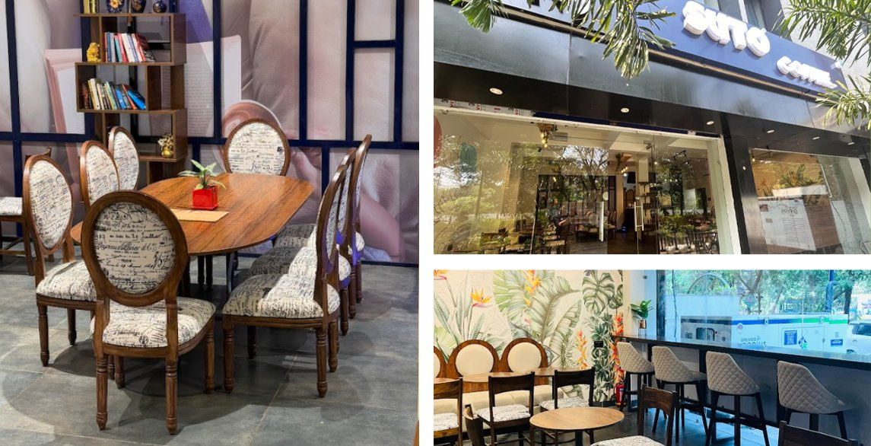
Home
Service
About Us
Contact
About Suto Cafe and Its Coffee Franchise Opportunities
Suto Cafe was founded with a mission to redefine the coffee experience. With a focus on premium quality, customer satisfaction, and innovation, it has grown into a trusted brand among coffee lovers. The brand aims to provide a unique and delightful café experience while maintaining strong values of excellence and service.
https://sutocafe.com/

Slide 3
Home
Service
About Us
Contact
Top Coffee Shop Franchise in India
Suto Cafe is the top coffee shop franchise in Indore, offering a cozy ambiance, premium brews, and delicious snacks. Known for its artisanal coffee and warm hospitality, it’s a perfect spot to relax or work. Whether you love espresso, cappuccino, or desserts, Suto Cafe promises a delightful experience in the heart of Indore.
https://sutocafe.com/

Slide 4
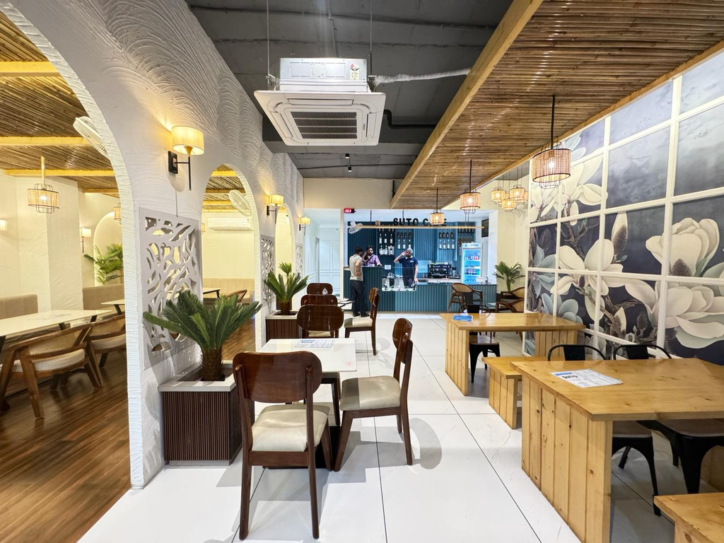
Home
Service
About Us
Contact
Steps to Becoming a Suto Cafe Franchise Owner
  Submit Your Franchise Application
  Discuss Business Requirements
  Finalize Agreement & Training
  Set Up Your Café
  Grand Opening & Business Operations
https://sutocafe.com/

Slide 5
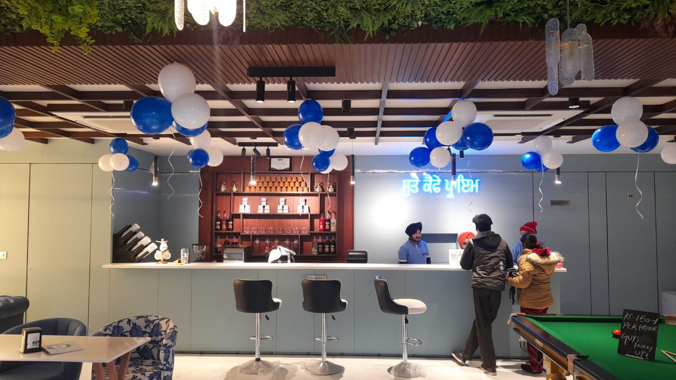
Home
Service
About Us
Contact
Suto Cafe and Its Coffee Franchise Opportunities
  High-Quality Coffee & Beverages
  Modern & Cozy Ambiance
  Innovative Menu
  Customer-Centric Approach
  Affordable Franchise Investment
  Training & Operational Guidance
  Marketing & Branding Support
  Ongoing Assistance
https://sutocafe.com/

Slide 6


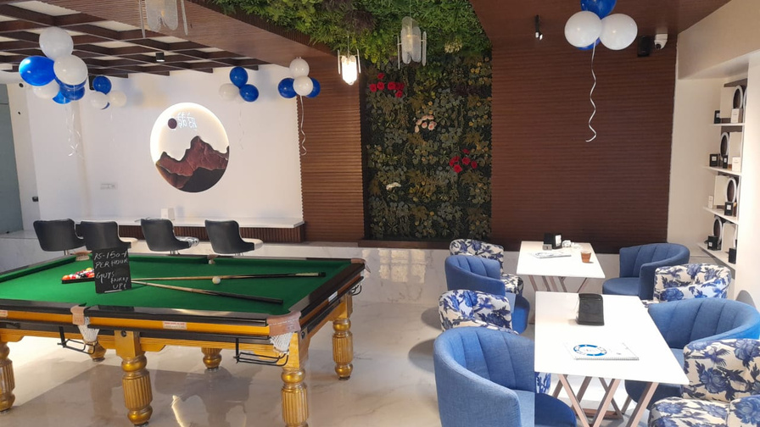

Home
Service
About Us
Contact
For more detailed information or to apply for a franchise
+91 7880128851
https://sutocafe.com/
franchise@sutocafe.com
SICA School Rd, AG Sector, Scheme No 54, Indore, Madhya Pradesh 452010

