Slide 1







https://pinegrove.in/boarding.aspx
Best Co-Ed Boarding Schools in India
Start Slide

Slide 2
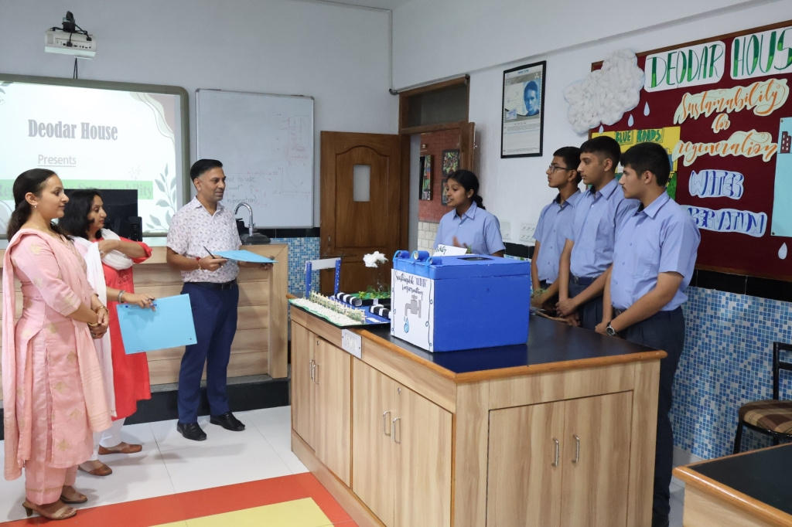
Pinegrove School, established in 1991, is a premier co-educational, fully residential CBSE boarding school in Himachal Pradesh. Nestled in the serene Shivalik Hills, it offers top-notch academics, sports, and extracurricular activities. With a strong focus on holistic education, Pinegrove nurtures students into confident, responsible individuals, making it one of India's finest residential schools.
https://pinegrove.in/boarding.aspx
Welcome To Our School

Slide 3
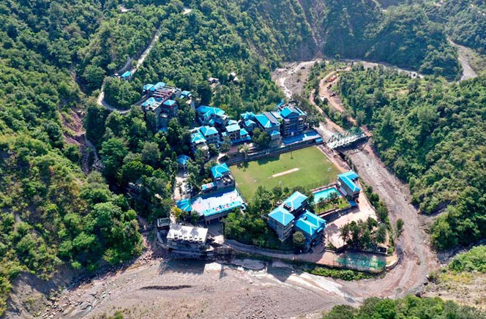

Best Co-Ed Boarding Schools in India
Discover the best co-ed boarding schools in India, offering world-class education, modern facilities, and holistic development. These schools provide a nurturing environment, blending academics, sports, and extracurricular activities to shape future leaders. With top-tier faculty and secure campuses, they ensure excellence in learning and personal growth. Enroll your child for a bright future!
https://pinegrove.in/boarding.aspx

Slide 4
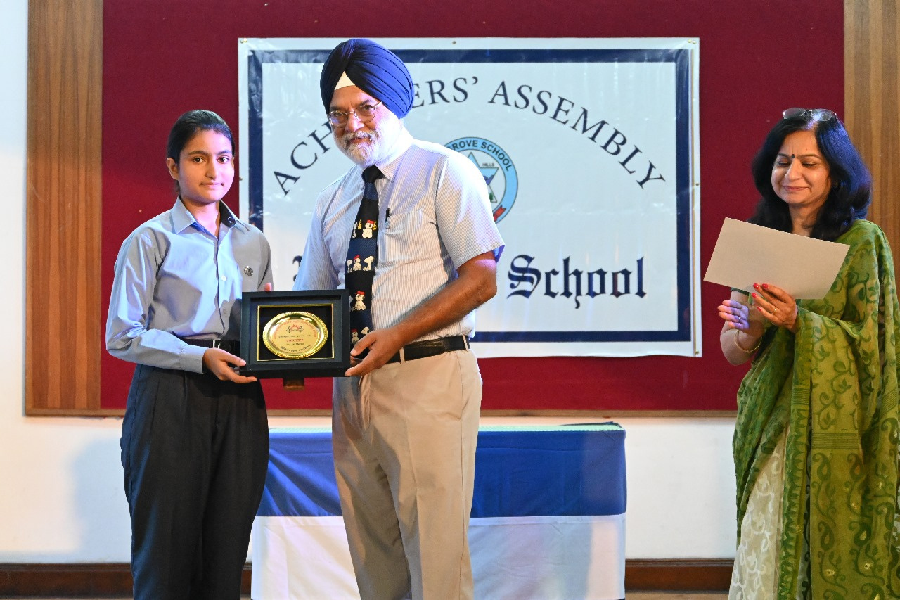

Portfolio
https://pinegrove.in/boarding.aspx

Slide 5



Contact Us
+91 980 5004 114 +91 980 5004 115
https://pinegrove.in/boarding.aspx
dharampur@pinegroveschool.com
subathu@pinegroveschool.com
Kuthar Road, Subathu 173 206 District Solan HP,India
Kasauli Road, Dharampur 173 209 District Solan HP,India

