Slide 1







https://pinegrove.in/location.aspx
Top Schools In Solan Himachal Pradesh
Start Slide

Slide 2
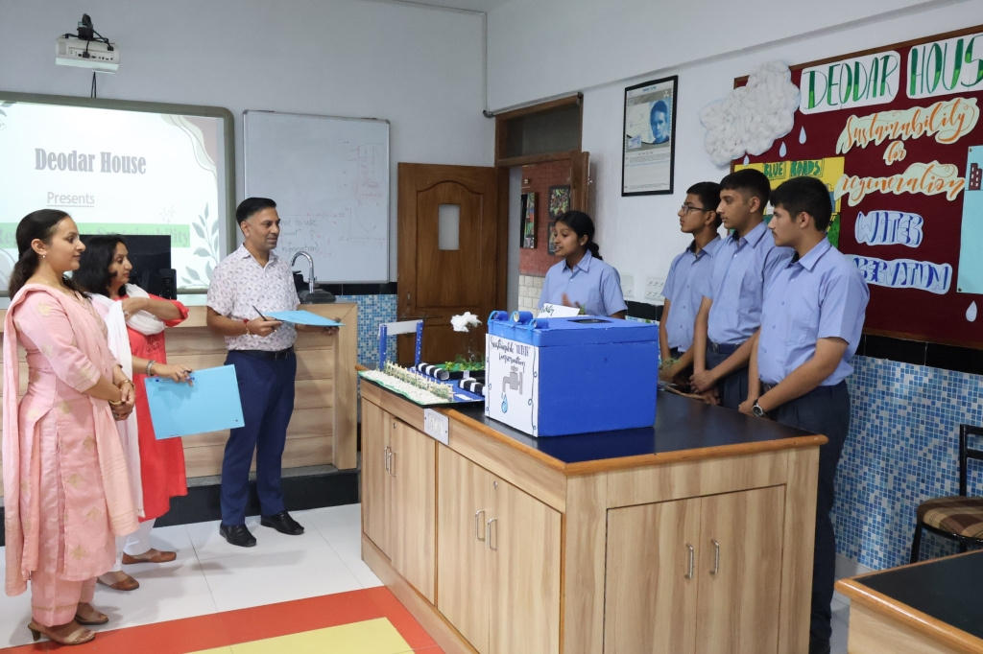
Pinegrove School, established in 1991, is a premier co-educational, fully residential CBSE boarding school in Himachal Pradesh. Nestled in the serene Shivalik Hills, it offers top-notch academics, sports, and extracurricular activities. With a strong focus on holistic education, Pinegrove nurtures students into confident, responsible individuals, making it one of India's finest residential schools.
https://pinegrove.in/index.aspx
Welcome To Our School

Slide 3
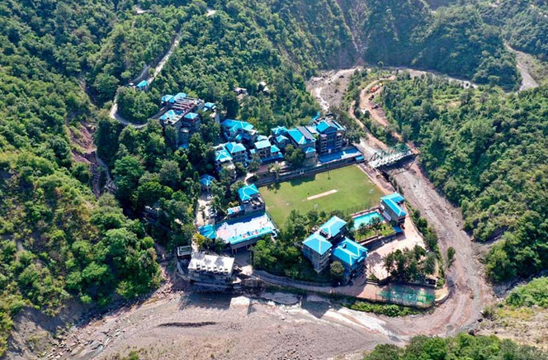

Best Boarding Schools In India
Pinegrove School, one of the best boarding schools in India, offers world-class education, modern facilities, and a nurturing environment. Established in 1991, it focuses on academic excellence, discipline, and holistic development. Nestled in the scenic Shivalik Hills, Pinegrove provides the perfect setting for students to grow into confident, responsible, and successful individuals.
https://pinegrove.in/index.aspx

Slide 4
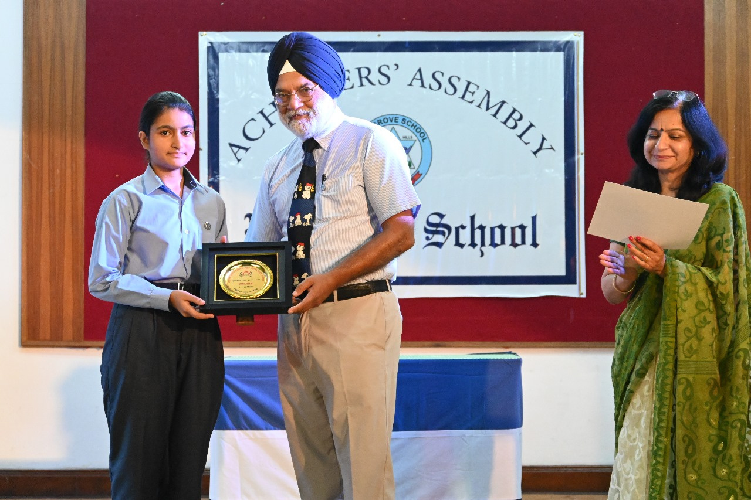

Portfolio
https://pinegrove.in/index.aspx

Slide 5



Contact Us
+91 980 5004 114 +91 980 5004 115
https://pinegrove.in/index.aspx
dharampur@pinegroveschool.com
subathu@pinegroveschool.com
Kuthar Road, Subathu 173 206 District Solan HP,India
Kasauli Road, Dharampur 173 209 District Solan HP,India

