Slide 1
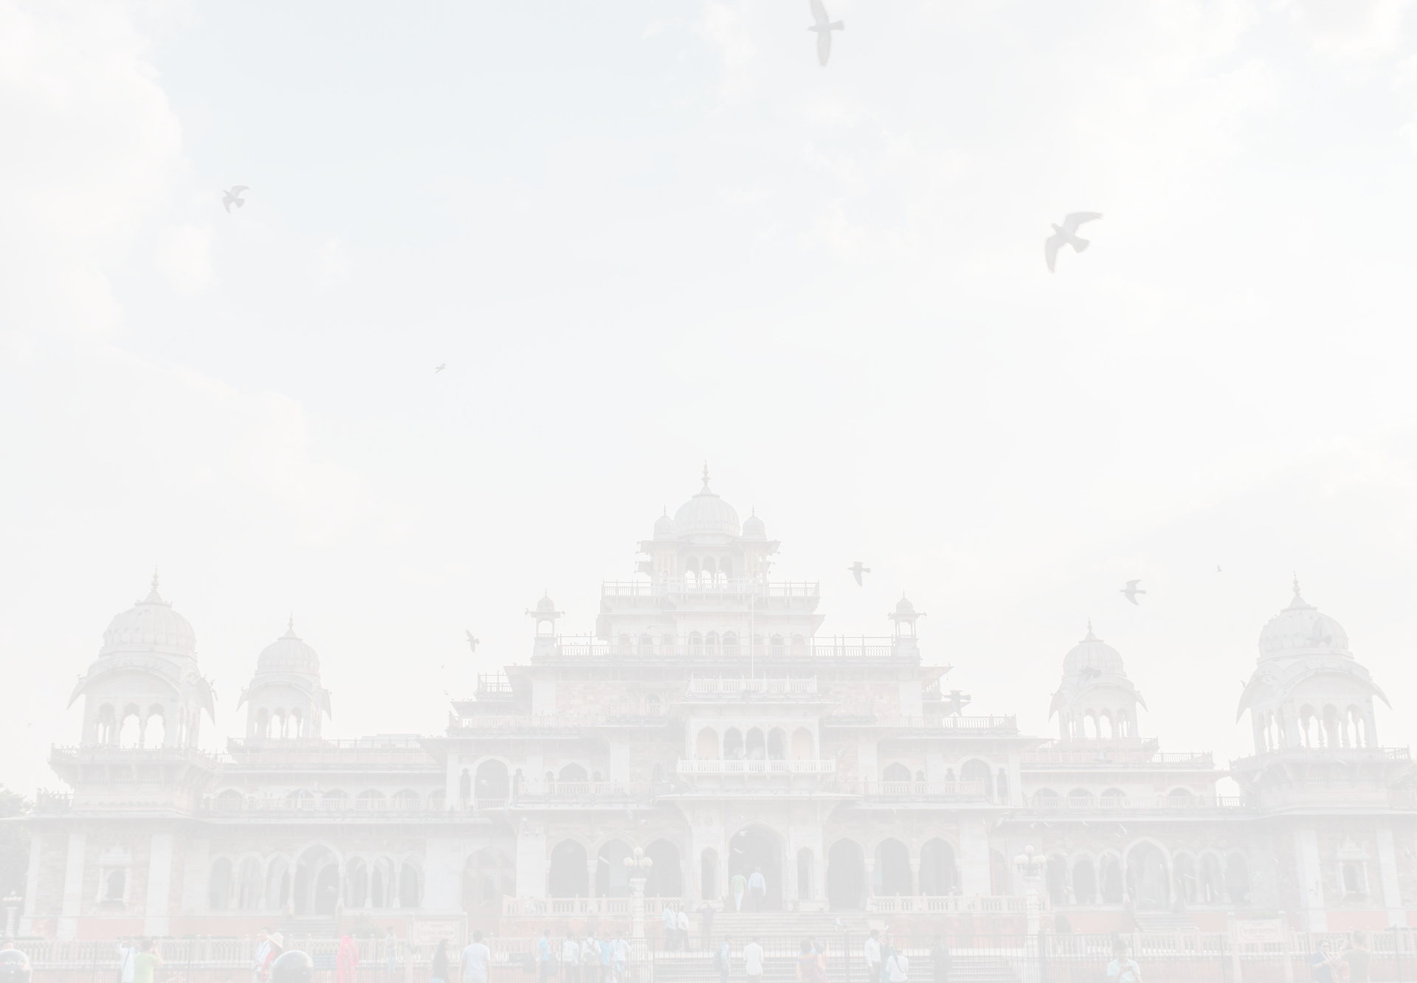

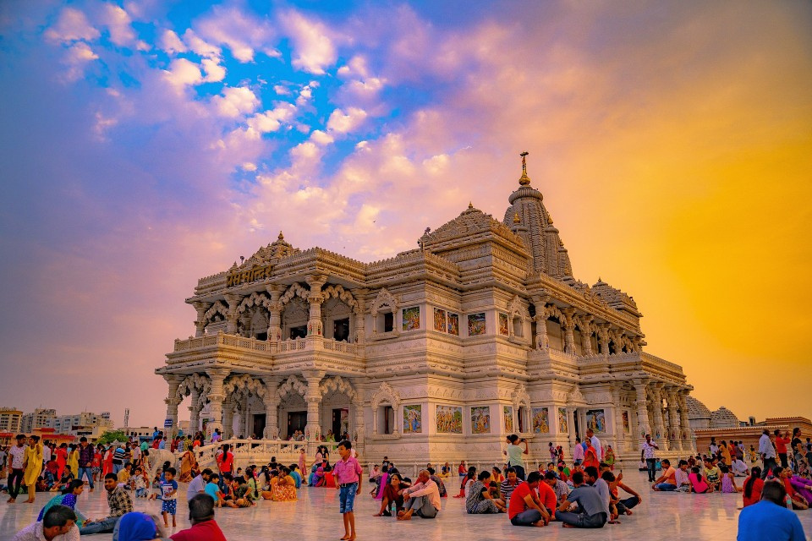

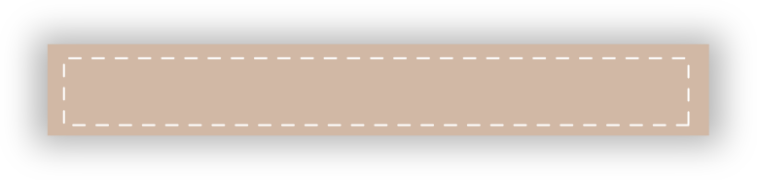
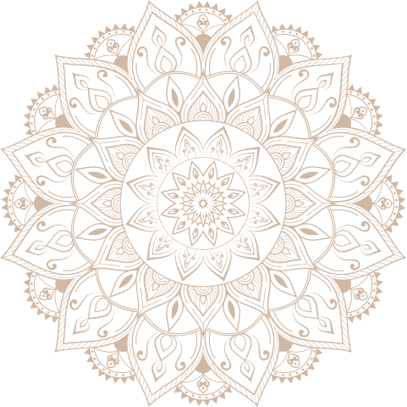
My
Mathura Holiday Tour Packages
5 PLACE TO VISIT IN MATHURA
HOLIDAYS BOOKING INDIA
https://www.holidaysbookingindia.com/destination/mathura

Slide 2
MATHURA HOLIDAY TOUR PACKAGES
Discover the best places to visit in Jaipur with Holidays Booking India! Explore Mathura, the birthplace of Lord Krishna, Perfect for families, couples, and friends, enjoy vibrant markets, rich heritage, and unforgettable memories in the Mathura . Plan you getaway with Holidays Booking India for an exceptional travel experience!
https://www.holidaysbookingindia.com/destination/mathura

Slide 3
  Shri Krishna Janmabhoomi
  Dwarkadhish Temple
  Vishram Ghat
  Kusum Sarovar
  Gita Mandir
https://www.holidaysbookingindia.com/destination/mathura

Slide 4


Contact Us
HOLIDAYS BOOKING INDIA
GROUND FLOOR, SHOP. NO 2, H. NO. 172, NEAR
BHAGAT COLONY WEST SANT NAGAR,
NORTH DELHI, DELHI - 110084
+91-9717883003
https://www.holidaysbookingindia.com/destination/mathura

