Slide 1




Hospital Medical Furniture Manufacturers
Reliable Solutions for Advanced Medical
Presented by: Naugra Medical
Website
https://www.naugramedical.com/hospital-medical-furniture

Slide 2



About Us
We are Naugra Medical, a leading name in the Medical and Hospital Lab Instruments industry. Our services include manufacturing, supplying, and exporting the associated medical instruments and equipment. We offer an integrated service to our clients to ease the necessities related to the medical field.
As Hospital and medical laboratory instruments manufacturers suppliers and exporters, we never compromise on the quality of the products that we deliver. Each piece of medical equipment and furniture that we manufacture features premium attributes. A perfect blend of effectivity and usability is what we work to achieve with our established collection.
Website
https://www.naugramedical.com/hospital-medical-furniture

Slide 3
Hospital Medical Furniture Manufacturers
Naugra Medical is a trusted Hospital Medical Furniture Manufacturer, providing high-quality furniture for hospitals, clinics, and healthcare facilities. Our extensive range includes hospital beds, bedside lockers, overbed tables, examination couches, and more.
Designed for durability, comfort, and efficiency, our furniture meets international quality standards. We ensure reliable, ergonomic, and cost-effective solutions to enhance patient care and medical professionals' convenience. Choose Naugra Medical for premium hospital medical furniture with superior functionality and long-lasting performance.
Website
https://www.naugramedical.com/hospital-medical-furniture

Slide 4
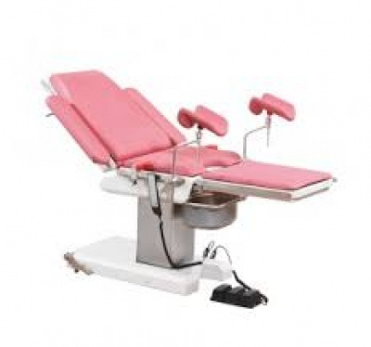
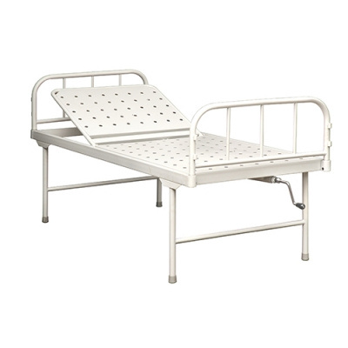
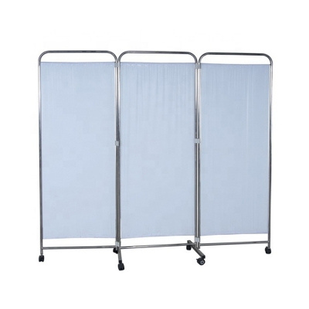
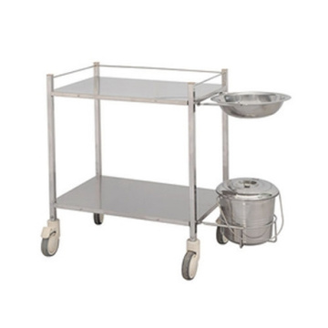
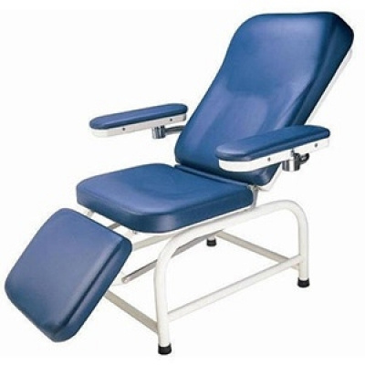
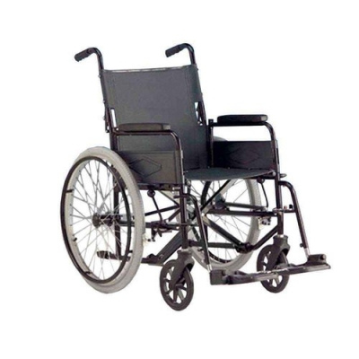
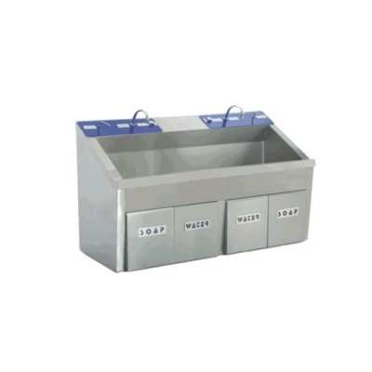
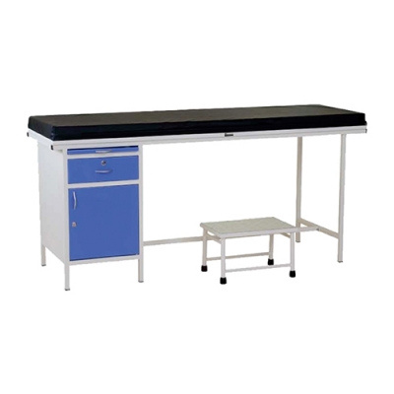
Website
https://www.naugramedical.com/hospital-medical-furniture

Slide 5
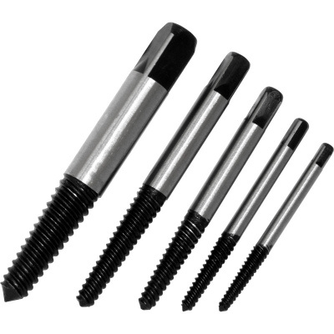
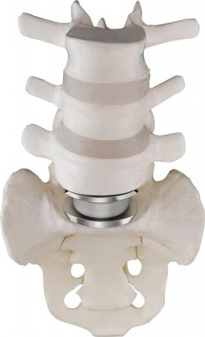
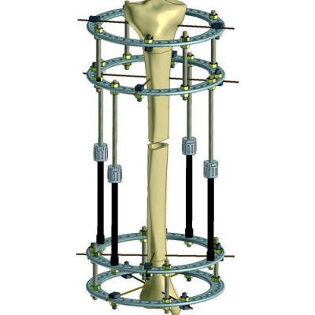

Thank You.
Get In Touch
Phone
+91-0171-2643080 , 2601773
Website
https://www.naugramedical.com/hospital-medical-furniture

