Slide 1
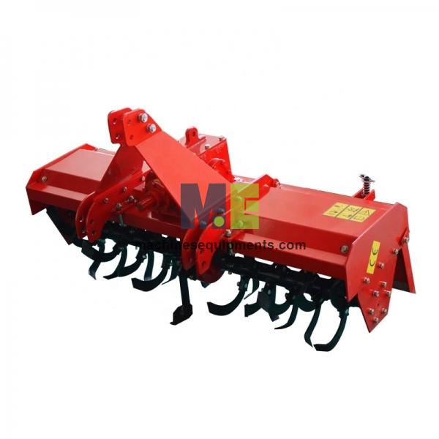
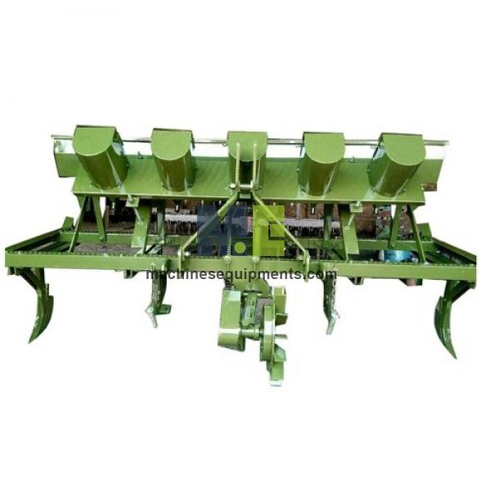

Machines Equipments
Agricultural Machinery And Equipment Exporters

Slide 2
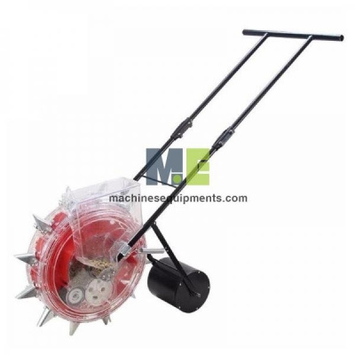
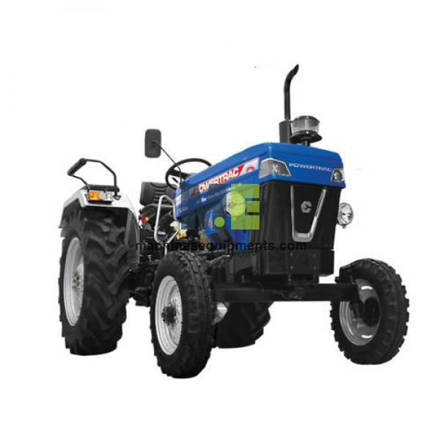
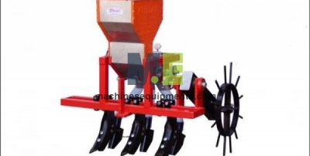
MachinesEquipments is a leading manufacturer, supplier, and exporter of high-quality agricultural machinery and equipment in China. Their extensive product range includes tractors, tillage implements, sowing equipment, harvesting machinery, threshers, and plant protection tools. Committed to eco-friendly solutions, they offer advanced machinery designed to enhance farming efficiency and productivity. With a focus on meeting diverse agricultural needs, MachinesEquipments provides reliable and cost-effective equipment to farmers worldwide. Their dedication to quality and innovation has established them as a trusted name in the agricultural industry.

Slide 3
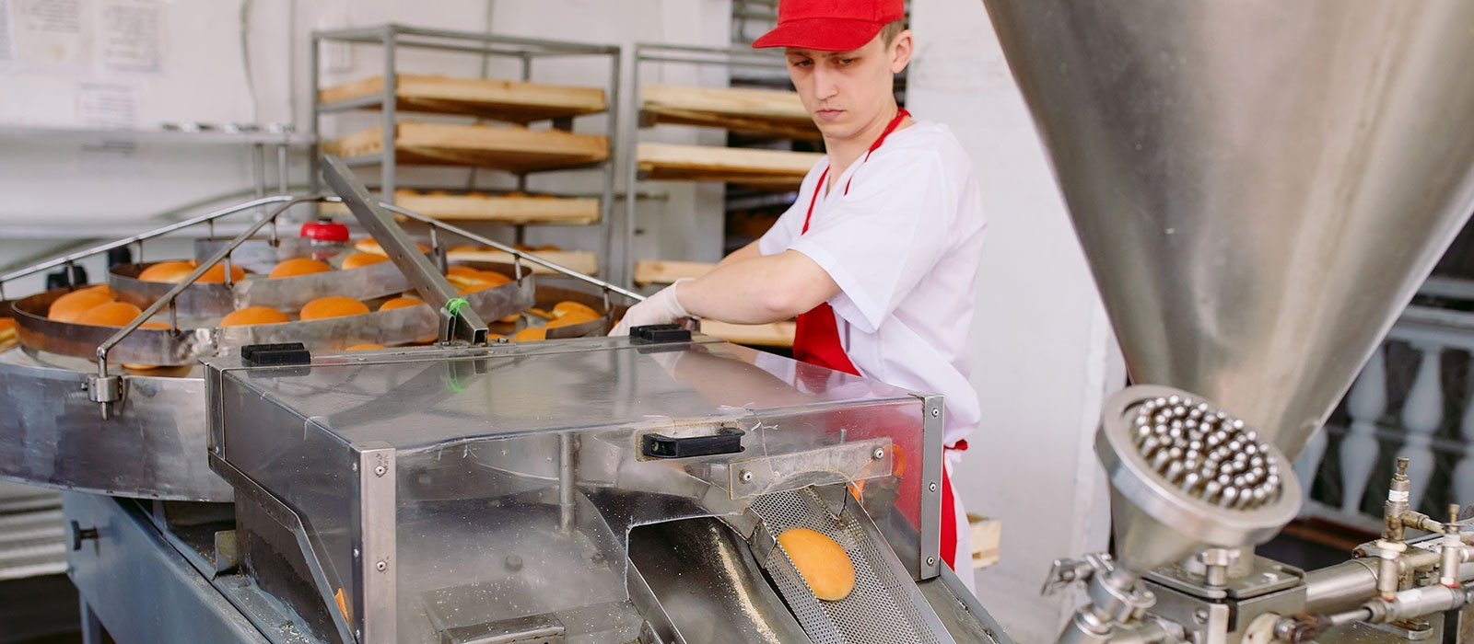

Thank You
sales@machinesequipments.com
https://www.machinesequipments.com/agricultural-machinery-and-equipment

