Slide 1


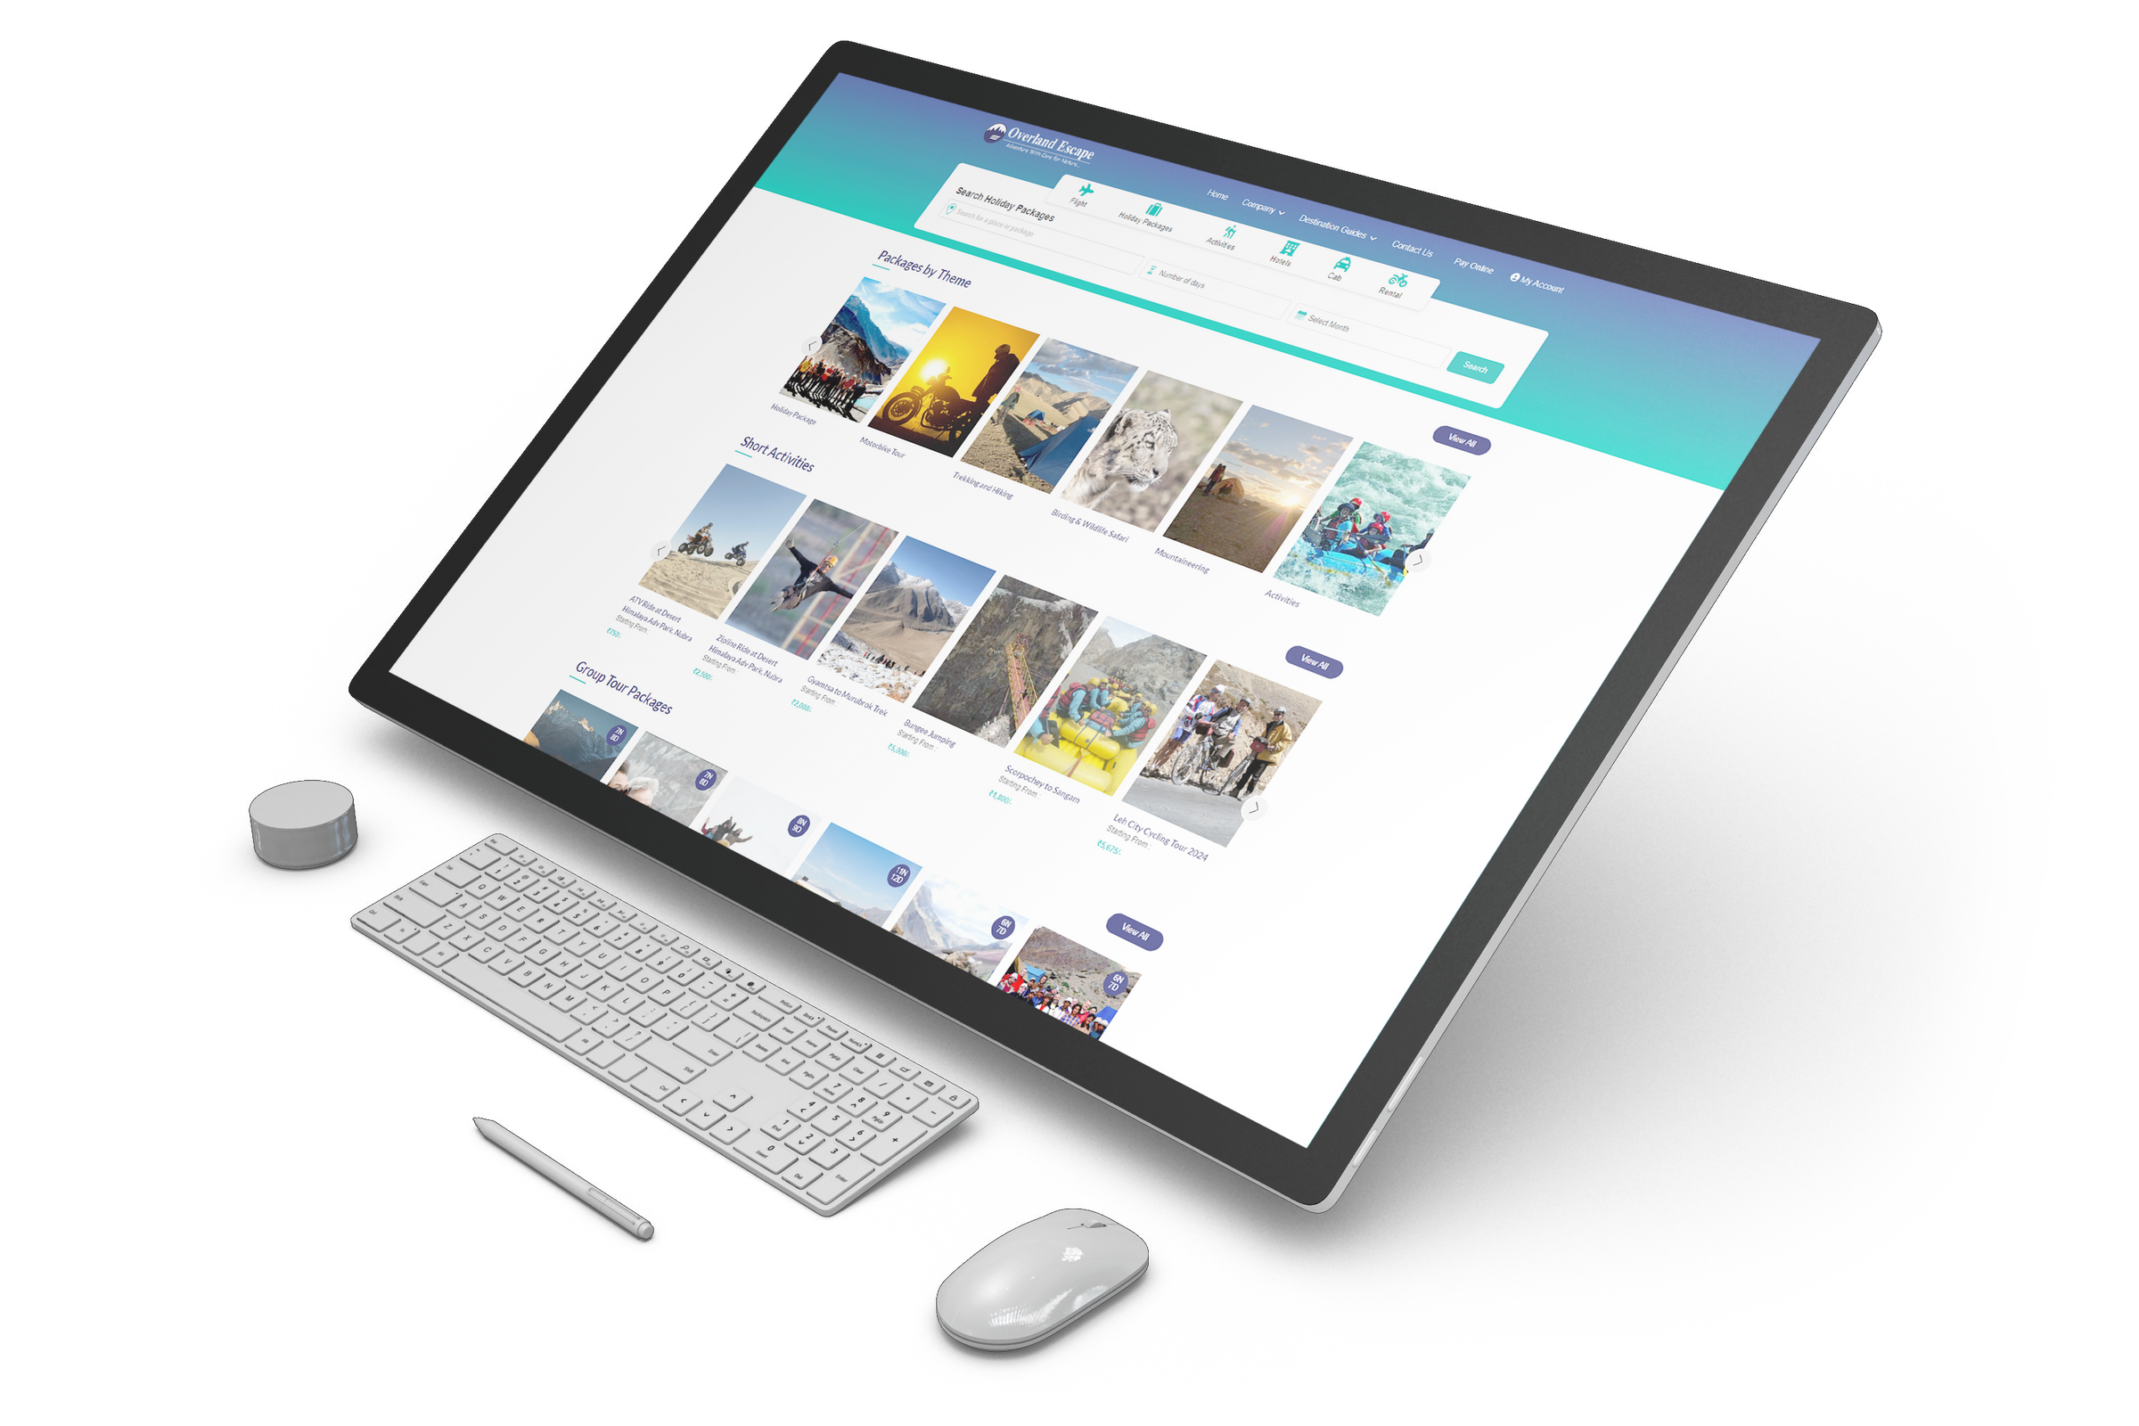
Travel Portal Software Solutions
By Travipro
Visit - https://www.travipro.com/travel-portal-development.html

Slide 2


TraviPro's travel portal development services offer a comprehensive online booking system tailored for travel management companies, destination management companies, travel aggregators, B2B and B2C travel agencies, tour operators, and home-based travel agents.
Key Features
  API Integration
  User Management Modules:
  E-Wallet and Payment Solutions
  Content Management System (CMS)
  Reporting and Analytics
  Multi-Currency and Multi-Language Support
  Dynamic Packaging System
  SEO-Friendly Architecture
https://www.travipro.com/travel-portal-development.html

Slide 3

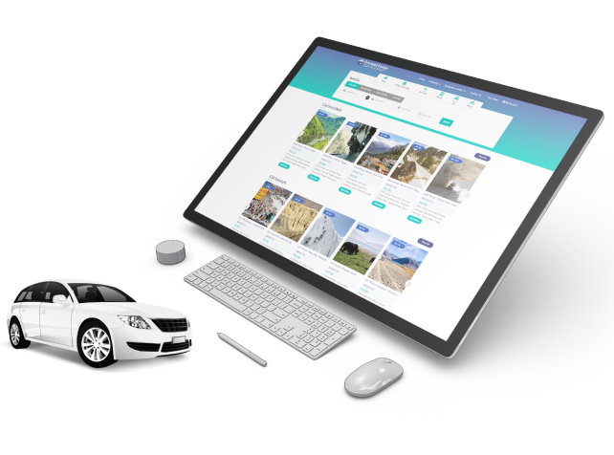
Address
B-112, Sector-64 Noida - 201301, Uttar Pradesh
Phone - +91 9560 433 318
Email - info@travipro.com
Visit- https://www.travipro.com/travel-portal-development.html

Slide 4
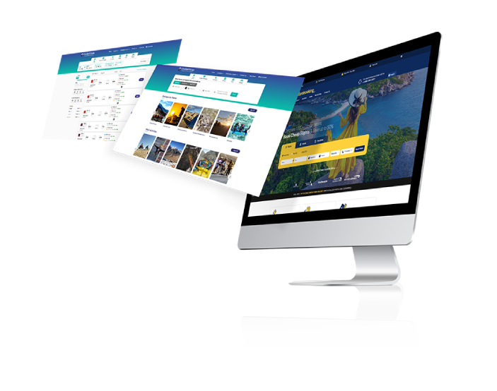

Thank You
https://www.travipro.com/travel-portal-development.html

