Slide 1



Best Residential Schools in India
A Premier Co-Ed Boarding Experience
Website:-
https://pinegrove.in/boarding.aspx

Slide 2

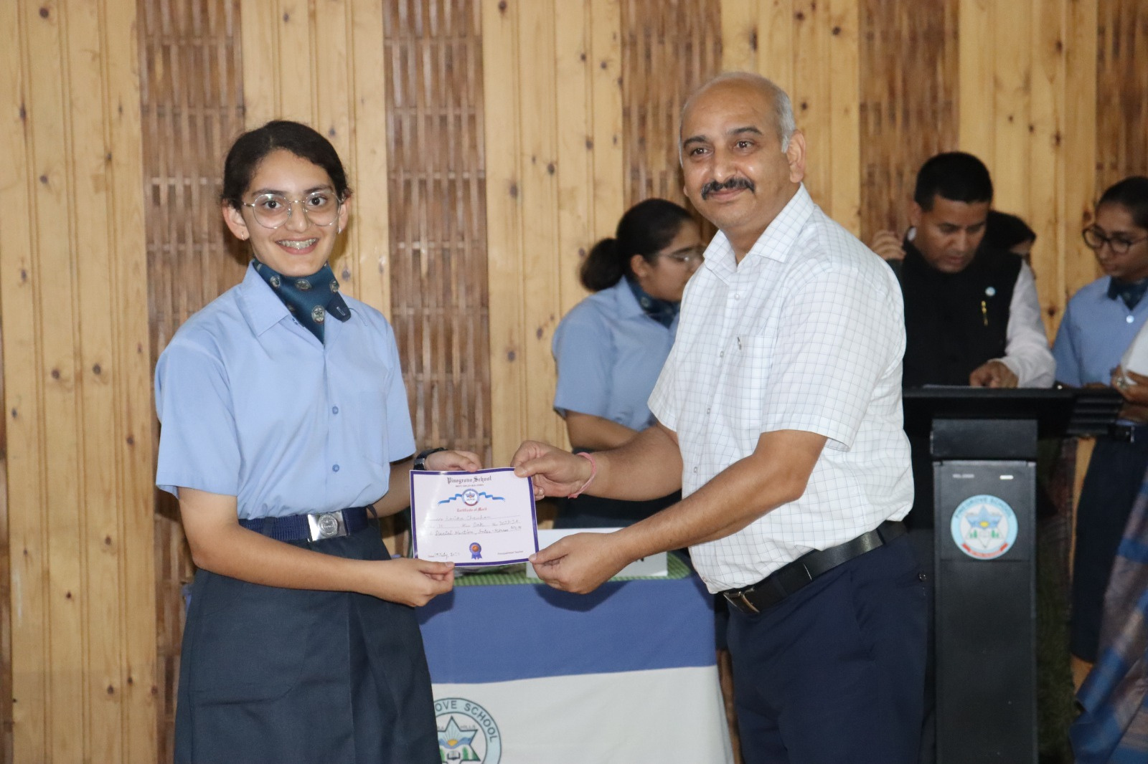
ABOUT US
  India’s Premier Boarding Schools: India is home to several top-tier residential schools that offer world-class education with a focus on both academics and extracurricular activities.
  Why Residential Schools? These schools provide a structured learning environment, helping students develop independence, leadership, and discipline.
  Pinegrove School’s Excellence: Among these, Pinegrove School stands out as a leading co-educational residential school, known for its balanced approach to academics and personal growth.
Website:-
https://pinegrove.in/boarding.aspx

Slide 3
Pinegrove School – Excellence in Boarding
  Modern Infrastructure: The school provides state-of-the-art facilities, including spacious dormitories with bunk beds, study areas, and attached washrooms to ensure comfort and hygiene.
  Holistic Development: Apart from academics, Pinegrove focuses on character building through sports, performing arts, and leadership training programs.
  Health & Safety: The school has a dedicated infirmary with a resident doctor and nurse to ensure students' well-being. The dining hall serves nutritious and well-balanced meals.
Website:-
https://pinegrove.in/boarding.aspx

Slide 4
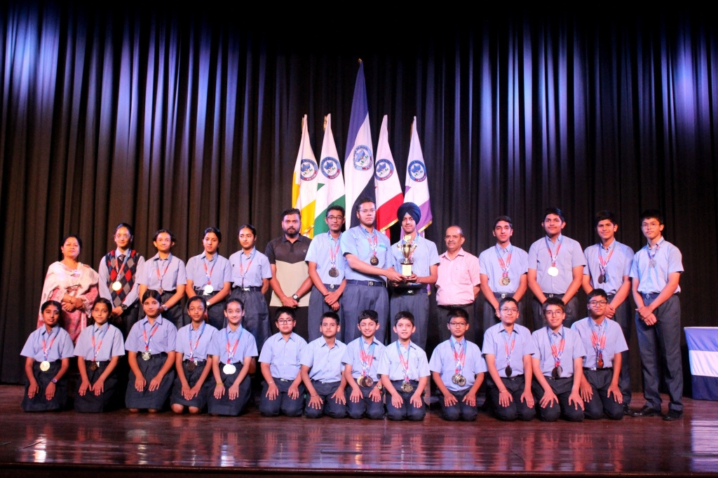


Why Choose Pinegrove School?
  Academic Excellence: The school follows a rigorous academic curriculum with experienced faculty ensuring top performance in board exams.
  Comprehensive Extracurricular Activities: Students engage in a variety of activities such as sports, music, drama, and debate to nurture their talents.
  Safe & Nurturing Environment: With round-the-clock supervision, a disciplined atmosphere, and a caring faculty, Pinegrove ensures a secure and supportive learning space.

Slide 5
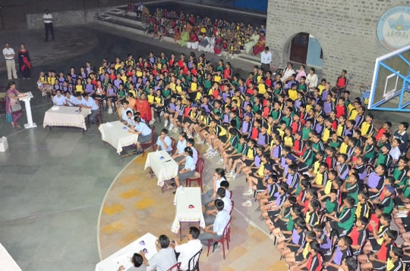
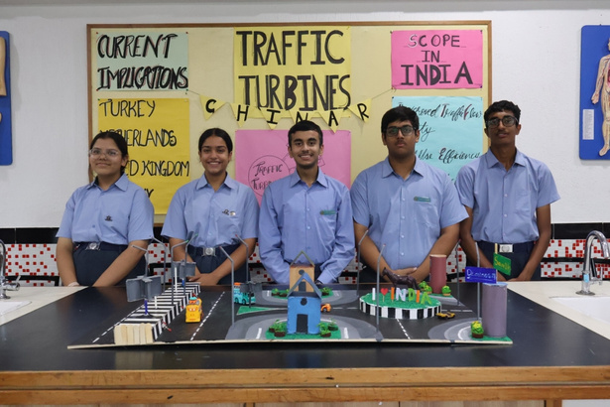
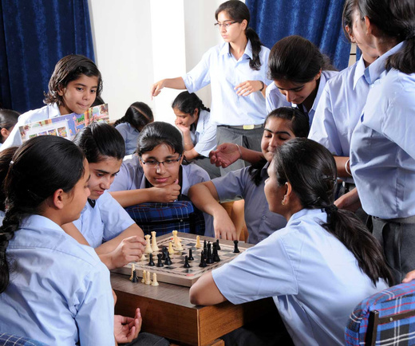
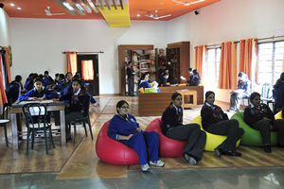
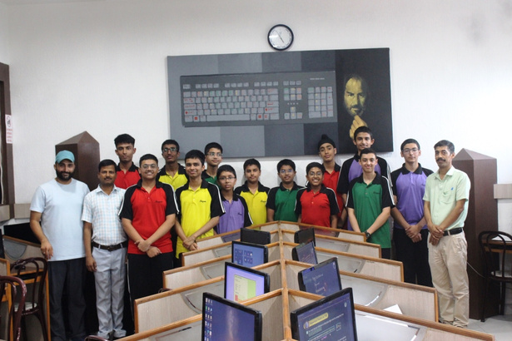
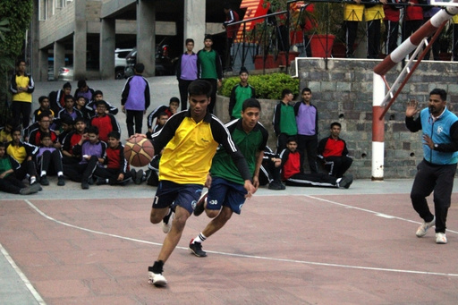
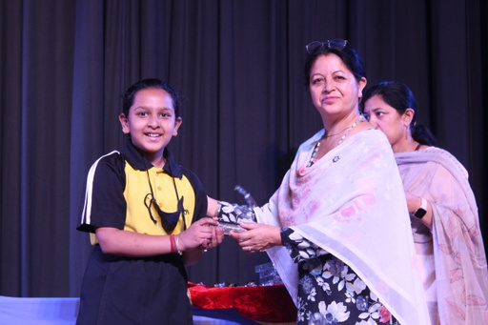
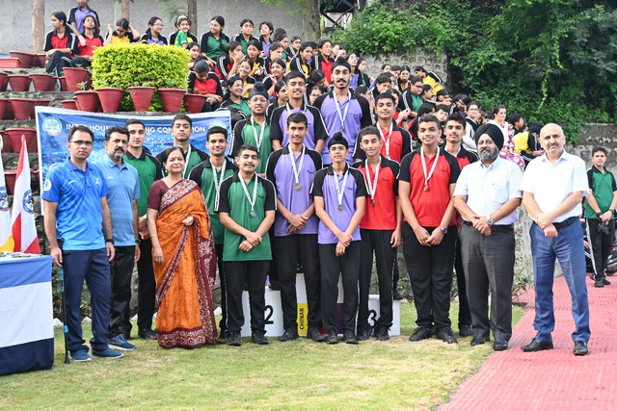
Website:-https://pinegrove.in/boarding.aspx

Slide 6



Website:-https://pinegrove.in/boarding.aspx
Thank's For Watching
Connect with us.
+91 980 5004 114
+91 980 5004 115
dharampur@pinegroveschool.com
subathu@pinegroveschool.com
Kuthar Road, Subathu 173 206 District Solan HP,India
Kasauli Road, Dharampur 173 209 District Solan HP,India

