Slide 1
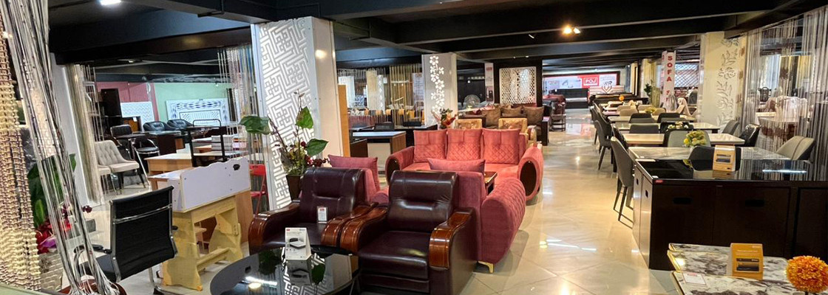

Furniture Franchise in Ranchi

Slide 2
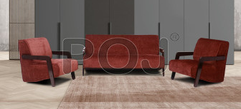

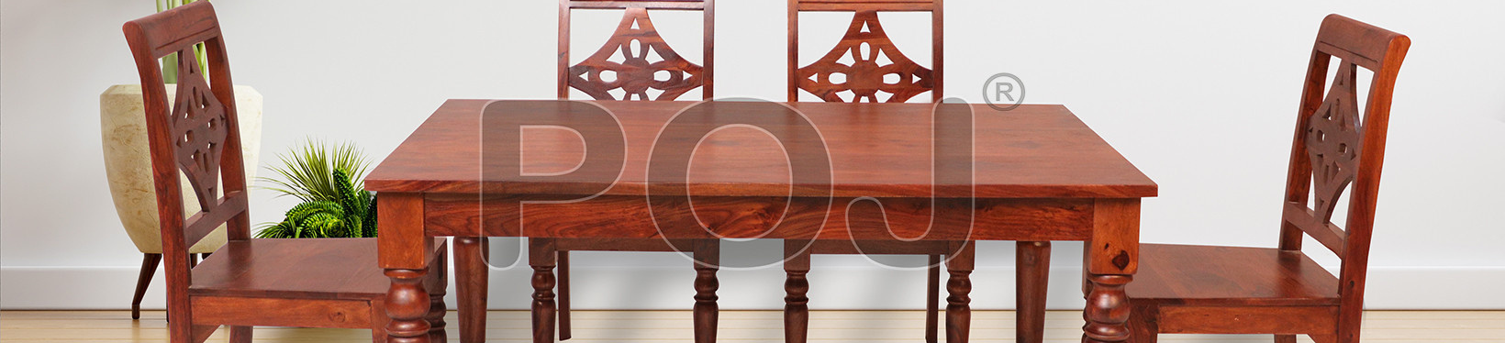
POJ Furniture's Ranchi showroom showcases premium home and office furniture, offering stylish and functional designs. As a leading Furniture Franchise in Ranchi, it provides quality solutions for diverse customer needs.

Slide 3
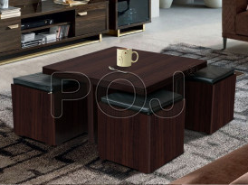
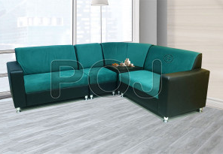

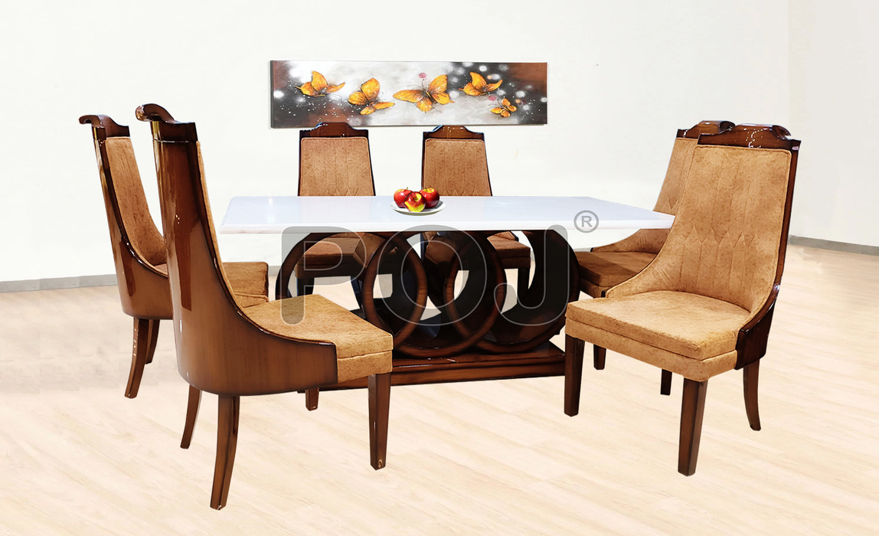
Address -2nd & 5th Floor, Roshpa Tower, Main Road, Ranchi , - 834001
Call- 9798721005
Email- pojfurniture@gmail.com
Visit - https://www.pojfurniture.com/our-showrooms/ranchi

