Slide 1



Car Rental Reservation System
By Travipro
https://www.travipro.com/car-rental-system.html

Slide 2


  TraviPro’s Car Rental System caters to car rental companies, travel consolidators, and travel agencies.
  It allows companies to manage inventory and reservations directly on their websites.
  Provides real-time vehicle availability and instant booking confirmations.
  Includes tools for managing bookings and quotations efficiently.
  Offers user-defined vehicle customization options for diverse customer needs.
  Simplifies reporting and analytics for better decision-making.
  Enhances vehicle security through tracking features.
  Promotes cost-effectiveness by managing maintenance and operational expenses.
  Enables online bookings and reservation status checks for customers.
  Improves customer satisfaction through streamlined and organized services.
https://www.travipro.com/travel-portal-development.html

Slide 3

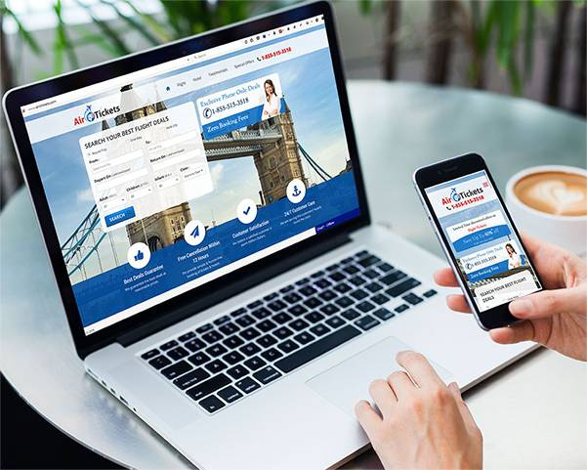
Address
B-112, Sector-64 Noida - 201301, Uttar Pradesh
Phone - +91 9560 433 318
Email - info@travipro.com
Visit- https://www.travipro.com/car-rental-system.html

Slide 4


Thank You
https://www.travipro.com/car-rental-system.html

