Slide 1





Talbros Engineering
Off-Highway Axle Shafts
https://talbrosaxles.com/products/off-highway-axle-shafts/

Slide 2
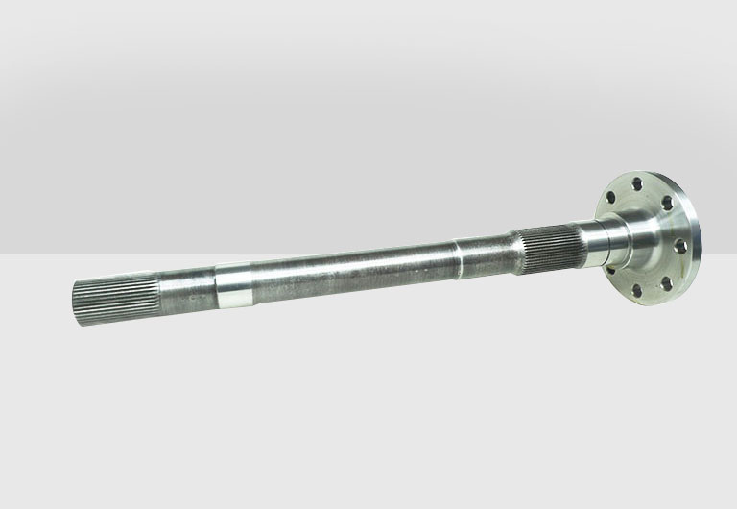
Off-Highway Axle Shafts
Talbros Axles specializes in manufacturing high-quality off-highway axle shafts designed for durability and performance. Their precision-engineered products cater to diverse off-highway applications, ensuring superior strength and reliability.
For more details visit us at:-
https://talbrosaxles.com/products/off-highway-axle-shafts/

Slide 3
Contact Us
Talbros Engineering
Email:-contact@vinitec.in
Address:- Plot No. 74-75-76, Sector-6 Faridabad 121006 ( Haryana)
Contact No.: +91-129-4284300
Website:- https://talbrosaxles.com/products/off-highway-axle-shafts/

