Slide 1




Siddhi Matrimonials
Marriage Bureau in Gurgaon

Slide 2
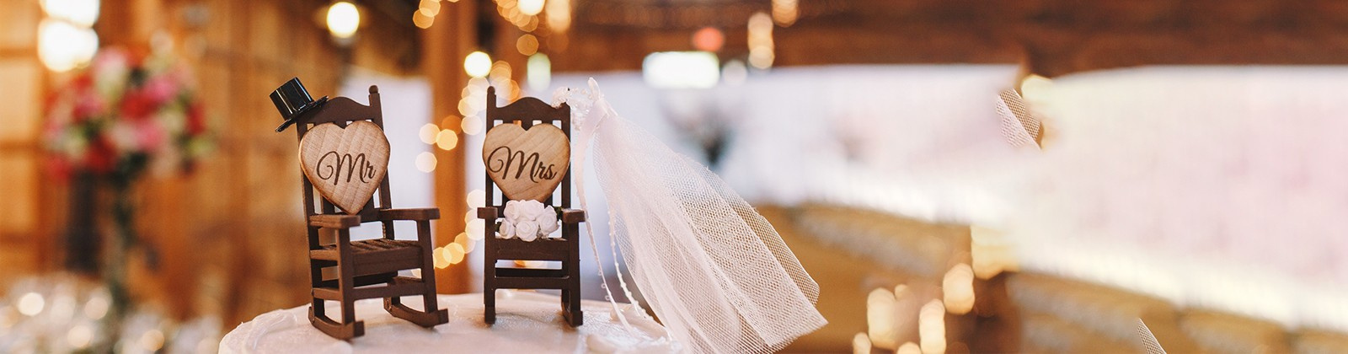
Siddhi Matrimonials, a trusted marriage bureau in Gurgaon, offers personalized matchmaking services to help individuals find their perfect life partner. With a vast database of verified profiles and a dedicated team, the bureau ensures a seamless and secure process. Their commitment to understanding client preferences makes them a top choice for matrimonial services in Gurgaon. Experience reliable matchmaking solutions tailored to your unique needs with Siddhi Matrimonials.

Slide 3



Address
1497, 2nd floor, Kotla Mubarakpur, Opp. Oncoplus Hospital, Defence Colony, Delhi – 110003
Phone - +91 78386 86853
Website - https://siddhimatrimonials.com/matrimonial-services-in-gurgaon

Slide 4
Thank You
Visit - https://siddhimatrimonials.com/matrimonial-services-in-gurgaon

