Slide 1
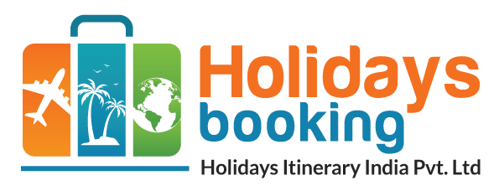

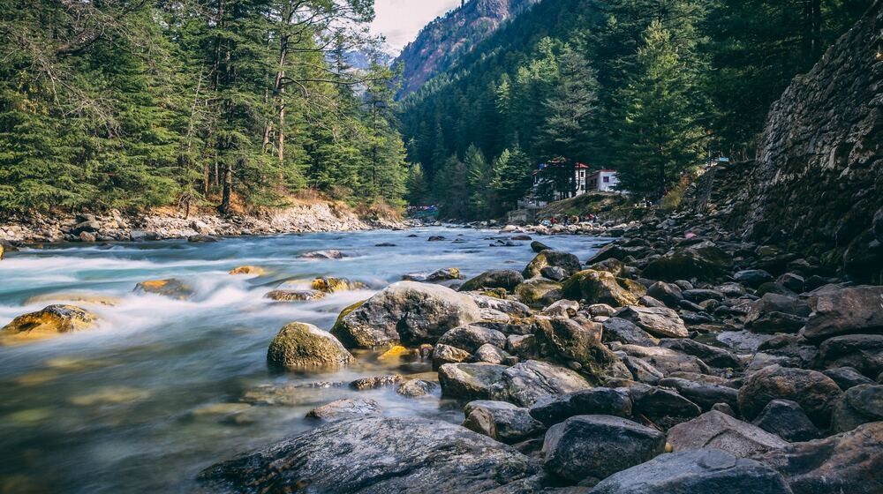
Home
Destinations
Packages
Theme
TRAVEL PRESENTATION TEMPLATE
BEST HIMACHAL PRADESH TOUR PACKAGES FOR FAMILY
Presented By: Holidaysbookingindia
Get Started
Website
https://www.holidaysbookingindia.com/tour-packages/himachal-pradesh

Slide 2

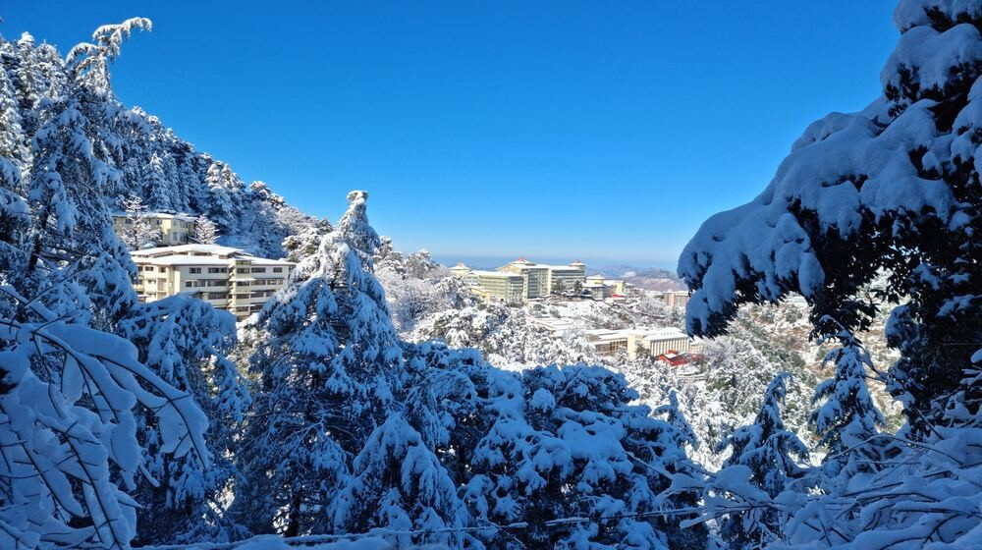
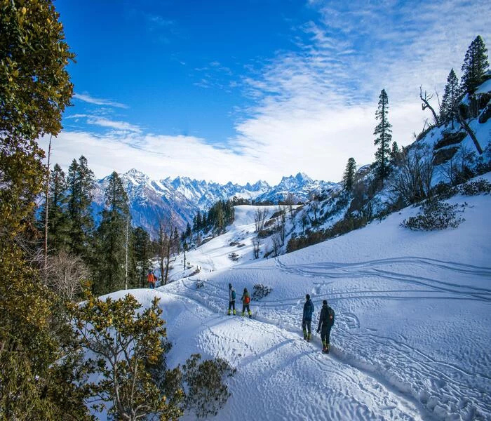
Home
Destinations
Packages
Theme
Best Himachal Pradesh Tour Packages for Family
Best Himachal Pradesh Tour Packages for Family – Discover the beauty of Himachal Pradesh with Holidays Booking India. Our specially curated family tour packages offer scenic landscapes, adventure activities, and cultural experiences. Enjoy hassle-free travel, comfortable stays, and guided tours, making your family vacation truly memorable. Book now for an unforgettable journey!
Website
Learn More
https://www.holidaysbookingindia.com/tour-packages/himachal-pradesh

Slide 3
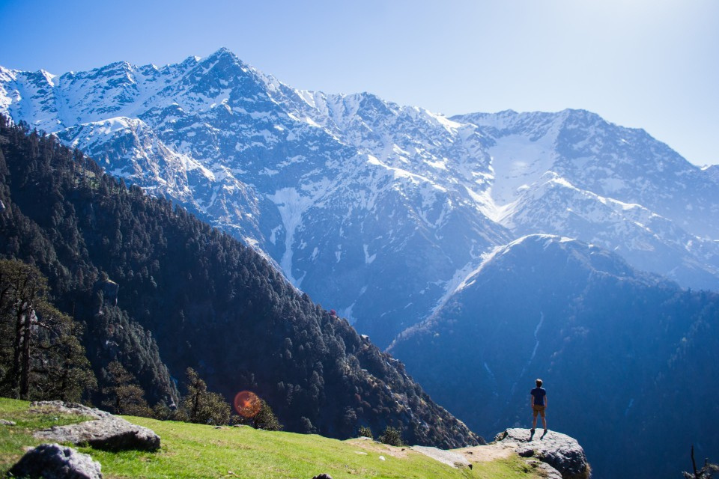
Home
Destinations
Packages
Theme
Must-Visit Attractions
  Shimla
  Manali
  Dharamshala
Website
https://www.holidaysbookingindia.com/tour-packages/himachal-pradesh

Slide 4

Adventure and Activities
Outdoor Adventures
  Trekking
  Paragliding
  Skiing
  Toy Train Ride
  Camping
Why Choose Holidays Booking India?
  Tailored Packages
  Unmatched Services
  Customer Support

Slide 5
Home
About
Contact
THANK YOU
Get in Touch
FOR YOUR ATTENTION
Phone Number
Email
+91 9717883003
info@holidaysbookin.com
Website
https://www.holidaysbookingindia.com/tour-packages/himachal-pradesh

