Slide 1


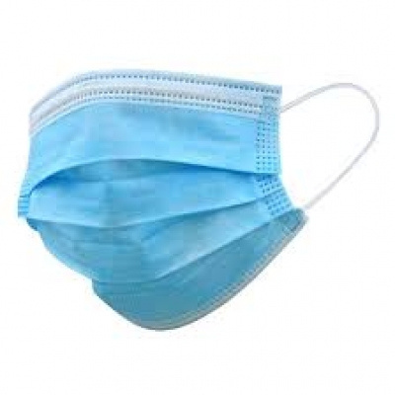


PRESENTATION
Medical Disposables Exporters
Website
https://www.naugramedical.com/medical-disposables

Slide 2




About Us
NaugraMedical is a leading hospital and medical lab equipments manufacturers, supplier and exporters in India. NaugraMedical is manufacturing & supplying a best quality of medical and hospital lab instruments in all over the world.
Website
https://www.naugramedical.com/medical-disposables

Slide 3
Medical Disposables Exporters
Naugra Medical is a trusted Medical Disposables Exporter, offering a wide range of high-quality, sterile, and reliable disposable medical products. We cater to hospitals, clinics, and healthcare facilities worldwide, ensuring safety and hygiene in every product. Our extensive inventory includes syringes, gloves, masks, and surgical gowns, meeting international standards.
Website
https://www.naugramedical.com/medical-disposables

Slide 4

Thank You.
Get In Touch
Phone
+91-0171-2643080 , 2601773
Website
https://www.naugramedical.com/medical-disposables

