Slide 1



PINEGROVE SCHOOL
Schools in Himachal Pradesh
Website:-
https://pinegrove.in/

Slide 2

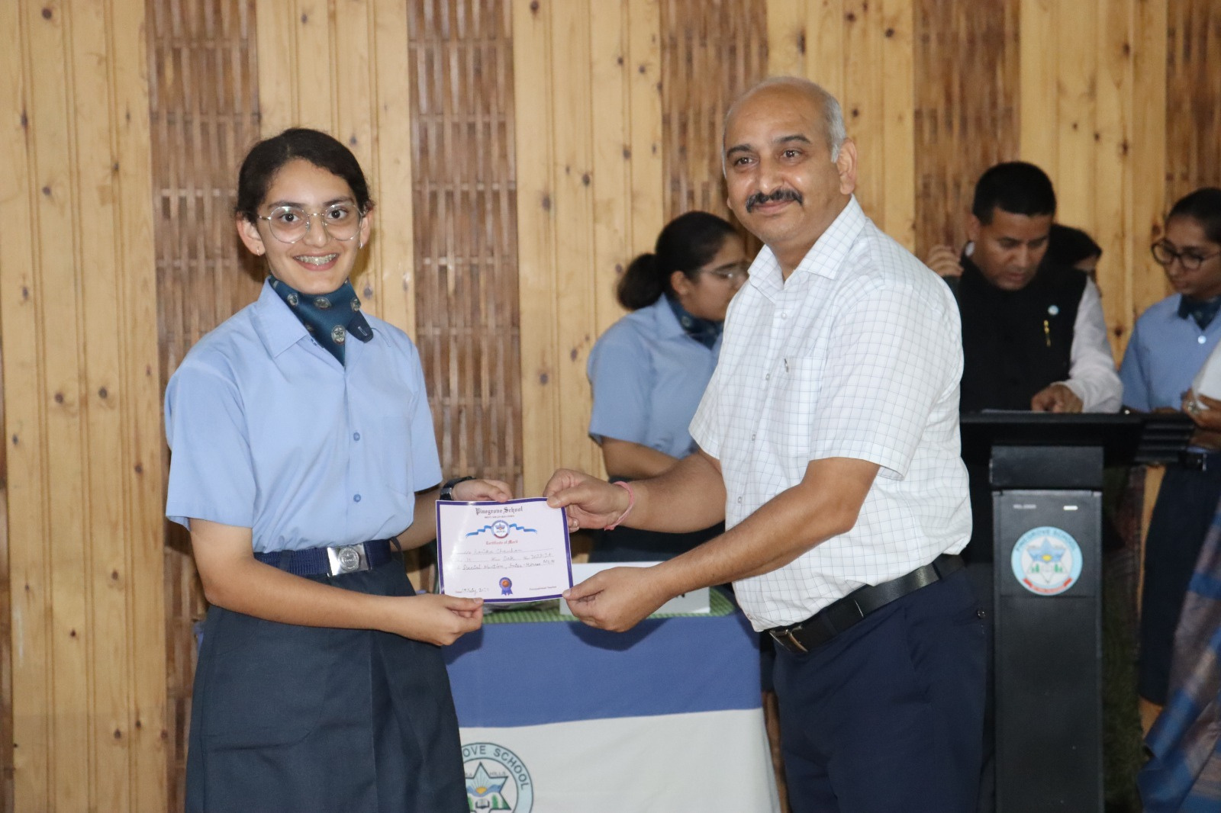
ABOUT US
Pinegrove School is among the best residential schools in India, renowned for its commitment to holistic education and excellence. Established in 1991, it is a co-educational, English-medium school affiliated with the CBSE board. Located in the picturesque Solan district of Himachal Pradesh, Pinegrove operates across two campuses: Dharampur and Subathu. These campuses are set amidst the serene Shimla Hills, providing an ideal learning environment
Website:-
https://pinegrove.in/

Slide 3
Schools in Himachal Pradesh
Pine Grove School offers top-tier education, making it one of the best schools in Himachal Pradesh. With state-of-the-art facilities, experienced faculty, and a focus on academics and extracurricular activities, we ensure holistic development for your child. Our secure and nurturing environment helps students excel and grow into confident individuals. Enroll today for a brighter future!.
Website:-
https://pinegrove.in/

Slide 4
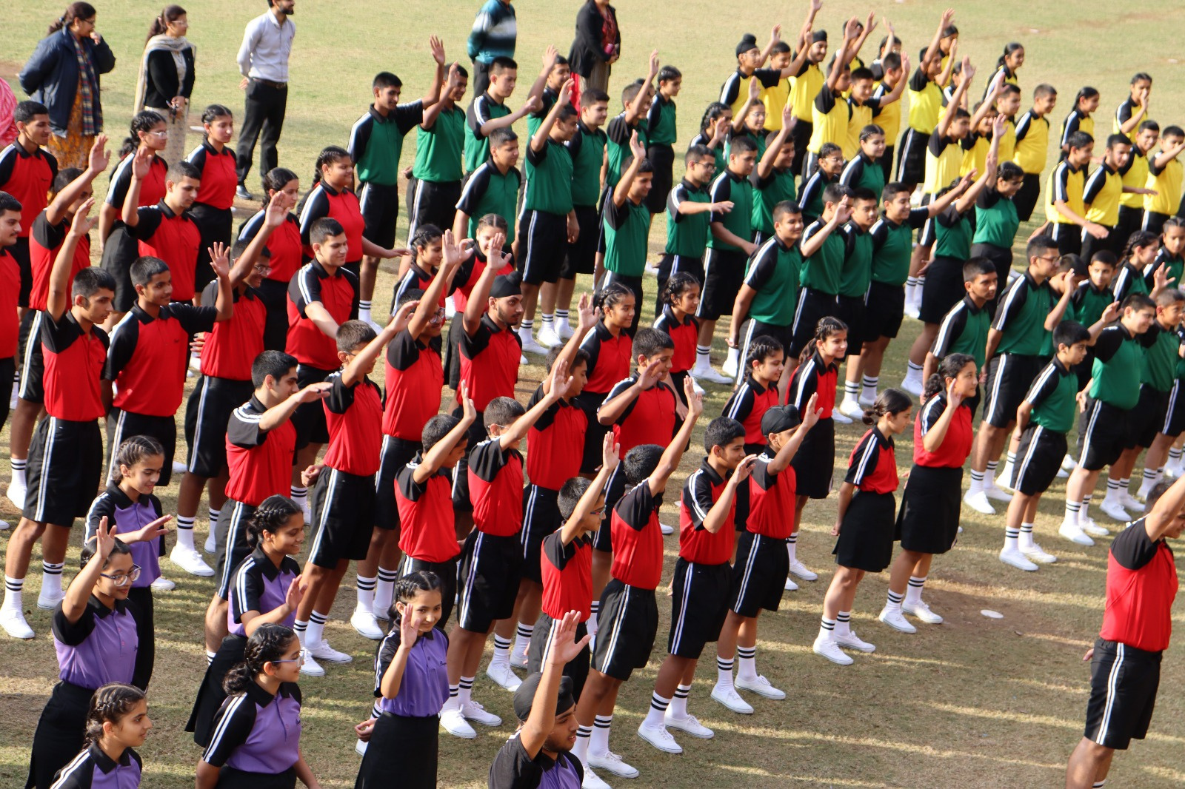
EXCELLENCE IN ACADEMICS
  Pinegrove School is known for its consistent academic achievements.
  Provides a strong foundation for higher education and competitive exams.
HOLISTIC DEVELOPMENT
  Focuses on co-curricular and extracurricular activities.
  Encourages participation in sports, arts, and cultural events.
VALUE-BASED EDUCATION
  Emphasizes discipline, integrity, and moral values.
  Creates a well-rounded personality for students.
STATE-OF-THE-ART FACILITIES
  Offers modern classrooms and advanced infrastructure.
  Provides access to top-notch sports facilities and learning resources.

Slide 5
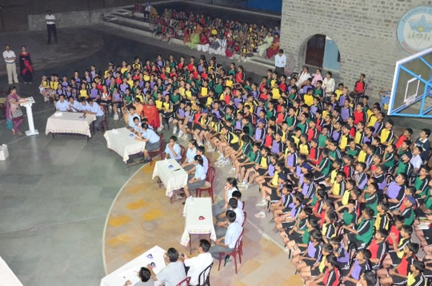
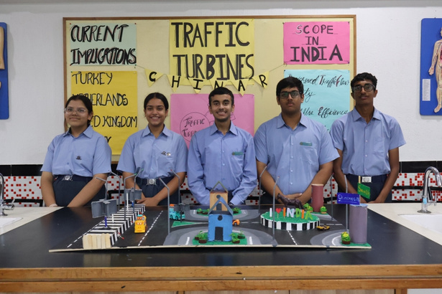
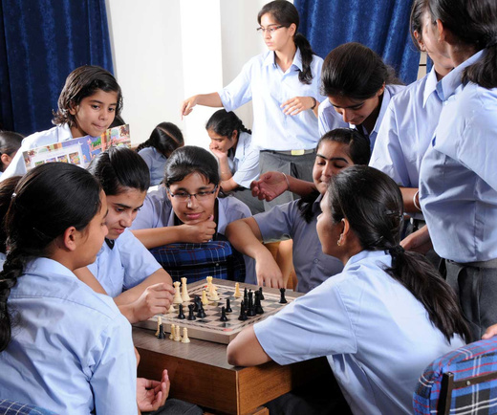
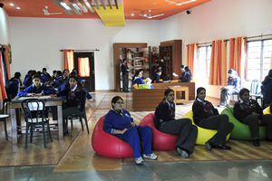
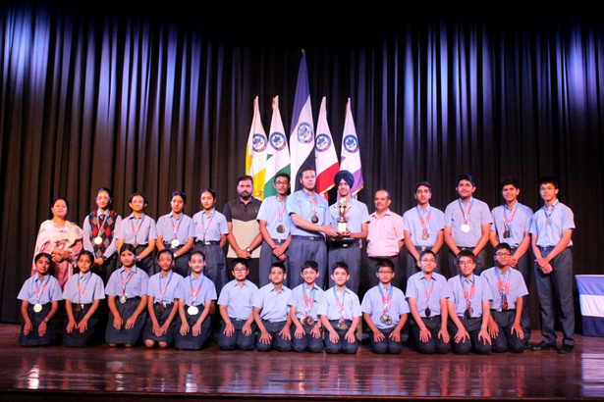
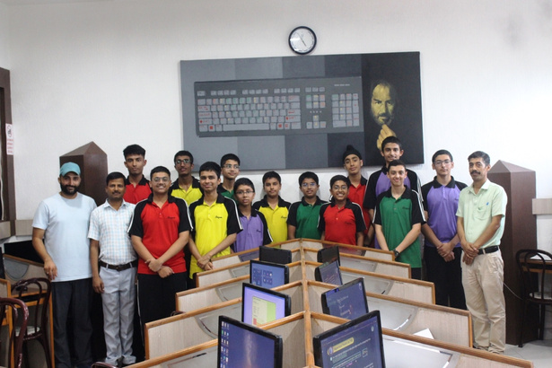

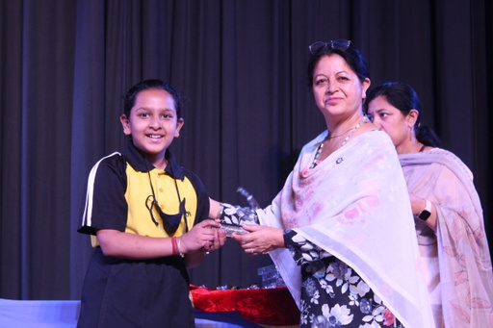
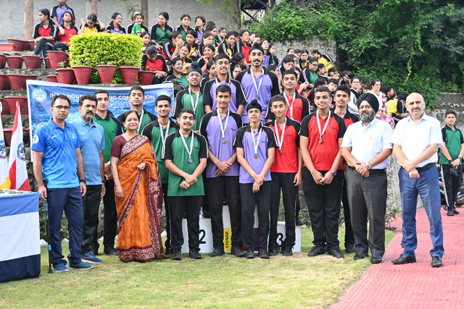
Website:-https://pinegrove.in/

Slide 6



Website:-https://pinegrove.in/
Thank's For Watching
Connect with us.
+91 980 5004 114
+91 980 5004 115
dharampur@pinegroveschool.com
subathu@pinegroveschool.com
Kuthar Road, Subathu 173 206 District Solan HP,India
Kasauli Road, Dharampur 173 209 District Solan HP,India

