Slide 1

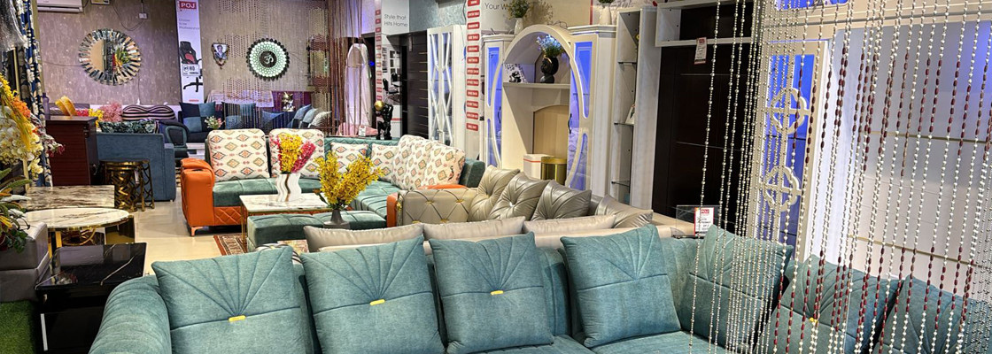
POJ Furniture

Slide 2
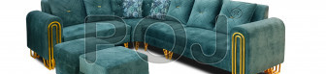
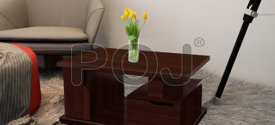
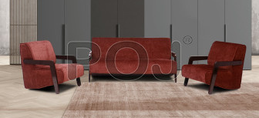
Buy Furniture for Your Living Room Online from POJ Furniture and give your living room a new and aesthetic look

Slide 3


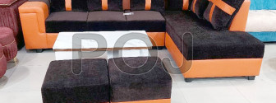
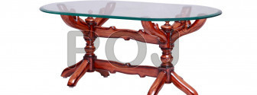
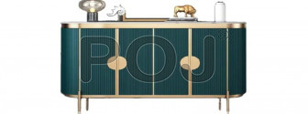
Thank You
Visit - https://www.pojfurniture.com/products/living-room-furniture

