Slide 1



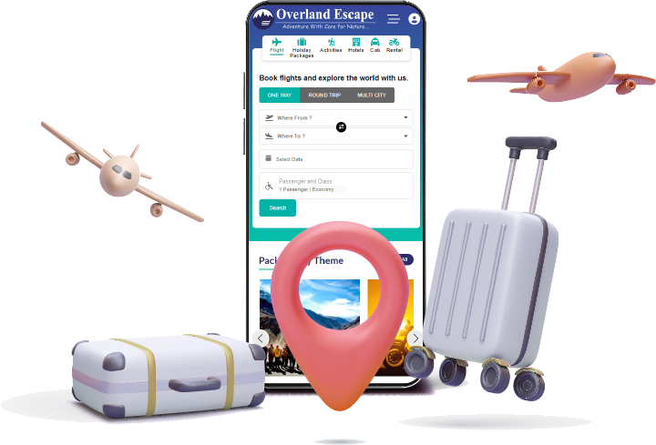

Flight Booking Portal Development in India
By Travipro
https://www.travipro.com/hotel-website-development.html

Slide 2

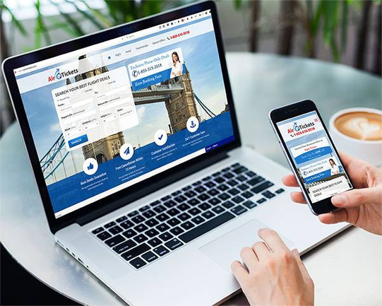
TraviPro offers advanced flight booking portal development tailored to meet diverse business needs. Their robust platform provides seamless booking experiences with features like real-time ticket availability, dynamic pricing, and multiple payment options. Designed for efficiency, it supports B2B and B2C models, ensuring enhanced user engagement and streamlined operations for travel agencies. TraviPro simplifies travel management with cutting-edge solutions.
https://www.travipro.com/travel-portal-development.html

Slide 3



Address
B-112, Sector-64 Noida - 201301, Uttar Pradesh
Phone - +91 9560 433 318
Email - info@travipro.com
Visit- https://www.travipro.com/flight-booking-portal-development.html

Slide 4
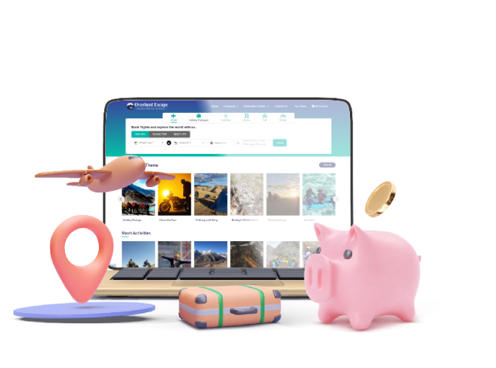
Thank You
https://www.travipro.com/flight-booking-portal-development.html

