Slide 1

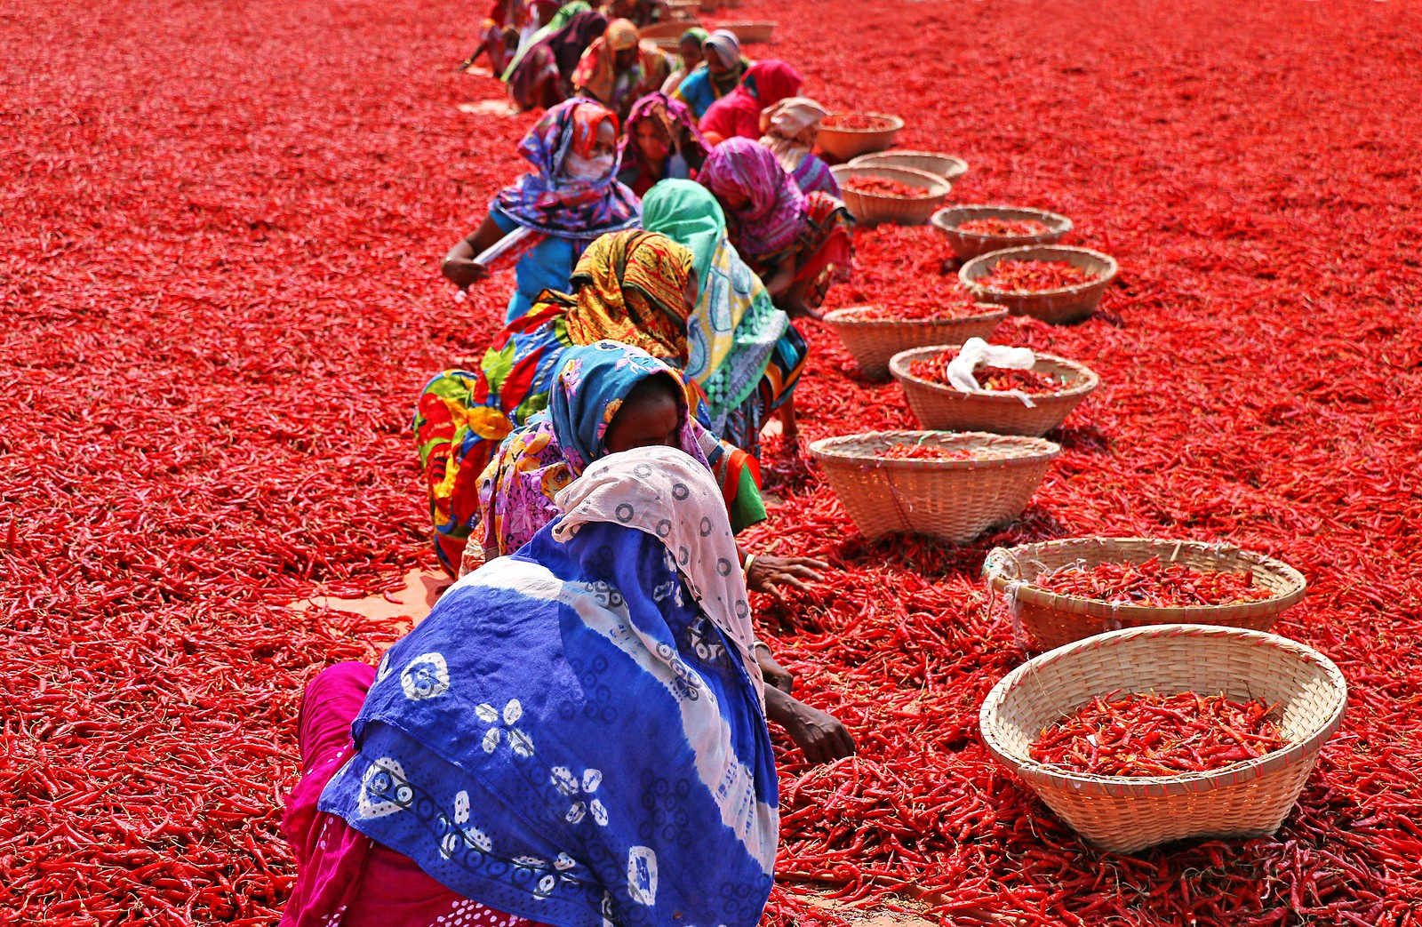
Agrocrops
Dry Red Chilli Wholesale Suppliers

Slide 2
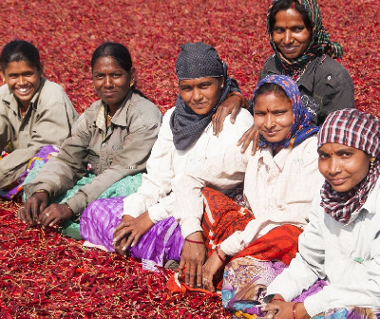
Agrocrops, a leading Indian dry red chilli exporter, sources high-quality produce directly from smallholder farmers. Their meticulous process includes thorough sorting, repeated verification, and modern machinery usage to ensure superior quality. Notably, they employ a 100% female workforce, providing training and stable livelihoods.

Slide 3
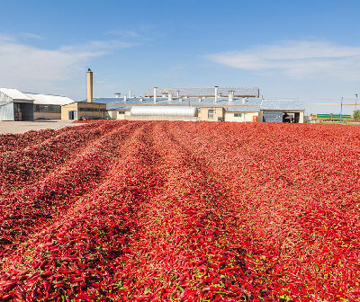
Address- D.No 25-16-180, 181,
Mirichi Yard Road, Guntur, Andhra Pradesh, 522005
Email Us - contact@agrocrops.com
Call us - +91 97013 63424
Website- https://www.spicesindia.net/

Slide 4

Thank You
Visit - https://www.spicesindia.net/

