Slide 1
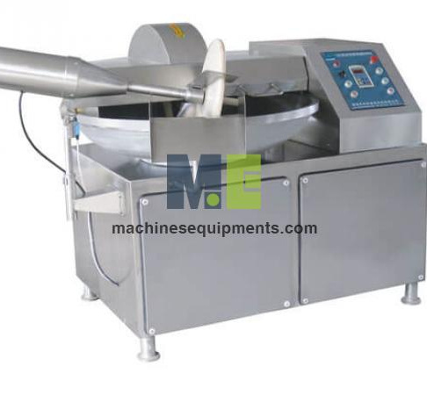
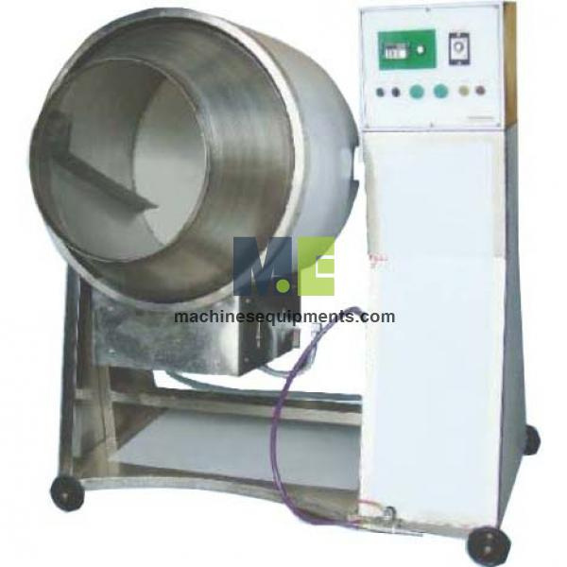

Machines Equipments
Meat Processing Machines Exporters

Slide 2
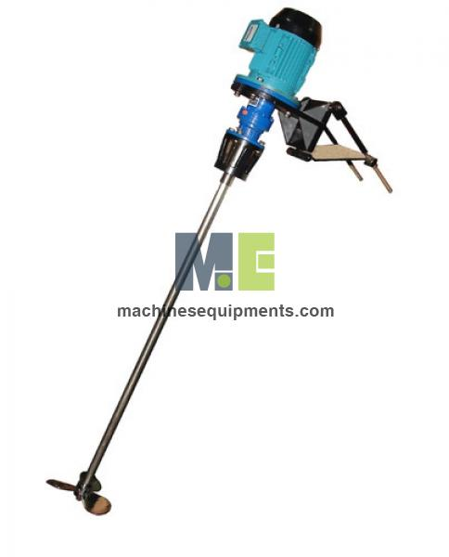
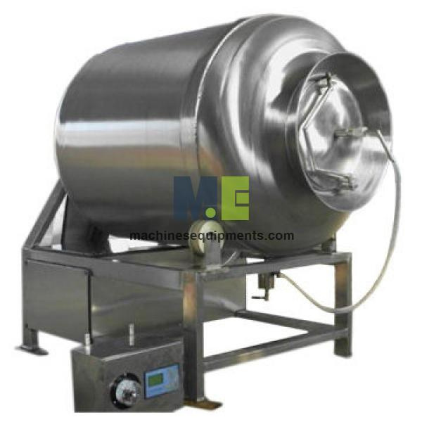
Explore high-quality meat processing machines on Machines Equipments. These advanced systems ensure efficient processing, meeting the highest industry standards for hygiene and precision. Ideal for various applications, they are designed for durability and optimal performance. Whether you need to streamline production or enhance output, these machines are a reliable choice for food processing plants and lines. Contact us today to upgrade your meat processing capabilities!

Slide 3
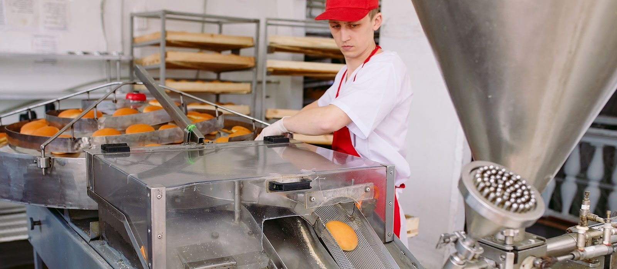

Thank You
sales@machinesequipments.com
https://www.machinesequipments.com/food-processing-plants-and-line/meat-processing-machine

