Slide 1


Jain Matrimonial Services in Delhi
By Siddhi Matrimonials

Slide 2

Siddhi Matrimonials offers premium Jain matrimonial services in Delhi, connecting like-minded individuals from the Jain community. With a focus on personalized matchmaking, the platform ensures compatibility and shared values among potential matches. Their dedicated team provides reliable and confidential assistance, catering to modern and traditional preferences. Whether seeking alliances for Digambar or Shwetambar Jain families, Siddhi Matrimonials combines tradition with modernity, fostering meaningful connections for lifelong happiness.

Slide 3

Address
1497, 2nd floor, Kotla Mubarakpur, Opp. Oncoplus Hospital, Defence Colony, Delhi – 110003
Phone - +91 78386 86853
Website - https://siddhimatrimonials.com/jain-matrimonial-services-in-delhi

Slide 4
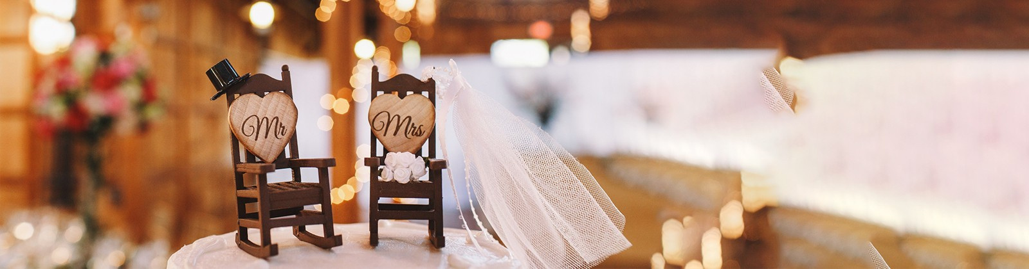
ThankYou

