Slide 1



Aloka Resort Manali

Slide 2


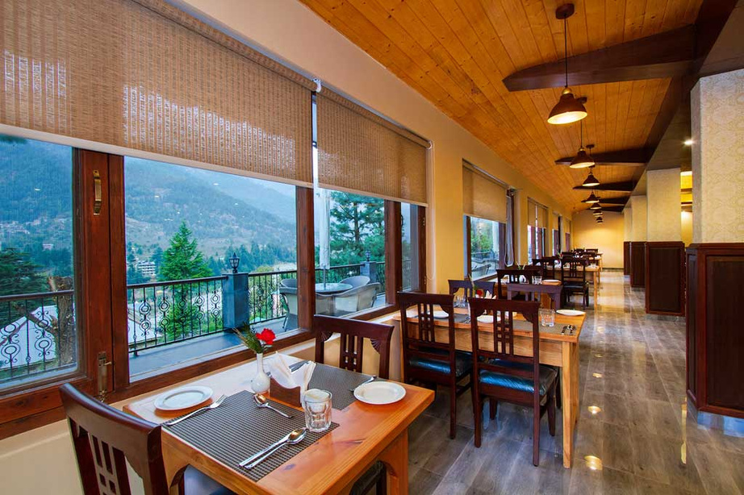
Aloka Resort in Manali is a premier destination for luxury and comfort amidst breathtaking Himalayan views. Nestled in serene surroundings, the resort offers modern amenities, cozy rooms, and exceptional hospitality. Whether you seek adventure or relaxation, Aloka Resort provides the perfect retreat with easy access to Manali's attractions. Experience an unforgettable stay at the top resort in Manali.

Slide 3
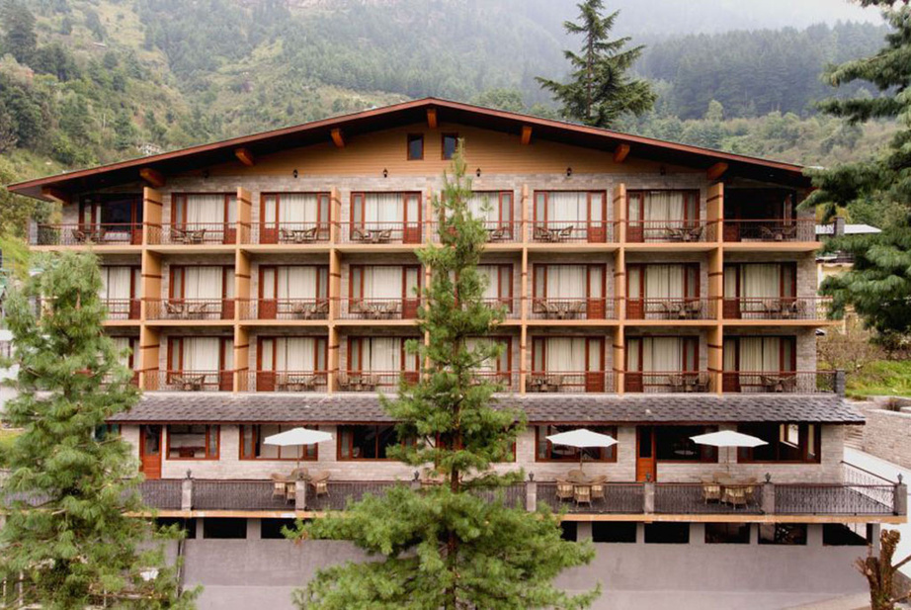
Address
Address
Chadyari, Tehsil Manali, Distt Kullu H.P, 175131, INDIA
Phone: +91 78386-09537, +91 98160-76122
Email: alokaresortmanali@gmail.com
Website - https://alokaresortmanali.com/

Slide 4

Thank You

